Slide 1



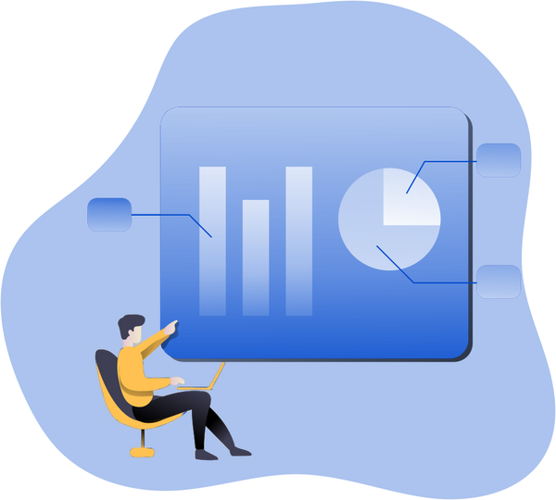

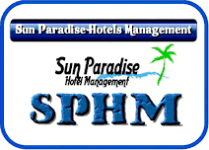
How to measure your hotel performance?
40-point guidelines to grow your business

Slide 2


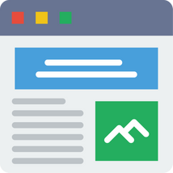




1
2
3
4
5
6
7
OTA Analysis
Booking Engine Analysis
Hotel Website Analysis
Table Of Contents
Review Analysis
Google Business Listing Analysis
Metasearch Analysis
Social Media Analysis

Slide 3

In this document, you'll find 40+ parameters to measure and improve your hotel performance.
You'll get a clear idea here about how your hotel is performing on OTAs, website, booking engine as well as other connected channels.
Overview
These parameters will help you increase your bookings, improve online presence as well as hike revenue.

Slide 4
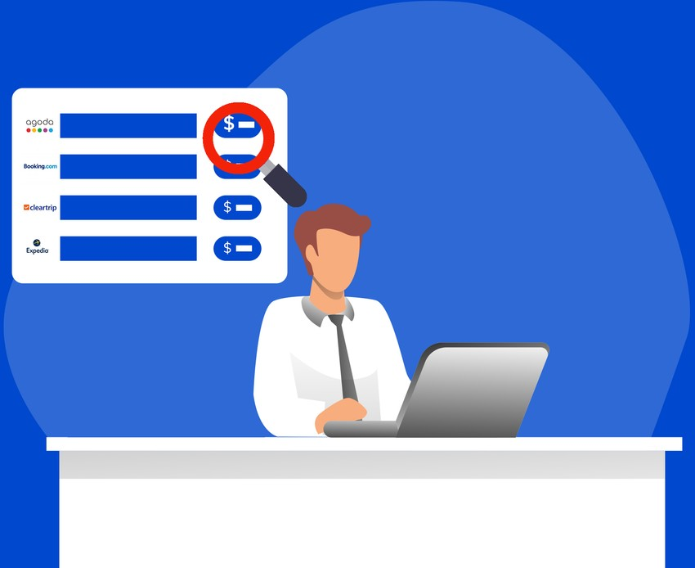
OTA
Analysis
To make the most out of connected OTAs, you need to have the right DISTRIBUTION of the rooms, at the right prices to sell the right room to your guests.

Slide 5
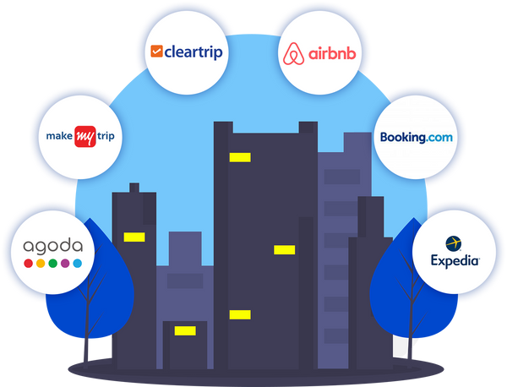
Select OTAs wisely
Limiting yourself to fewer OTAs gives you fixed online visibility; thus losing several booking opportunities for you. So, ALWAYS consider listing your hotel on more than 8 OTAs.
Keep the following things same on all OTAs:
Total rooms Star rating Room types
Cancellation policy
Check-in & check-out time
What should you do?
Refer to our guide on how to select the RIGHT OTAs for your hotel.

Slide 6
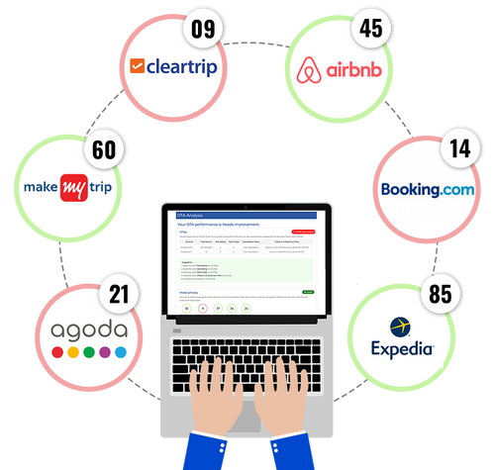
Keep your hotel's photos on OTAs
Good hotel photos will help your guests in exploring your hotel more, thus resulting in faster bookings.
What should you do?
Improve your rankings and quality score by posting high- quality pictures on your connected OTAs.
Ideally, you should add MORE THAN 25 pictures of your hotel on all the OTAs.
Of which, DO consider adding at least 4 high-quality pictures per room.

Slide 7
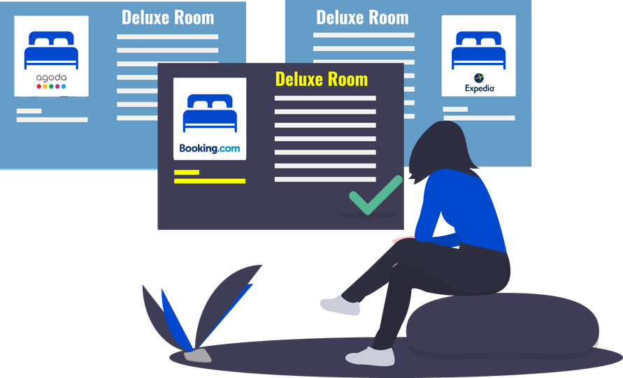
Same room types across all OTAs
Not maintaining similarity of room types on all OTAs can create confusion among your guests and hamper their experience.
What should you do?
ALWAYS show the same room types across all the OTAs.

Slide 8
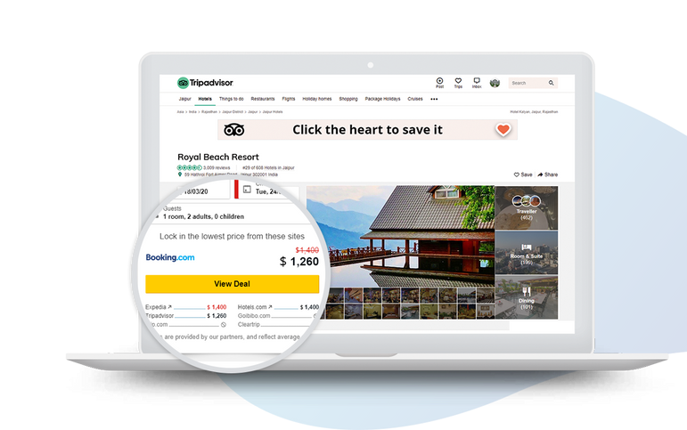
Rate Parity
Not keeping the same rates on all OTAs can get you warnings or ban notice from the OTAs. This even affects your OTA rankings.
What should you do?
Maintain effective rate parity to improve rankings and get more bookings.

Slide 9

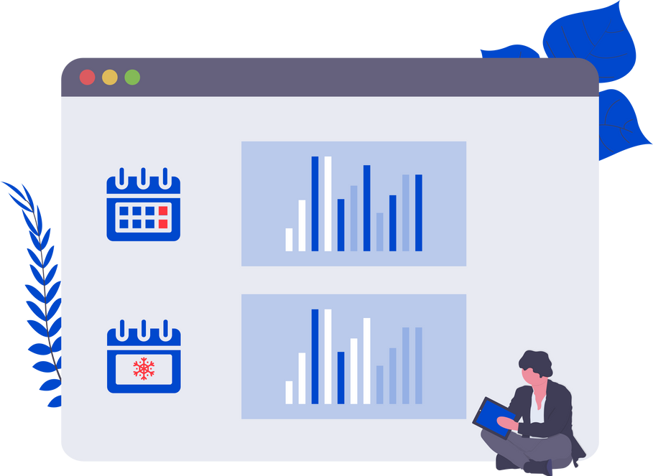
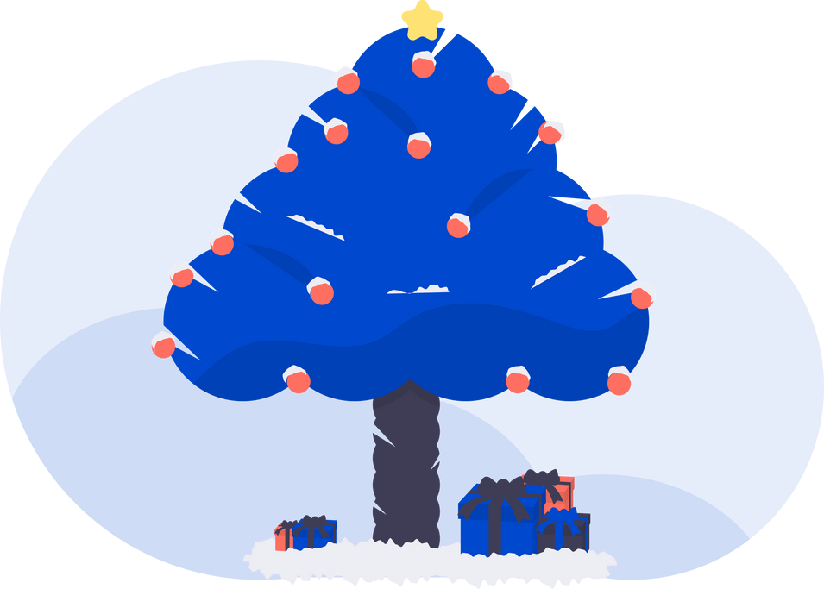
Seasonal and weekend rates
Adding weekend and seasonal rates is useful to gain potential customers. So, automate these rates effectively with yield management.
What should you do?
INCREASE your rates during high-peak seasons like weekends and vacations. And, DECREASE them during off-peak seasons.
This will ensure constant revenue generation at your hotel even during the low-peak seasons.
DO get a fully-featured channel manager to optimise yield management strategies.

Slide 10
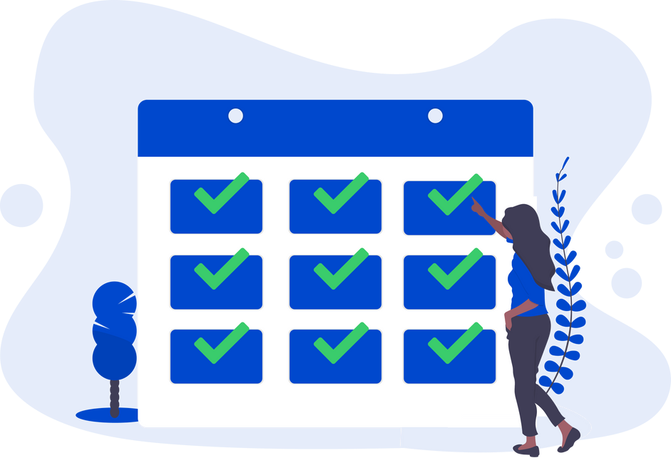
Keep your inventory bookable
Keeping your inventory open on OTAs will get you advance bookings. This will even improve your rankings on the OTAs.
What should you do?
Keep your hotel's inventory open for the next 12-24 months, Because this will rank you better and get more bookings comparatively.
Additionally, you will also get more bookings on an advance basis from guests.

Slide 11
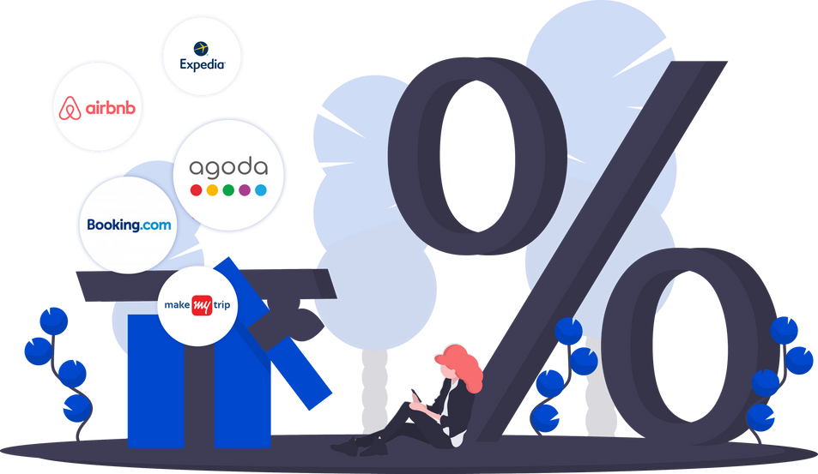
Offer discounts and free items on OTAs
Doing this will make you more preferable over your competitors, and will even help you upsell your extra services and amenities.
What you should do?
Run regular promotions on the OTAs to increase the number of bookings.

Slide 12
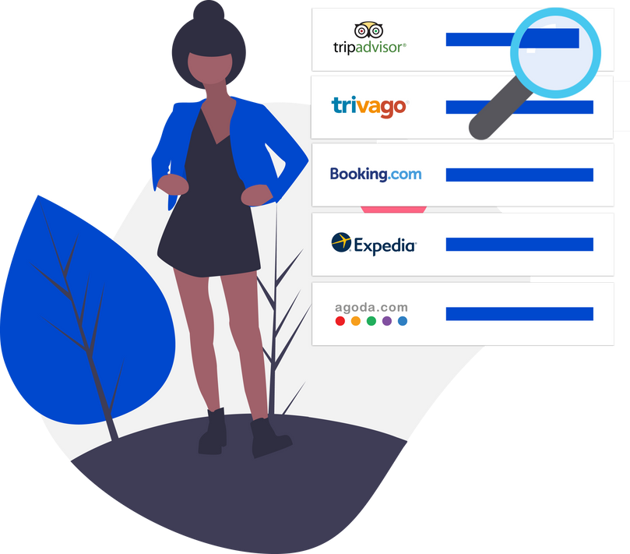
Optimize your OTA ranking
Bad ranking on the OTAs = losing many bookings. So,
What you should do?
Get more positive reviews and respond to them.
Write proper content in your listing. Maintain your rate parity.

Slide 13
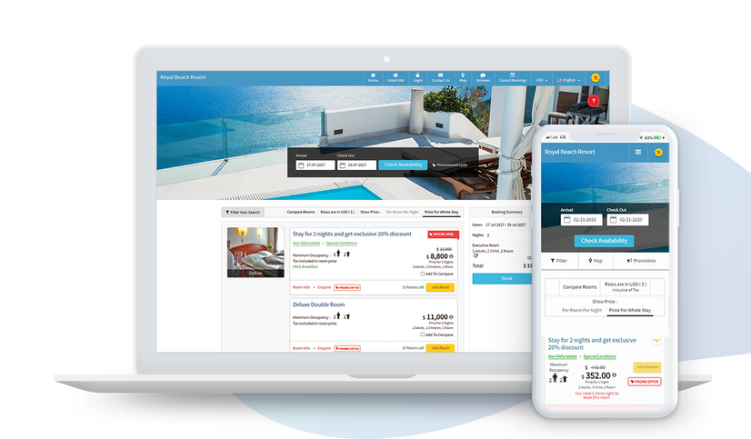
Booking Engine Analysis
An online booking engine is your key to commission-free direct bookings. A booking engine reduces your dependency on OTAs, thus earning you higher revenue, against lesser
efforts.

Slide 14
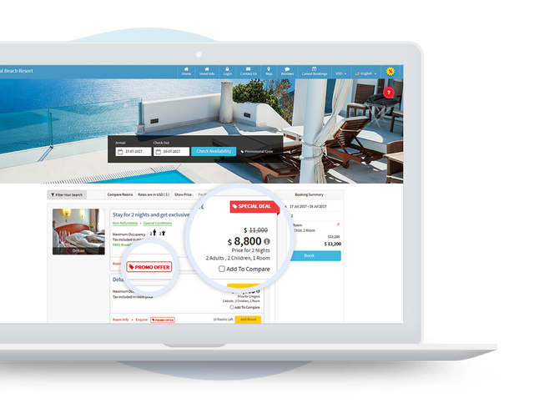
Offer discounts, packages and promotions on booking engine
Offering such exciting deals and discounts will compel your lookers to directly book with you. This will help you in getting commission-free direct bookings.
What you should do?
Set up discounts, sell packages or run promotions to attract more guests to book with you.
If your current booking engine does not support creating packages and promotions, you should consider getting a new one.

Slide 15
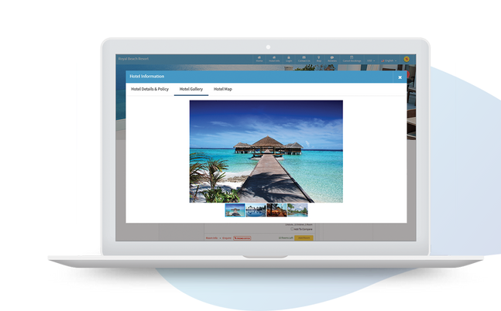
Keep best hotel pictures on the booking engine page
Photos act as a “social proof” for your guests.
High-quality pictures will provide your website visitors with a 360-degree virtual tour of your hotel. This will give them a clear idea about your hotel's location and environment.
What you should do?
Post effective pictures of your hotel to make your guests book faster with you.
You should add a minimum of 4 high-quality photos per room. DO consider keeping photos of your hotel's exterior, interior as well as your location.

Slide 16
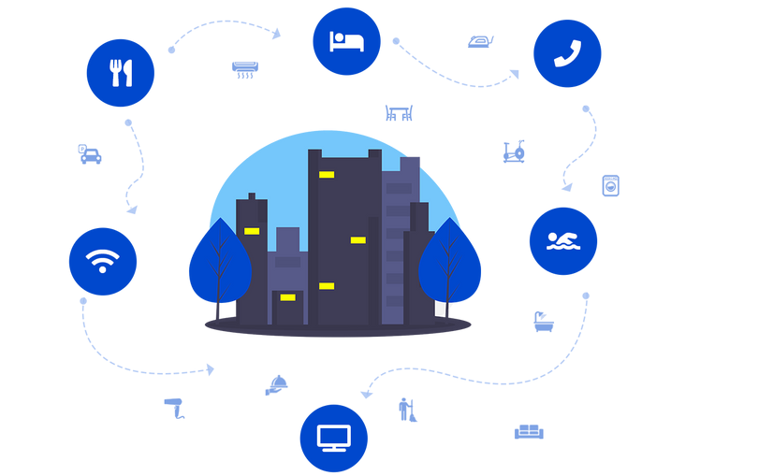
Display hotel amenities
Doing this helps your guests to know the kind of facilities you provide. This can make their stay experience better.
What you should do?
HIGHLIGHT your hotel’s amenities on your booking engine.
Add various widgets on your booking engine to do this, which will convert your lookers to bookers.

Slide 17
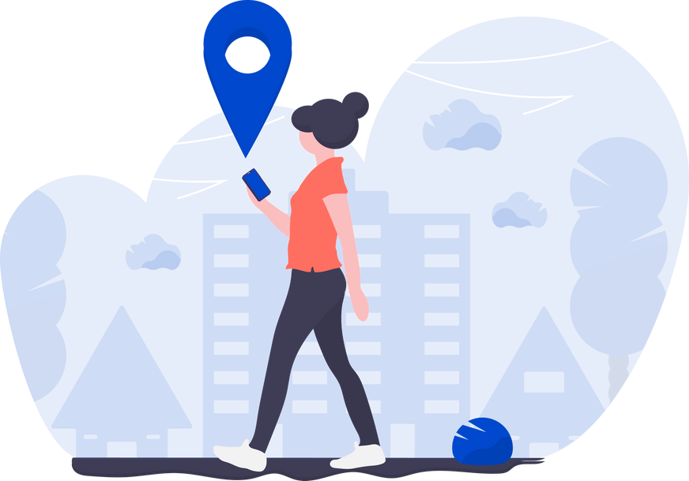
Show directions to your property
This makes it easier for your guests to locate you.
What you should do?
ALWAYS show clear instructions to reach your hotel on your website.
Embed “Google Maps” directions on your hotel’s website.

Slide 18
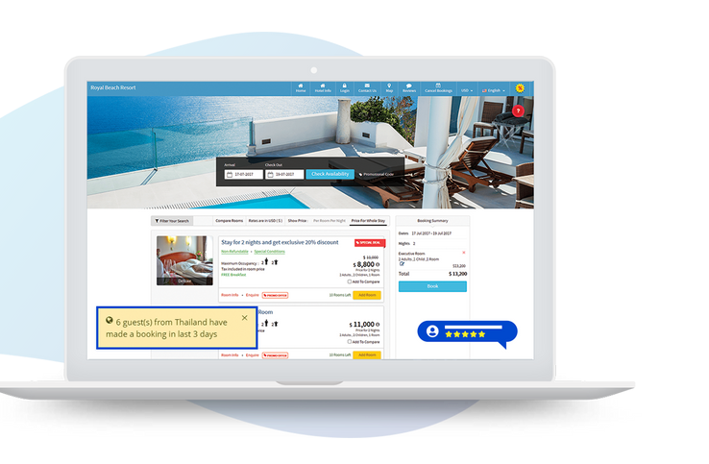
Bookings and review notifications
Showing notifications of recent bookings and reviews will engage your booking engine visitors, and make them book faster with you.
This will build a trust factor between you and your guests.
What you should do?
Highlight reviews on your booking engine page. Opt for a booking engine that displays such reviews and booking notifications on a regular basis.

Slide 19
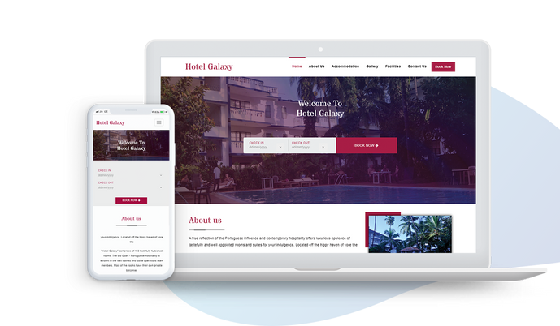
Match with website look and feel
MAKE SURE your booking engine has a similar look and feel as your website. This will help in attracting more visitors to book with you.
What you should do?
Enhance your hotel bookings by creating a seamless browsing and booking experience for your website visitors.

Slide 20
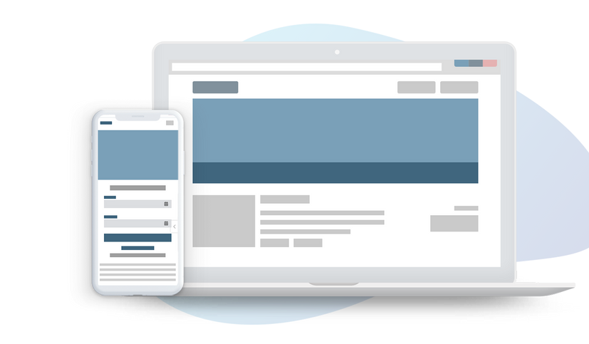
Hotel Website Analysis
Good performing hotel websites will in turn improve your hotels’ ranking and visibility on Google. So, a timely analysis of your website performance is essential to get higher sales as well as better guest experience.

Slide 21
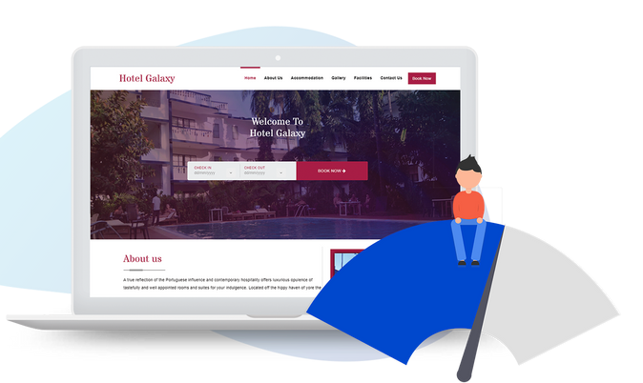
Website page loading time
Having fast page loading time would improve your website performance, SEO and guest booking experience.
What you should do?
MAKE SURE your website loading time is not more than the loading time i.e. 2-5 seconds.
2 sec
In case your website loading time is higher then contact your website designer and improve its performance.

Slide 22
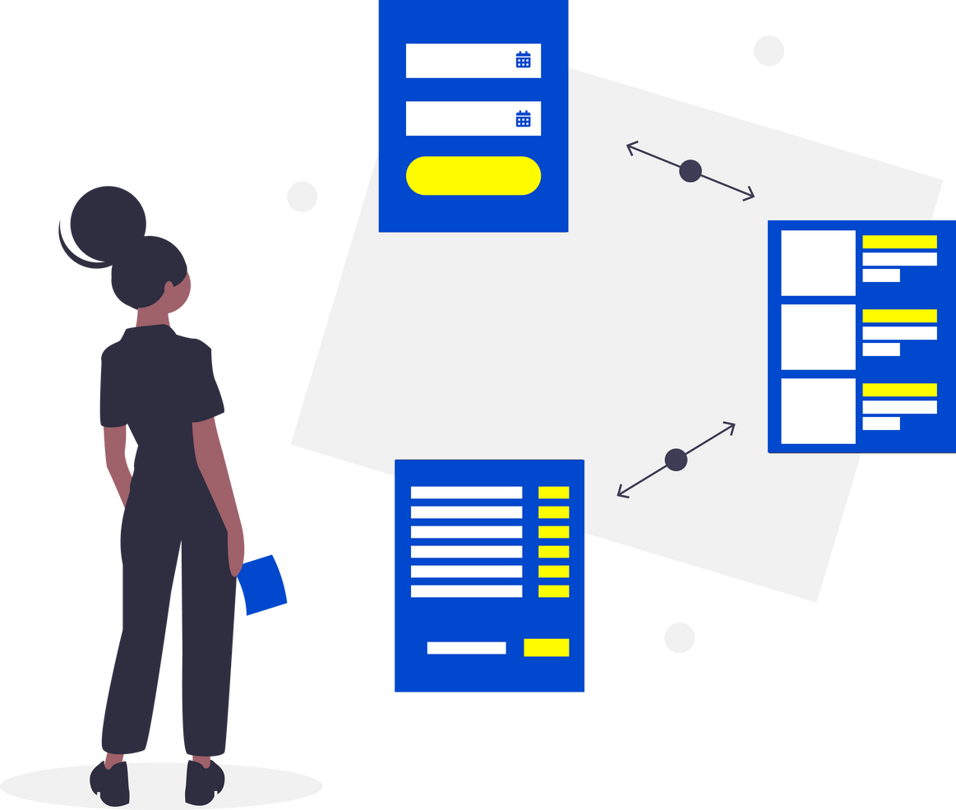
Easy booking procedure
Your website is the first step towards a great experience for your guest. So, receive commission free bookings by giving an easy booking procedure to your them.
What you should do?
Ensure to offer a seamless browsing and booking experience for your website visitors. Focus on:
“Book Now” button should be visible even while scrolling down.
DO add appropriate CTAs.
Consider adding more information on your homepage related to your hotel like rooms, galleries, offers and more.
Optimize SEO keywords for better website performance. Increase your backlink ratio.

Slide 23
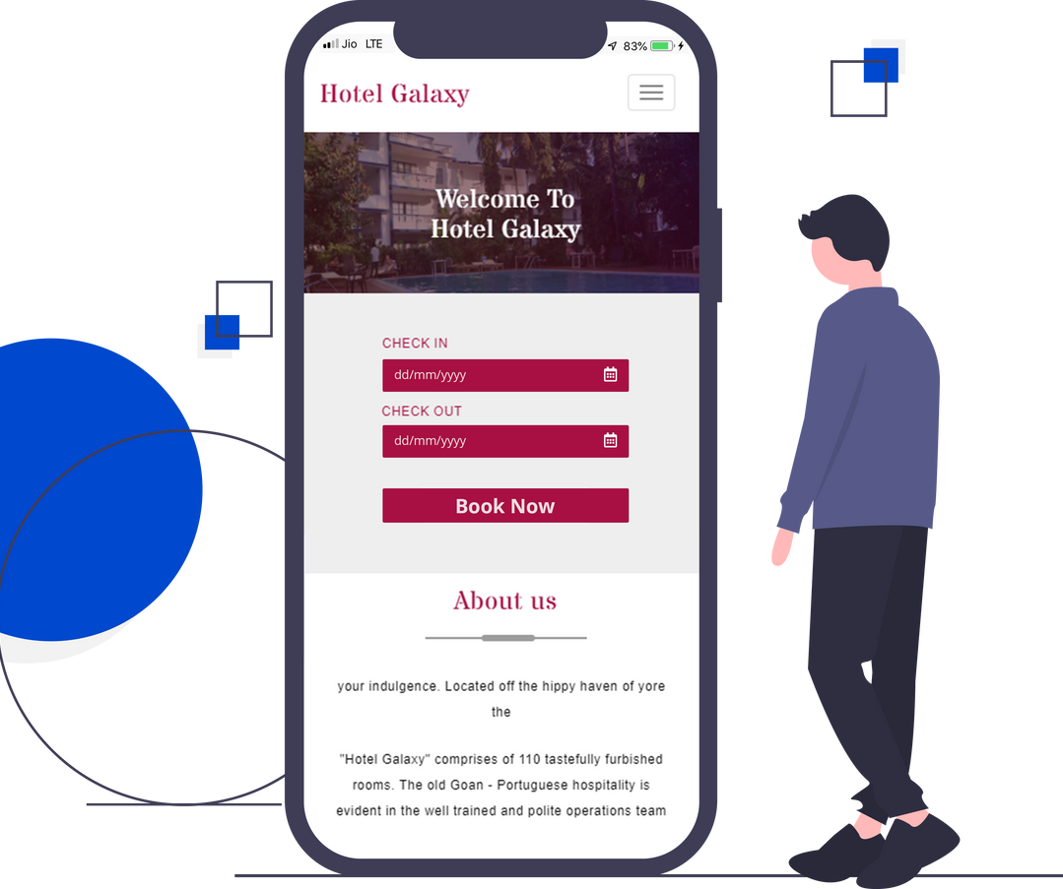
Mobile-friendly (Responsive) hotel website
Having a mobile-friendly hotel website will enhance your guests’ experience and get you more bookings.
What you should do?
Ensure that your website is mobile-friendly for optimal user experience.
Make sure it loads faster and perfectly on a mobile device.

Slide 24

Broken links on hotel website
Broken links on your hotel website will hamper your guest experience and bookings .
What you should do?
Keep a regular check on your website performance to increase visitors and bookings. Also, ensure that your hotel website does not have any broken links.

Slide 25
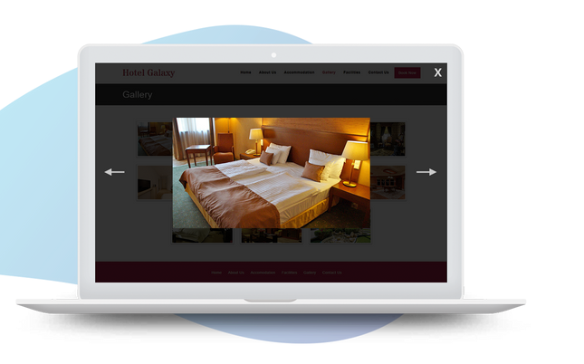
High-quality photos on the website
High-quality photos acts as a piece of social evidence and converts your website lookers to bookers. It gives your guests a clear idea of what to expect when they arrive at your hotel.
What you should do?
Highlight enough good pictures of your hotel on your website.
Showcase them what you exactly offer at your hotel be it rooms, amenities, extra services etc.

Slide 26
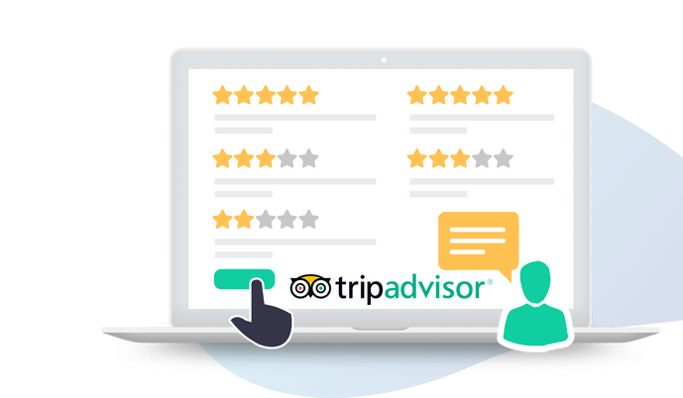
TripAdvisor reviews and awards
TripAdvisor reviews and awards play a huge role in convincing your lookers to book with you.
Displaying such reviews allows your guests to choose as well as compare multiple hotels’ and thereby enhance more guests.
What you should do?
Highlight the reviews received via TripAdvisor.
Also, create a sense of trust in your guest through these reviews.

Slide 27
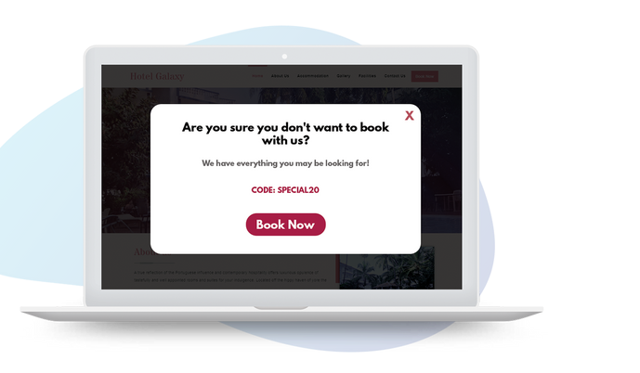
Exit popup offer
Exit popup helps in increase booking opportunities from your website by attracting the looker to book with you.
What you should do?
Create effective exit popups on your hotels’ website to attract more guests.
Offer discounts or promotions that will compel your guests to stay and explore more.

Slide 28
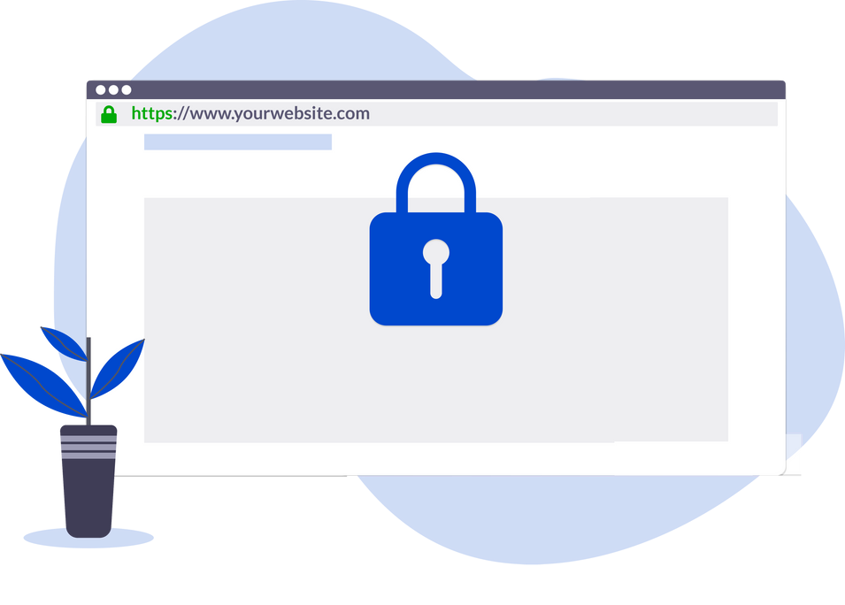
Website security
Security is an important aspect, which ensures that your website protects the data it stores and that no personal data of your guest is compromised.
What you should do?
Ensure that your website is trustworthy so your bookers can book with you without hesitation. For this,
Add SSL to your website - this will help you get good rankings on Google.
MAKE SURE your site is secure from any hacking attempts.

Slide 29
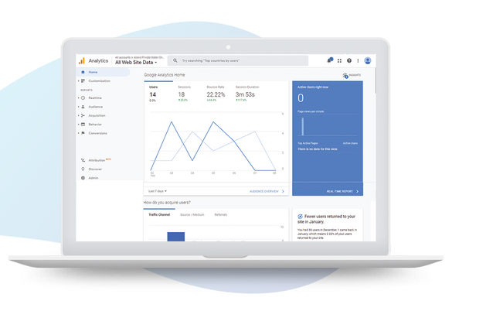
Website visitor tracking
Visitor tracking enabled via Google Analytics will help you to understand your booker's behaviour and run relevant promotions to get more bookings.
What you should do?
Track your visitors and their behaviour on your website.
P.S eZee’s booking engine is integrated with Google Analytics. Start NOW!

Slide 30
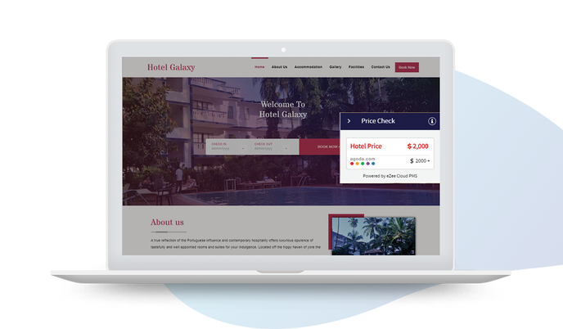
Price widget
Having a price widget on your hotel website will show a comparison of your room rates and OTAs, thus increasing more of your visitors to book directly with you.
What you should do?
Integrate price widgets on your hotels' website to receive more commission-free bookings.
Show them a clear picture of the difference in prices that are displayed on OTAs and your hotel website.

Slide 31
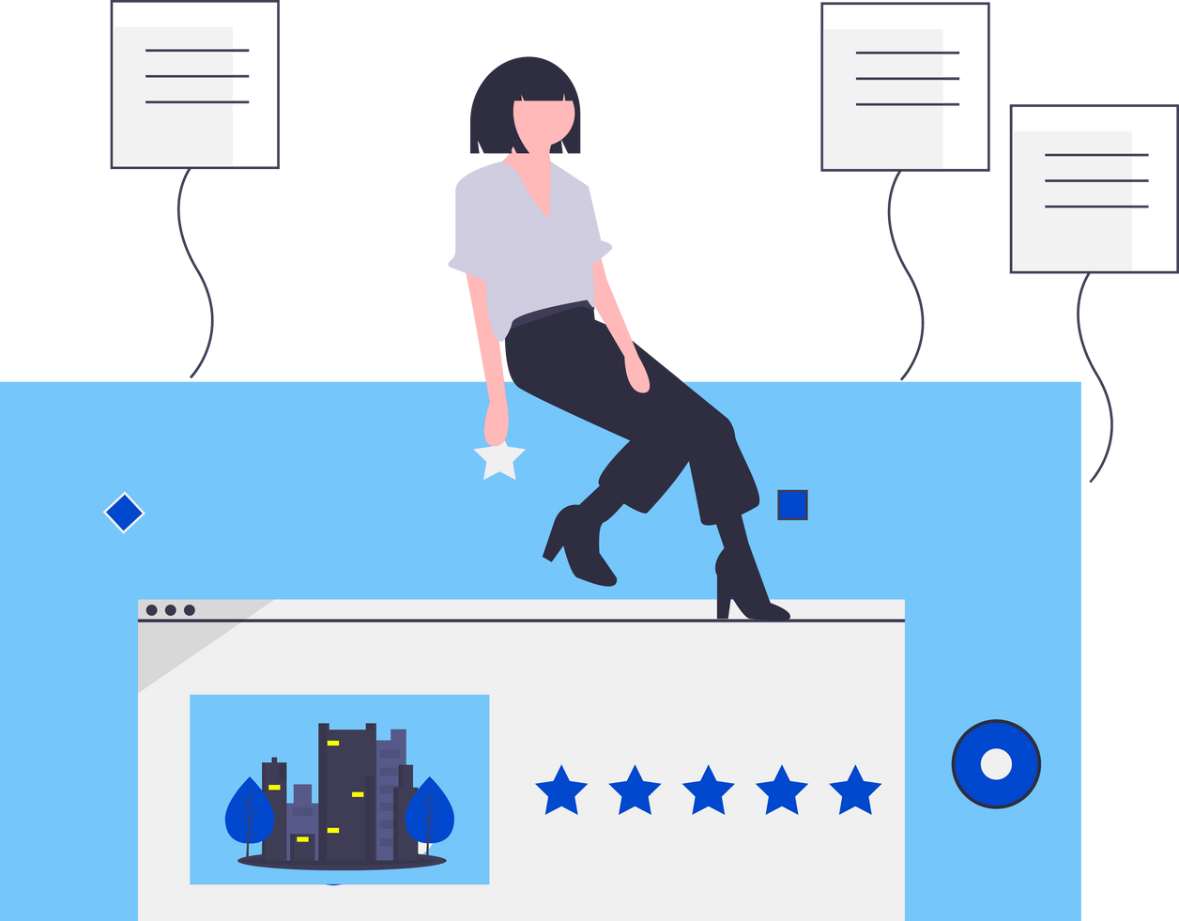
Review Analysis
Perform review ananlysis by taking reviews of your guests, based on their personal opinion. This will help you to understand their experience and improve your hotel performance accordingly.

Slide 32
MAKE SURE you actively reply to all reviews received on any website in order to gain more trust of your guests. Also,
Consider approaching your guests for reviews.
Try responding regularly to the reviews you get on TripAdvisor, Booking.com and more.
Tip:
Collect, track, reply and analyze the reviews you get from all sites at a single place using eZee's Reputation Management System.
Bonus:
Download NOW Free Hotel Review Response Templates! Start responding to your guests correctly and on time!!

Slide 33
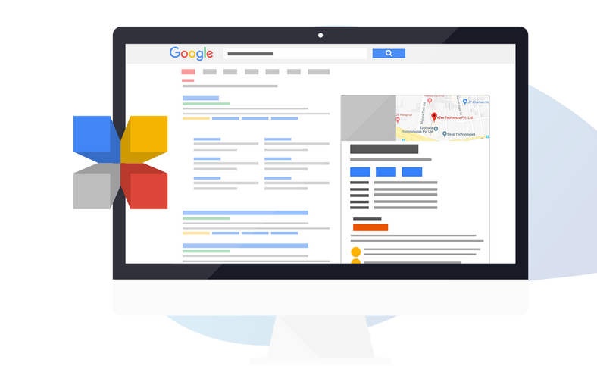
Google Business Listing Analysis
Listing your hotel on Google Business helps you to improve your property's ranking as well as showcase your hotels' presence online.

Slide 34
If your business presence is on Google consider that it is showcased everywhere. So, it is IMPORTANT for you to consider listing your hotel on Google Business.
What should you do?
Always maintain a good brand image of your business.
ALLOW your guests to easily locate your presence on Google.
Let them check your hotels' rates, reviews, availability and much more.

Slide 35

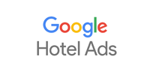

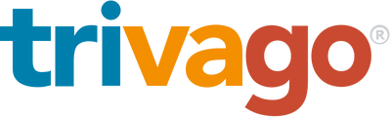
Metasearch Analysis
Metasearch allows guests to compare your hotel rates from various online travel agencies (OTAs) and other booking sites, all in one place. Such analysis will improve your online presence and increase direct bookings.

Slide 36
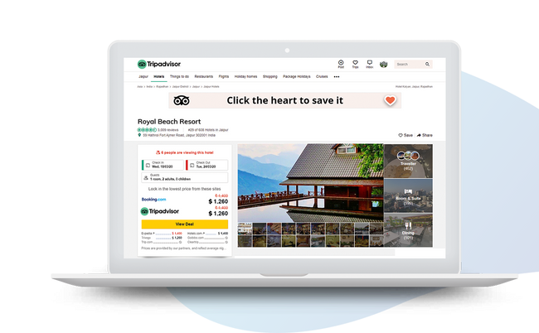
Bookable via Booking Engine on TripAdvisor
TripAdvisor Instant Booking Program helps to improve your online presence and gets you direct bookings as well.
What should you do?
MAKE SURE your guests are able to book directly with you from TripAdvisor to increase several booking opportunities for your hotel.
Enroll for TripAdvisor Instant Booking Program easily through eZee. (Trip Connect Premium Partner)

Slide 37
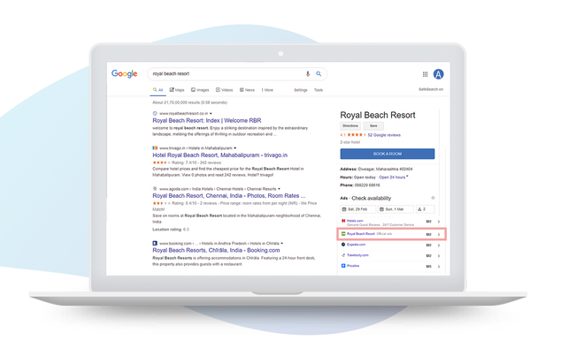
Bookable via Booking Engine on Google Hotel Ads
Stats say:
75% of guests start searching for hotels from Google. So, through Google Hotel Ads get a chance to easily increase your direct bookings.
What you should do?
Be visible on the world's largest search engine through Google Hotel Ads.
Get started NOW with Google Hotel Ads campaign through eZee; an authorized Google Hotel Ads integration partner.

Slide 38
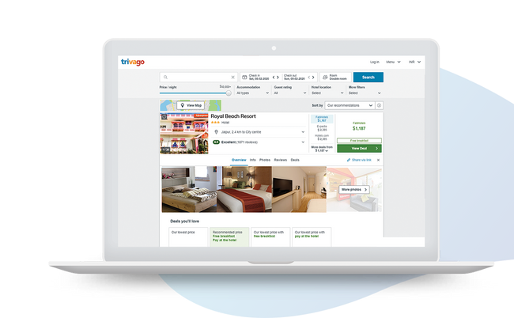
Bookable via Booking Engine on Trivago
Similar to TripAdvisor, it is advisable to be bookable on Trivago as well. This will improve your hotel’s visibility and direct bookings.

Slide 39

Social Media Analysis
Social Media presence helps to increase your repeat guests, improve guest experience, receive more reviews and much more.

Slide 40
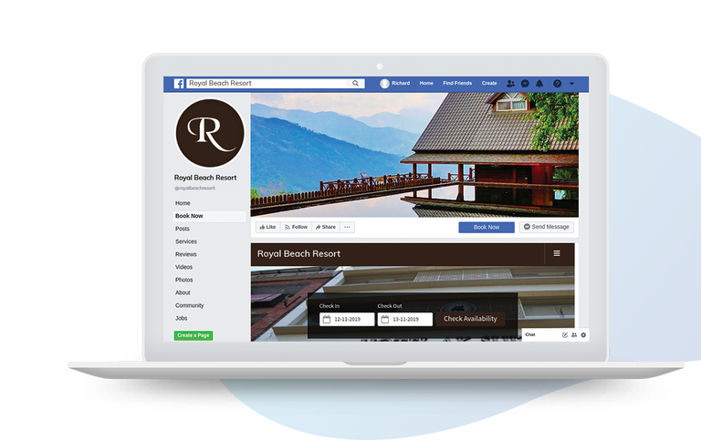
Booking engine integration with Facebook
Enhance branding, increase bookings and build better relations with your guests! Get more direct bookings through your Facebook Page by integrating your booking engine with Facebook.
What you should do?
Increase your social media reach as much as possible and consider getting more likes on your Facebook page as well.
Bonus:
Download NOW Free Social Media Post Templates for your Hotel!

Slide 41



Finding ways to optimize your hotel revenue?
Get a free consultation from experts
Download free guide to revenue management

Slide 42


By
Simplified Operations, Maximized Revenue
+91-99789-72220
sales@ezeetechnosys.com
www.eZeeAbsolute.com

