Slide 1
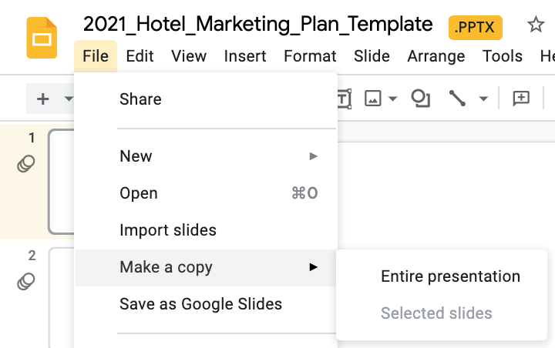
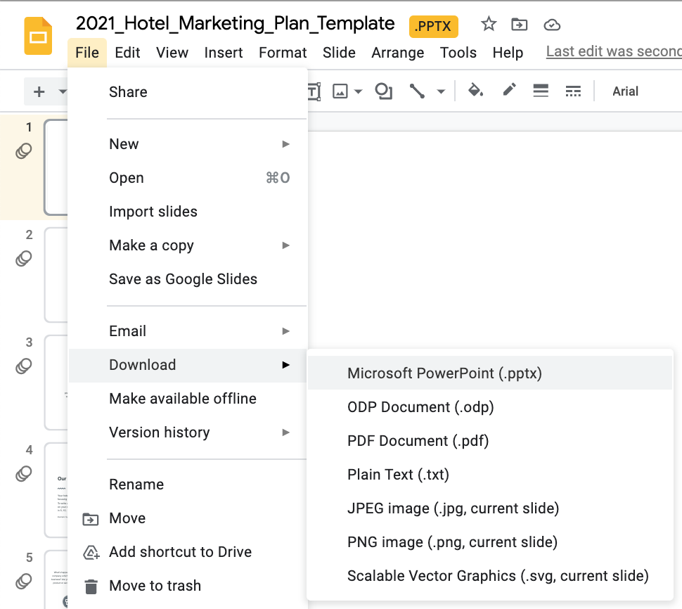
To edit with Google Slides, click File, then select "Make a copy" and then “Entire presentation” to save an editable copy of the template within your own Google Drive.
To edit with Microsoft PowerPoint, click File, then select "Download" and then “Microsoft PowerPoint (.pptx)” to save an editable copy of this file to your computer.
(Feel free to delete this slide once you’ve saved your copy!)

Slide 2

PLACE YOUR
LOGO HERE
[YOUR HOTEL NAME] MARKETING PLAN
Date: MM / DD / YYYY

Slide 3
EXECUTIVE SUMMARY
[Write Your “Big Picture” Objective Here.]
Opening your hotel sales and marketing plan with an executive summary sets the tone for your entire presentation. Think of your executive summary as a broad overview of everything you’re about to present in your wider marketing plan. In a few sentences, you’re using this space to introduce the “big idea” or “big objective” for the upcoming year. Include any context driving your plan, like a major renovation.

Slide 4
VISION & MISSION STATEMENT
Our Vision
Our Mission
Your hotel vision statement looks ahead to the future, focusing on what you want to do or achieve long-term. To write a hotel vision statement, you need to be clear on your company’s direction. Where do you want to be in 5, 10, 15 years? Vision statements are aspirational.
Example: Hyatt Hotels, “A world of understanding and care.”
Your hotel mission statement is about who you are and what you do right now, today. When you write a hotel mission statement, you’re thinking about your immediate objectives. Who do you serve and how do you serve them? This is your purpose for the present.
Example: Hyatt Hotels, “To deliver distinctive experiences for our guests.”

Slide 5
MARKET ANALYSIS
What’s happening at your hotel company which could impact your business? Are you changing up your product or service? Rebranding?
What do your guests think of your hotel? Is there less interest from certain groups or more from others? Are they communicating with you in a new way?
How is the economy doing? Are there any new laws or regulations that impact your business or the hospitality industry where you are?
Competitors
Collaborators
Company
Customers
Climate
Who are the key players and what are they up to? Opening a buzzy new restaurant? Starting or finishing a major renovation?
Who are your partners and what’s going on with them? Think: Convention & Visitors Bureau, your PR firm, a top-producing travel agency, or another service provider.

Slide 6
PRICING STRATEGY
STR
Competitive Set
Low Price
High Price
“PENETRATION”
“PREMIUM”
Hotel rate positioning strategies fall under four primary (broad) categories: Economy, penetration, skimming, and premium pricing. Explain your rate strategy here and Visualize where your competitors fall in comparison.
Comp Set Hotel 1
Comp Set Hotel 2
Comp Set Hotel 3
Comp Set Hotel 4
High Quality
Hotel 2
Hotel 1
Our Hotel
Hotel 4
Hotel 3
Low Quality
“ECONOMY”
“SKIMMING”

Slide 7
S.W.O.T. ANALYSIS
Strengths
[Your Strength #1]
Pick out a few strengths that stand out as Unique Selling Points or USPs.
[Your Strength #2]
Strengths could be an excellent location, wonderful employees and service, or strong brand-name recognition.

Slide 8
S.W.O.T. ANALYSIS
Weaknesses
[Your Weakness #1]
Be honest about what could be hindering your hotel’s growth.
[Your Weakness #2]
These could be poor online reviews, an outdated website, lack of F&B or gym facilities, or budget.

Slide 9
S.W.O.T. ANALYSIS
Opportunities
[Your Opportunity #1]
Do a little research to get ideas for new markets to engage or revenue-driving products to launch.
[Your Opportunity #2]
Two areas to look for opportunities are market trends and guest feedback.

Slide 10
S.W.O.T. ANALYSIS
Threats
[Your Threat #1]
What external factors could negatively impact your hotel? Think: changes to OTAs or a boom in Airbnb listings nearby.
[Your Threat #2]
Other potential threats include new hotel openings, negative press coverage, even a recruitment or staffing shortage. Anticipating these threats gives you more time to take action!

Slide 11

ROOMS AVAILABLE VS. SOLD
[Place a graph or chart with
2-3 years’ of past data here.]
To get where you’re going, you need to know where you’ve been. Pull some historical data for your hotel, not only to track changes but to make projections and business goals for the upcoming year. Grab at least 2-3 years (ideally more!) of data and write your commentary or insights down here.

Slide 12
MARKET SHARE
[Place a graph or chart with
2-3 years’ of past data here.]
To get where you’re going, you need to know where you’ve been. Pull some historical data for your hotel, not only to track changes but to make projections and business goals for the upcoming year. Grab at least 2-3 years (ideally more!) of data and write your commentary or insights down here.

Slide 13
AVERAGE RATE
[Place a graph or chart with
2-3 years’ of past data here.]
To get where you’re going, you need to know where you’ve been. Pull some historical data for your hotel, not only to track changes but to make projections and business goals for the upcoming year. Grab at least 2-3 years (ideally more!) of data and write your commentary or insights down here.

Slide 14
REVPAR
[Place a graph or chart with
2-3 years’ of past data here.]
To get where you’re going, you need to know where you’ve been. Pull some historical data for your hotel, not only to track changes but to make projections and business goals for the upcoming year. Grab at least 2-3 years (ideally more!) of data and write your commentary or insights down here.

Slide 15
OCCUPANCY
[Place a graph or chart with
2-3 years’ of past data here.]
To get where you’re going, you need to know where you’ve been. Pull some historical data for your hotel, not only to track changes but to make projections and business goals for the upcoming year. Grab at least 2-3 years (ideally more!) of data and write your commentary or insights down here.

Slide 16
TYPICAL GUEST PROFILE
Age
PROFILE #1
PROFILE #2
Age
##-##
##-##
Concerned with [xxxx] and [xxxx]
Needs [solution] in order to [problem/challenge]
Wants [xxxx], but doesn’t have [xxxx]
Tends to favor [xxxx] over [xxxx]
Loves when a hotel delivers on [xxxx]
Finds fulfillment in [xxxx] and [xxxx]
Enjoys [xxxx], big fan of [xxxx]
Values time with [xxxx]

Slide 17


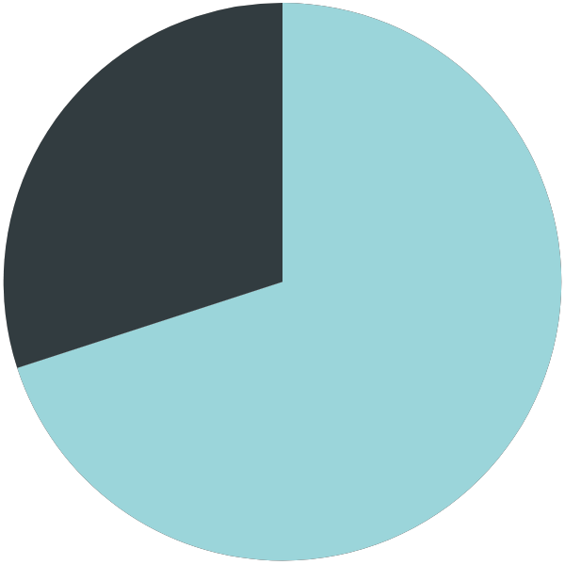
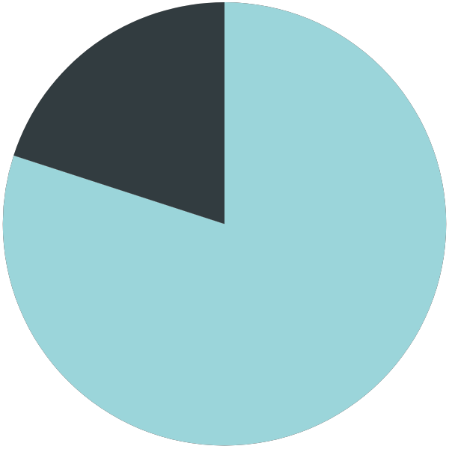
KEY MARKETS (GLOBAL)
50%
Europe
40%
50%
North
America
30%
60%
Asia
70%
20%
Latin
America
80%
Corporate
Leisure

Slide 18
KEY MARKETS (U.S.)
40%
NY
60%
20%
CA
80%
50%
FL
Corporate
Leisure
50%

Slide 19
KEY MARKETS (EUROPE)
Corporate
30%
GB
Leisure
70%
40%
GER
60%
50%
FR
50%
20%
IT
80%

Slide 20

OVERALL MARKET SEGMENTATION
20%
20%
1
BAR &
Discount
2
Negotiated
35%
SHARE OF
REVENUE
3
Wholesale
4
Groups
60%

Slide 21
MARKETING OBJECTIVES
Bookings/Revenue
Groups & Events
Are you prioritizing recovery of occupancy or rate to increase revenue? Will you create a new revenue stream this year?
What type of groups and events are booking right now? What will you prioritize this year?
Brand Awareness
Guest Retention/Loyalty
Are you bringing something new to the market? Do people know about you? How will you get the word out?
How will you increase the Average Lifetime Value of past guests? How will you get them to come back?
Service/Reputation
Colleague Engagement
How are your reviews? Is it important for you to increase the number of 5-star reviews?
Are your colleague happy? Do they feel like part of your hotel’s success? Are you retaining talent and filling new roles?

Slide 22
MARKETING CHANNELS
Content Marketing
SEO
Creating original content that can be repurposed and shared across the other marketing channels.
Driving consistent, quality traffic to your hotel website targeting specific, relevant search keywords.
PPC
Social Media
Pay-Per-Click advertising options include Google, social media platforms, and/or display networks.
Which platforms will you focus on most? Where is your audience active?
DIRECT
BOOKINGS
PR
Email
Developing relationships with traditional press, journalists, and media outlets.
Can also include bloggers and influencers.
An important “owned” channel. Grow your email list, segment users by interests, and nurture leads.

Slide 23
S.M.A.R.T. GOALS
S
M
A
R
T
Specific
Measurable
Achievable
Realistic
Time-Bound
What exactly do I want to accomplish here?
How will I know when I’ve achieved this goal?
Do I know how to accomplish this goal or can I learn how?
Is this goal really possible, or even worthwhile?
Can I accomplish this goal within one year?

Slide 24
KEY MARKETING METRICS/GOALS
Item | Metric | Current | Goal
Content Marketing | Traffic to Website | # | #
Search Engine Optimization | Traffic to Website % of Direct Bookings | # % | # %
Social Media | Traffic to Website New Followers Engagement Rate | # # # | # # #
Paid Advertising | Revenue Return On Ad Spend | $ $ | $ $
Public Relations | Press Mentions | # | #
Email Marketing | Open Rate % of Direct Bookings | % % | % %

Slide 25
BOOKING FUNNEL
Tactics
AWARENESS
Ex. Organic social media content, press coverage, working with influencers.
Tactics
INTEREST
Ex. Invest in content marketing and SEO to capture visitors in early stages of trip planning.
Tactics
CONSIDERATION
Ex. Improve website content to educate and inform guests re: destination, hotel, COVID, etc.
BOOKING
Tactics
Ex. Set up remarketing email and/or Facebook campaigns to bring guests back onto website.
EXPERIENCE
(RETENTION)
Tactics
Ex. Add a “leave a review” message to post-stay email campaigns. Share UGC on social media.

Slide 26
MARKETING CHANNEL TACTICS
Content Marketing
What kind of content do you create for your hotel? Images and videos? A podcast for meeting planners? Does your hotel website have a blog? Content marketing is an important channel because the content you create feeds every other marketing channel.
[List the specific content marketing actions you will implement with desired outcome.]
[List the specific content marketing actions you will implement with desired outcome.]
[List the specific content marketing actions you will implement with desired outcome.]
[List the specific content marketing actions you will implement with desired outcome.]

Slide 27
MARKETING CHANNEL TACTICS
Search Engine Optimization (SEO)
“Natural search” aka “organic search” is a strategy hotels can use to drive traffic to their own website. Research keywords for your market/audience and optimize content to attract those searchers. Blogging (content marketing) is another strategy that helps SEO.
[List the specific SEO actions you will implement with desired outcome.]
[List the specific SEO actions you will implement with desired outcome.]
[List the specific SEO actions you will implement with desired outcome.]
[List the specific SEO actions you will implement with desired outcome.]

Slide 28
MARKETING CHANNEL TACTICS
Social Media
Social sites like Facebook and Instagram can really boost your brand awareness by getting your message in front of more potential guests. This also includes reputation management and online review sites like TripAdvisor.
[List the specific social media actions you will implement with desired outcome.]
[List the specific social media actions you will implement with desired outcome.]
[List the specific social media actions you will implement with desired outcome.]
[List the specific social media actions you will implement with desired outcome.]

Slide 29
MARKETING CHANNEL TACTICS
Pay-Per-Click Advertising (PPC)
PPC is a great way to convert a warm lead into a conversion. Depending on your budget, you may want to have an “always on” strategy intended to drive traffic, paired with a “retargeting” campaign that reminds users to come back and complete their direct booking.
[List the specific paid media actions you will implement with desired outcome.]
[List the specific paid media actions you will implement with desired outcome.]
[List the specific paid media actions you will implement with desired outcome.]
[List the specific paid media actions you will implement with desired outcome.]

Slide 30
MARKETING CHANNEL TACTICS
Public Relations
(PR)
Some PR strategies for hotels focus on developing relationships with journalists and traditional media outlets. Now, PR has grown to include online influencers and bloggers. Be proactive and consider what campaigns (new suite offer) or stories (major renovation) are “newsworthy.”
[List the specific PR actions you will implement with desired outcome.]
[List the specific PR actions you will implement with desired outcome.]
[List the specific PR actions you will implement with desired outcome.]
[List the specific PR actions you will implement with desired outcome.]

Slide 31
MARKETING CHANNEL TACTICS
Email Marketing
You own your email list, so use it! Consider creating a lead magnet to attract more subscribers with something of value, like a destination guide. Determine a consistent schedule, like a bi-weekly newsletter, and focus on sharing value more than promoting offers.
[List the specific email marketing actions you will implement with desired outcome.]
[List the specific email marketing actions you will implement with desired outcome.]
[List the specific email marketing actions you will implement with desired outcome.]
[List the specific email marketing actions you will implement with desired outcome.]

Slide 32
MARKETING BUDGET
Item | Budget | Owner | Notes
Content Marketing | $0.00 | [Name]
Search Engine Optimization | $0.00 | [Name]
Social Media | $0.00 | [Name]
Paid Advertising | $0.00 | [Name]
Public Relations | $0.00 | [Name]
Email Marketing | $0.00 | [Name]
Other Tools & Resources | $0.00 | [Name] | Eg. Subscriptions, software
TOTAL | $0.00

Slide 33
MARKETING TEAM
DIRECTOR OF SALES & MARKETING
MARKETING COORDINATOR
[First Name Last Name]
name@yourwebsite.com
[First Name Last Name]
name@yourwebsite.com
MARKETING MANAGER
SOCIAL LINKS
[First Name Last Name]
name@yourwebsite.com

