Slide 1


For Hoteliers: Free templates of Google Ads
By Hotel Management SPHM Hospitality

Slide 2

How to use these templates?
Identify the type of Ad you want to do.
See what type of audience you want to target.
Choose the template you think is best suitable.
Mix and match headlines with the description.
The content in [brackets] is variable. Modify it as per your requirements.
Start running Ads!
We recommend you to be dynamic in publishing Ads. Don’t stick with one template in all your Ads.
Using these templates with a touch of your creativity will work wonders.
NOTE: The content in [brackets] is variable. Please modify it according to your requirement.

Slide 3
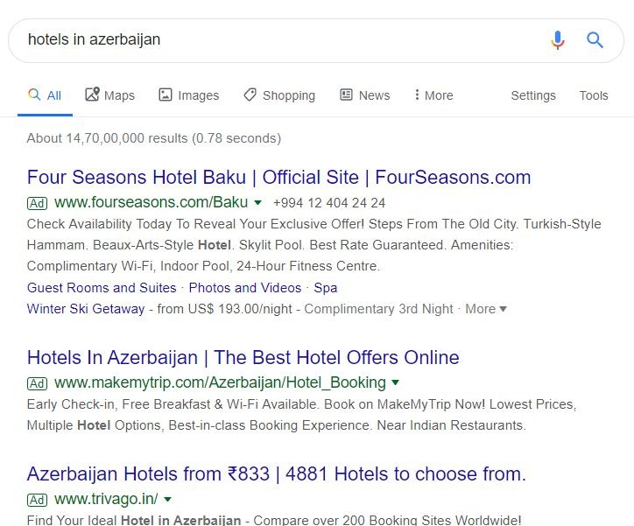
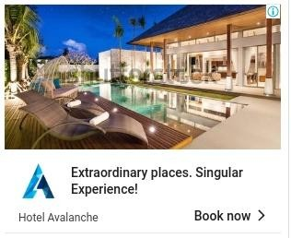
Types of Ads we will cover are:
Google Search Ads
Google Display Ads

Slide 4
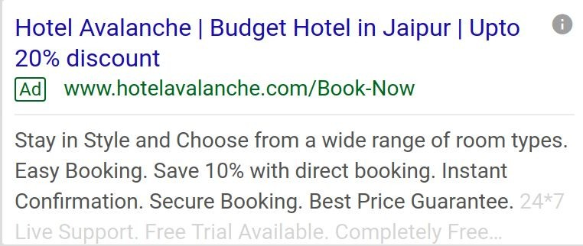



Templates of
Headlines
Description
Google Search Ads

Slide 5
Headlines:
30 characters including space. Google Search Ads include 3 headlines.
1. Basic property details:
[Property name], [City]
2. Beneﬁts:
Start Your Holiday Plan Today
3. Discount offers:
Book direct & enjoy [_%] saving
[Property website]
Best Rate Guaranteed
Upto [_%] discount
Best Hotel in [City, Area]
Luxury [no.] star hotel group/property
Lowest Price Guaranteed
Budget Hotel in [City name]
Book Now
Leave Your Stress Behind
NOTE: The content in [brackets] is variable. Please modify it according to your requirement.

Slide 6
Description:
90 characters including space. Google Search Ads include 2 descriptions.
Amenities and offerings: General description: Highlights:
Discover a true luxury hotel in the heart of [city name].
We offer [no.] star accommodation.
Exclusive offer. Join Us Every Saturday for [Karaoke] night!
Easy Booking. Personalised Service.
Book direct and enjoy [_%] discount for stays until [dd/ month /yy].
No cancellation fees.
Book Now. Pay on Arrival.
No Reservation Costs.
Save [_%] with direct booking. Instant Conﬁrmation.
Book online now. Free cancellation.
Book Direct and Save more.
Just [no.] minutes away from [popular location name].
Award winning hotel/property.
Compare The Best Hotels In [city name].
Stay in Style and Choose from a wide range of room types.
Secure Booking. Best Price Guarantee.
Contact [no.] | [Hotel details] | [Offers]
Highlights: [no.] star hotel. Best known in the city.
[Property name] is a preferred as the best choice of hostel in [city name].
Offering Best Rates | Explore best guest experience | Contact [no.]
Search, Compare & Save! Book Direct and Pay Less.
Discover all our exclusive offers on the website.
[no.] star property.
Great Location. Luxury Accommodation.
NOTE: The content in [brackets] is variable.
Please modify it according to your requirement.

Slide 7

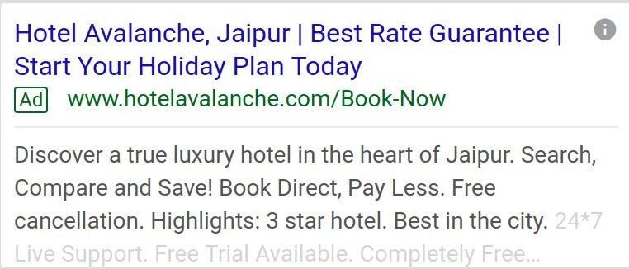
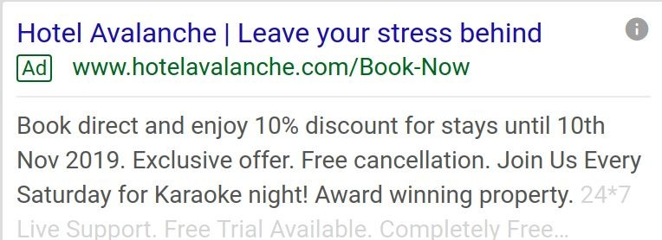
Few examples of how to use the templates:

Slide 8
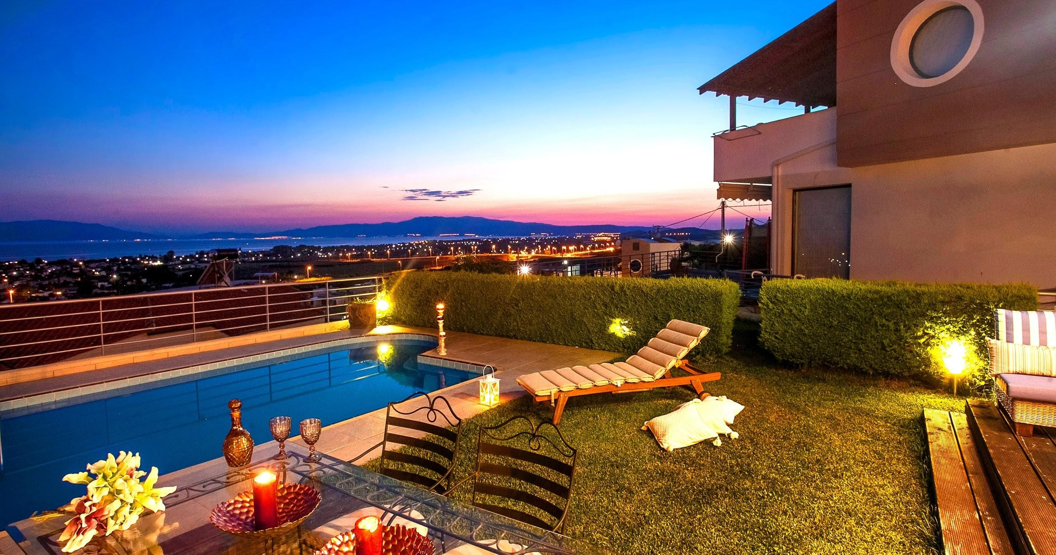


Searching for a Hotel at Jaipur?
Templates of Google Display Ads
Headlines
Book your stay now at Hotel Avalanche enjoy its exclusive beneﬁts. Description
Hotel Avalanche
Book Now

Slide 9

Headlines:
Google Display Ads have short headlines and long headlines OR short headlines and description OR description only.
Long (90 characters including space): Short (30 characters including space):
Stay for 2 nights or more and save [_%] discount at the [property name]
Plan your next getaway at [city name] and enjoy luxury stay at [property name]
Start your travel journey with a [_%] discount at [property name]
Searching for a Hotel at [city name]?
Book your stay now at [property name] and enjoy its exclusive beneﬁts.
Extraordinary places. Singular Experience!
Travel + Fun
In need of a break?
Planning for weekend getaway?
Festive season has arrived!
NOTE: The content in [brackets] is variable. Please modify it according to your requirement.

Slide 10
Description:
90 characters including space
(Flash highlights)
*Daily Free Breakfast
*Free WiFi
*Pool access
*Transport facilities and much more!
Plan your getaway today and get best offered rates as low as [Rate]
Exclusive Offer!
Turn your Dream Vacation into Reality
WITH DAILY RATES AS LOW AS [RATE]
at [property name] | [website name]
NOTE: The content in [brackets] is variable. Please modify it according to your requirement.

Slide 11
Have a look at few examples

Slide 12
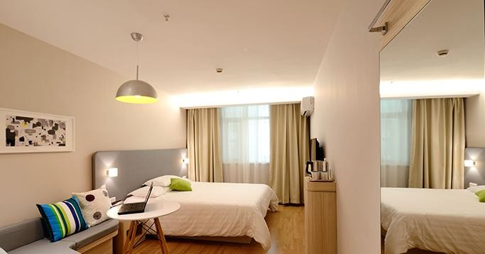

Searching for a Hotel at Jaipur?
1
Book your stay now at Hotel Avalanche and enjoy its exclusive beneﬁts.
Hotel Avalanche
Book Now

Slide 13
Extraordinary places. Singular
2
Experience!
Turn your Dream Vacation into Reality WITH DAILY LOW $100 at Hotel Avalanche
Hotel Avalanche
www.hotelavalanche.com
Book Now

Slide 14
Thank You!

