Slide 1



For Hoteliers: Free templates of
By Hotel Management SPHM Hospitality

Slide 2

How to use these templates?
See what type of audience you want to target.
Choose the template you think is best suitable.
Mix and match headlines with the description.
The content in [brackets] is variable. Modify it as per your requirements.
Start running Ads!
We recommend you to be dynamic in publishing Ads. Don’t stick with one template in all your Ads.
Using these templates with a touch of your creativity will work wonders.

Slide 3
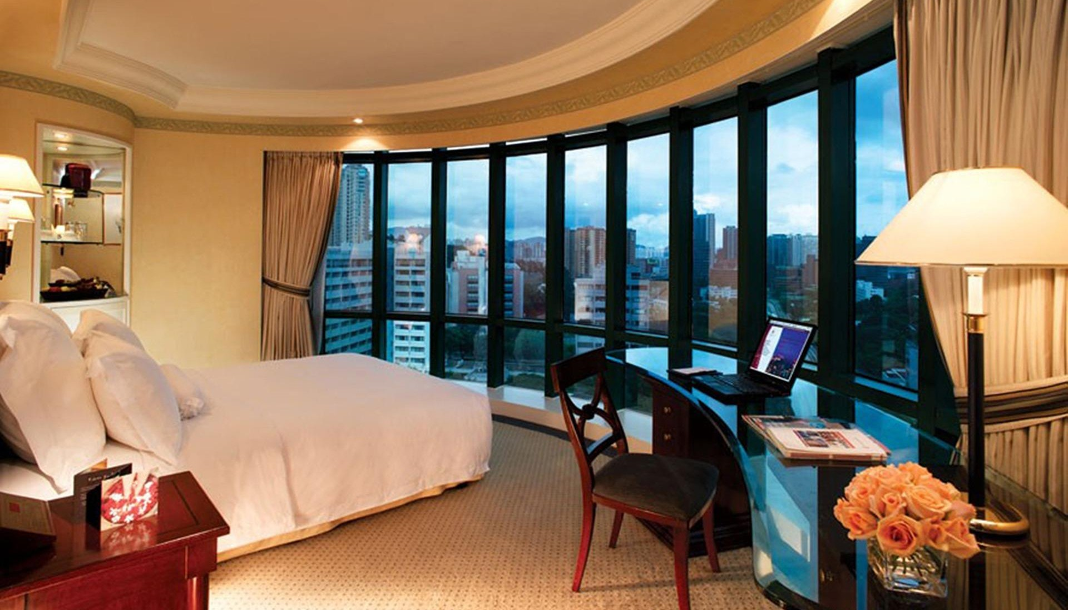
Templates of
Stay Away but Feel Like Home at Hotel Avalanche
Primary Text
Facebook Ads
Facebook ads content is categorized into:
Primary text which is mandatory
Headline & Description
of which both are
optional
Hotel Avalanche
Exclusive deal starts today!
Headline
Enjoy luxurious facilities, relax and create
Book Now
memories!
Description

Slide 4
Primary Text
Planning a Vacation? Book now and save up to [_%] discount
No third-wheelers on your romantic holiday, unless you count the pool!
Tick-Tock-Tick! Book early and Save more.
Make Dream Vacations Dreamier | Book directly with [Property Name] through [Promo Code] and save [_%] discount!
Stay Away but Feel Like Home at the [Property Name]. Enjoy luxurious facilities, relax and create memorable memories!
NOTE: The content in [brackets] is variable. Please modify it according to your requirement.

Slide 5
Headline & Description
[Property Name]
Exclusive deal starts today! [Hotel website]
Enjoy rooms with private pool at the [Property Name]
No extra eyes on you, just you, the view and your own private pool. [Book Now]
[Property Website Link]
Early birds discount up to [_%]
Enjoy complimentary meals, romantic dinner and much more.
[Property Website] [Learn More]
It’s time to breakup with your daily chores! [Website Name] [Book Now]
[Book Now]
[Get Offer]
NOTE: The content in [brackets] is variable. Please modify it according to your requirement.

Slide 6

Examples of Facebook Ads

Slide 7



1
3
2
4

Slide 8
Festive Ads Examples

Slide 9
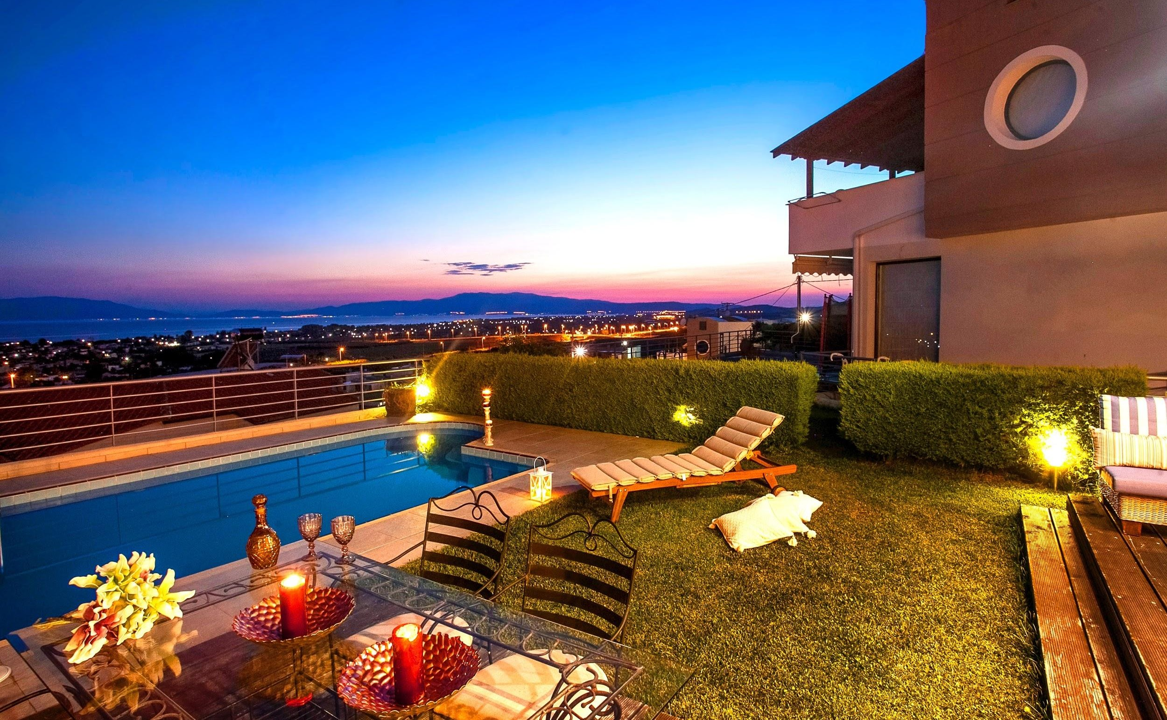
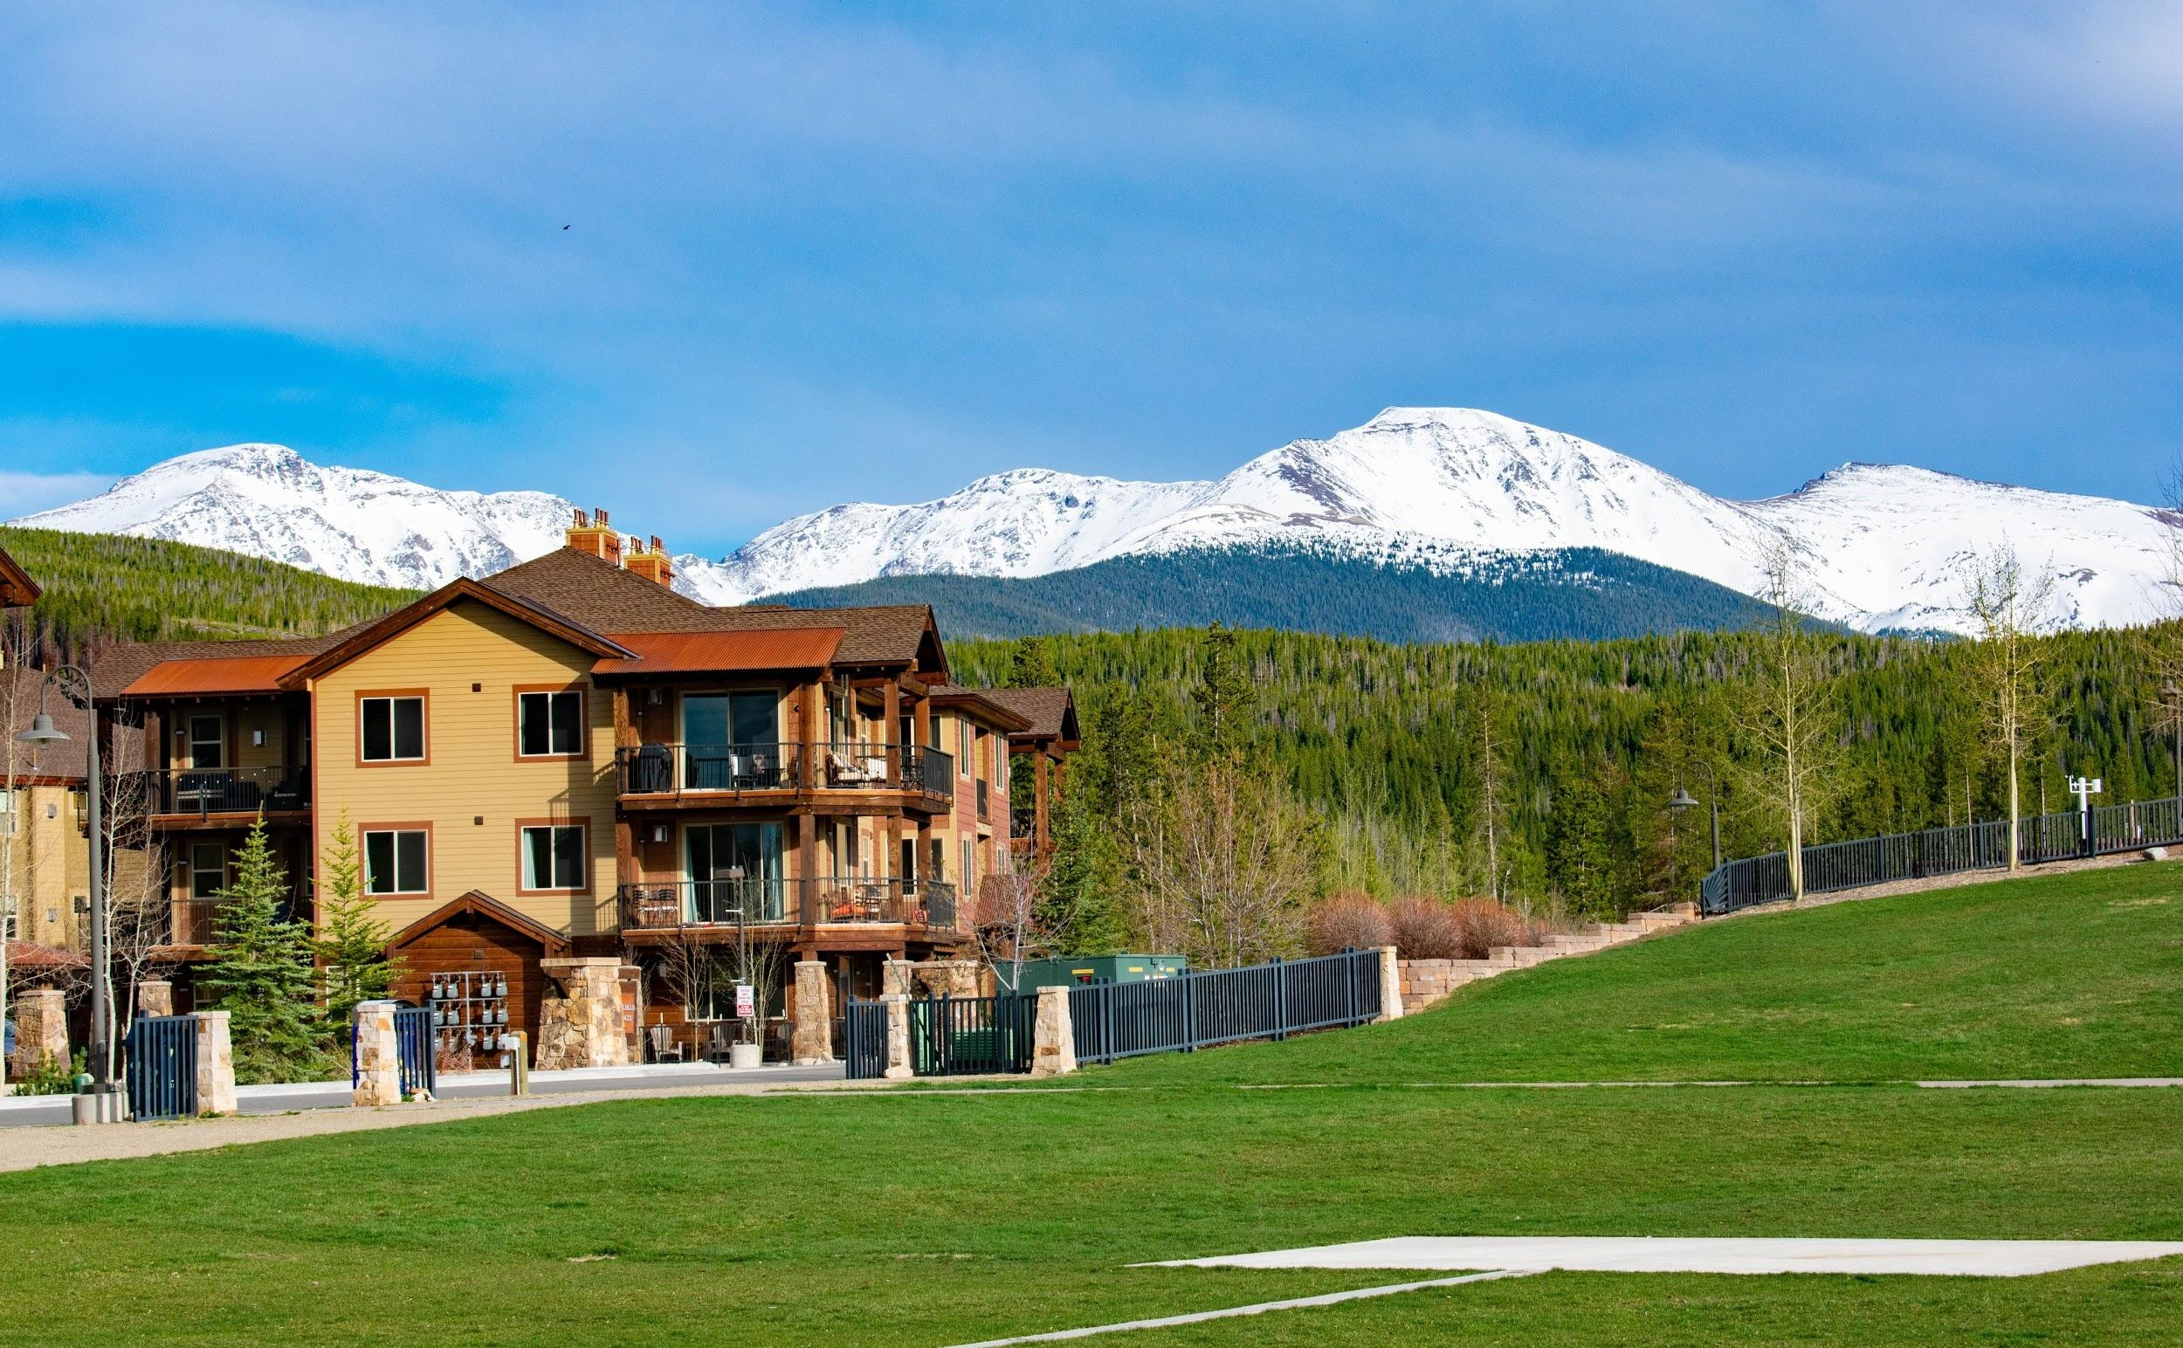
This Diwali let’s have a sparkling celebration at Hotel Avalanche
Enjoy the Chills of Winter at Hotel Avalanche
Spend quality time with your loved ones!
Avail 10% discount on early booking.
Get Offer
Book Direct and get 15% off
Book Now

Slide 10
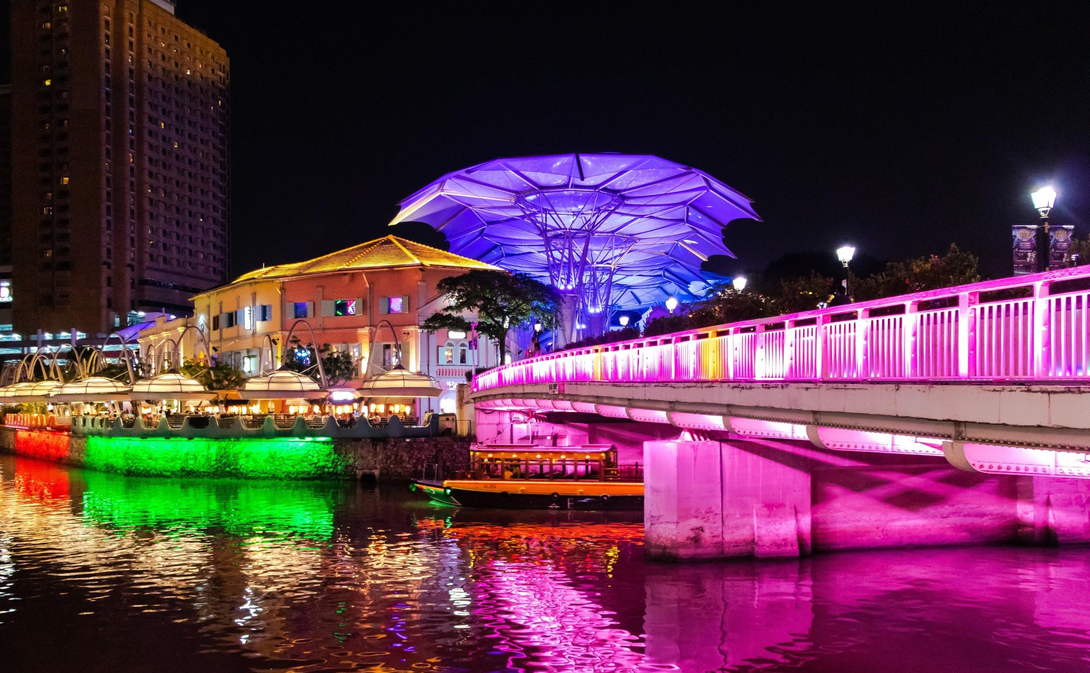
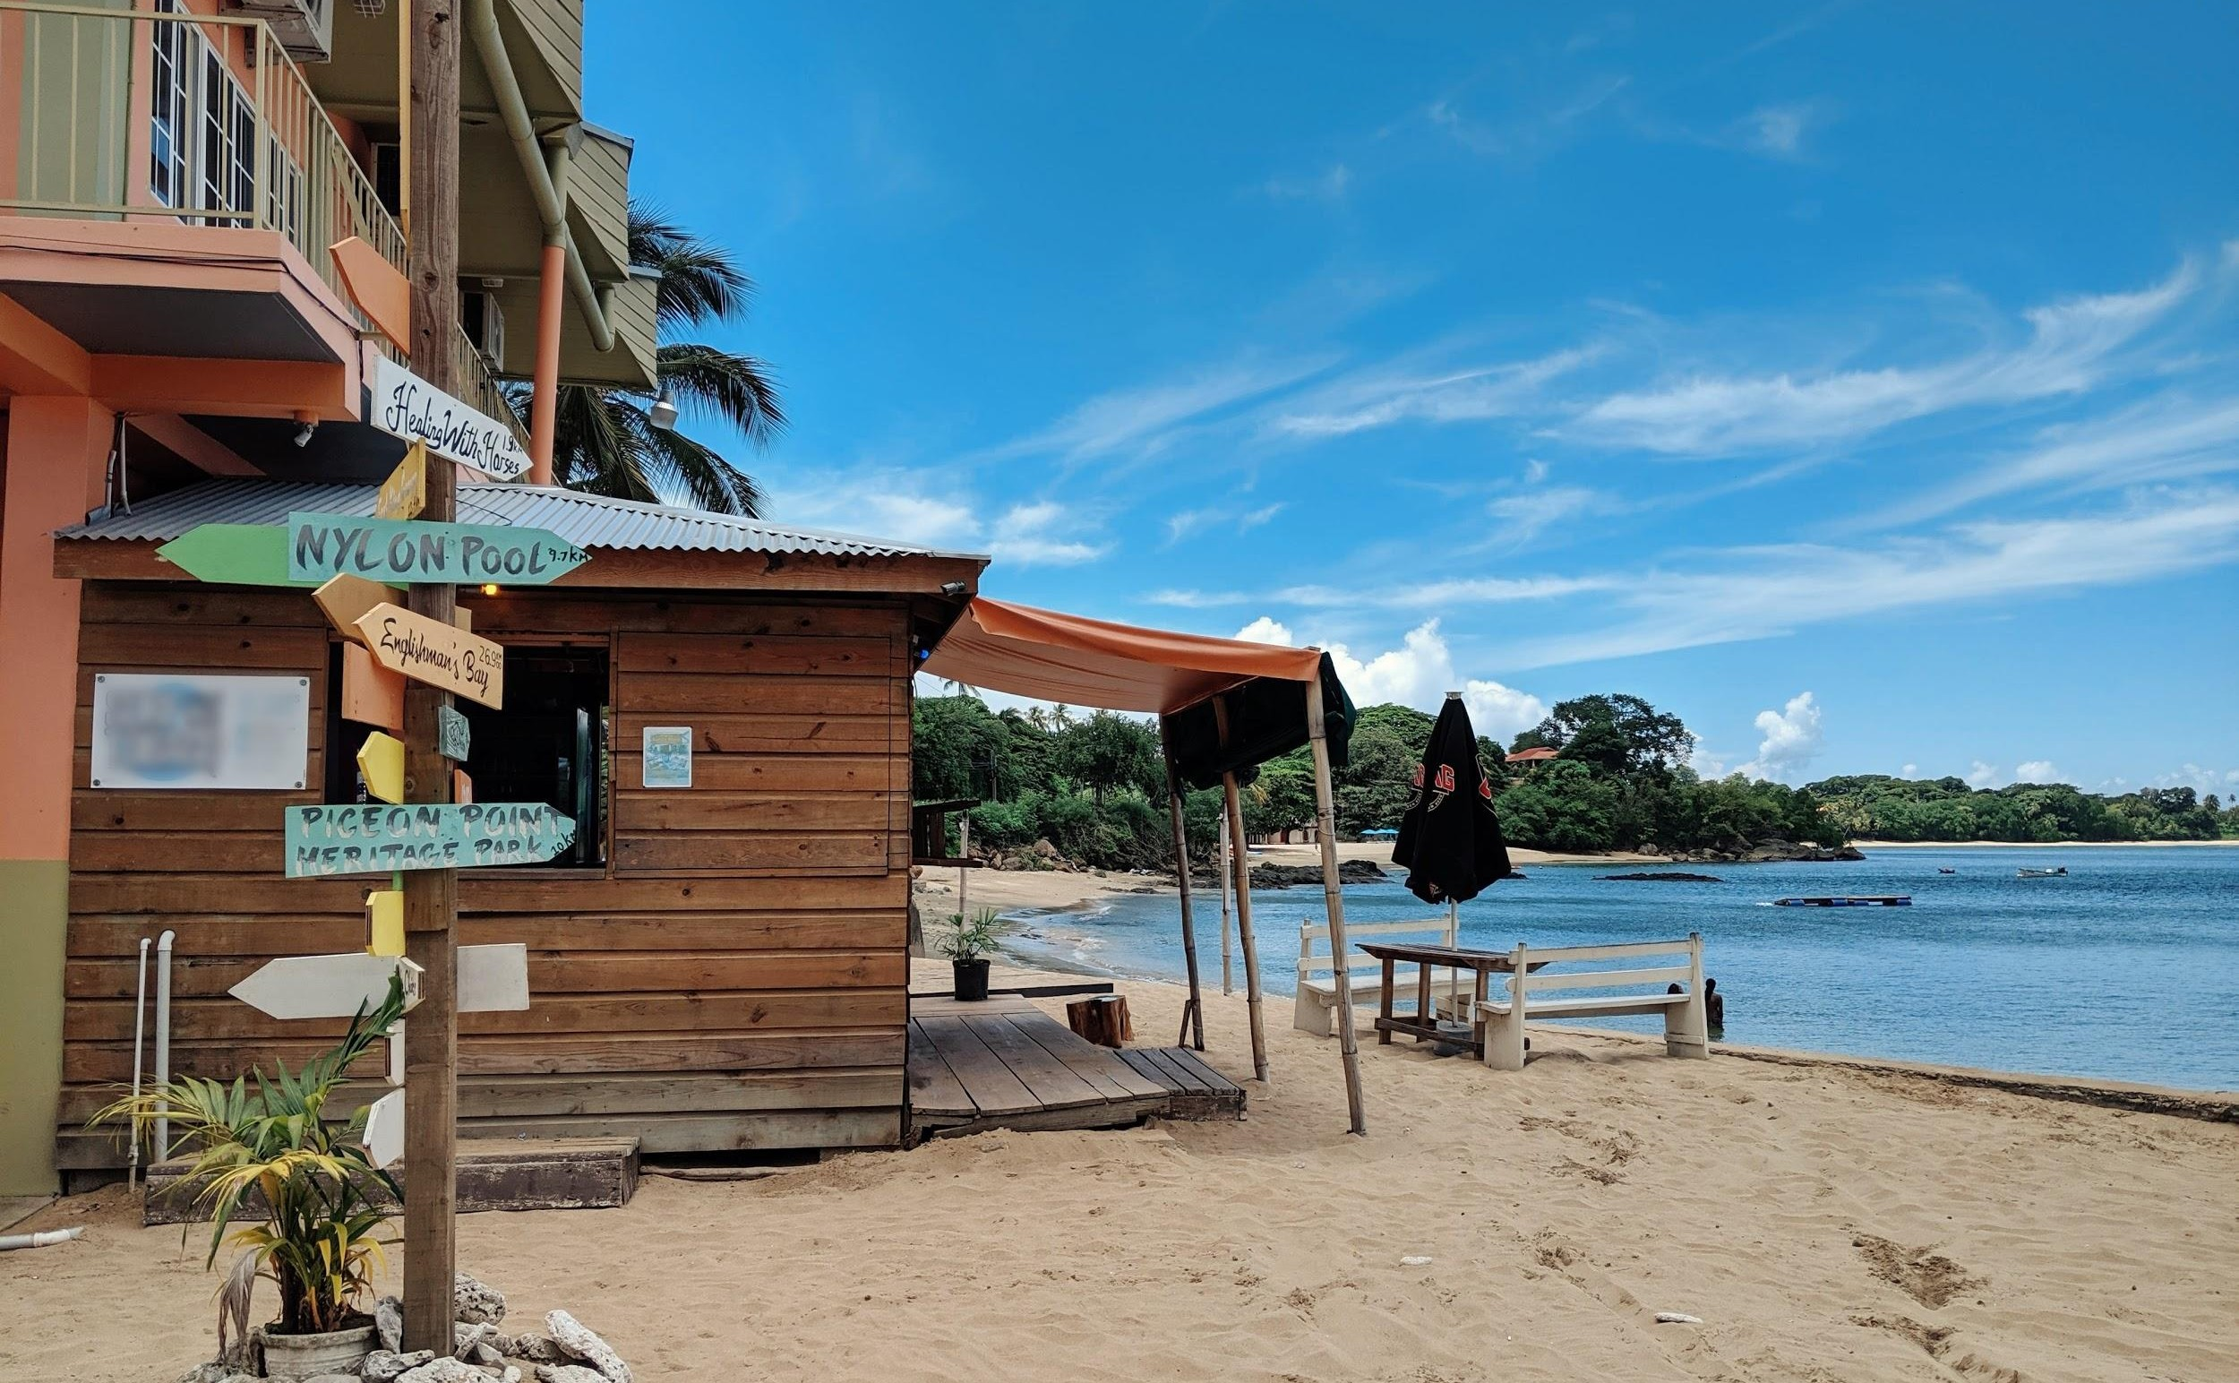
2020 NEW YEARS EVE!
Eat. Sleep. Beach. Repeat!
Book your stay at Hotel Avalanche and experience the best of the town!
Everything at one place!
Book now and save [20%] discount!
Get Offer
Enjoy your Summer Holidays with Hotel Avalanche
Get upto 10% discount
Book Now

Slide 11
Thank You!

