Slide 1
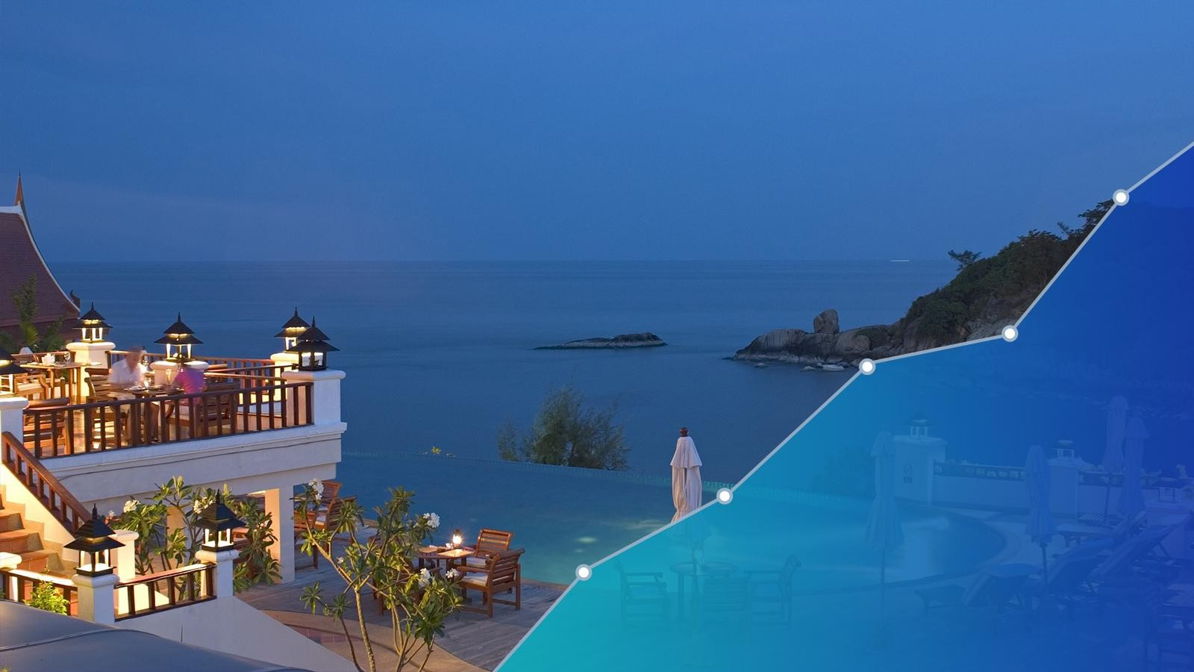


A step-by-step guide for
Hotel Revenue Management
revenue management
Hotel revenue management

Slide 2

TABLE OF CONTENTS
★
★
What is hotel revenue management?
Why hotels should consider working on revenue management?
★
Basic Strategies
★
Advance Strategies
1.
2.
3.
4.
5.
Think again on OTA connections
Perform smart inventory distribution
Focus on direct bookings
Upsell, upsell, upsell
1.
2.
3.
4.
Perform demand forecasting
Competition analysis
Yield management
Pricing strategies
Use reviews
2

Slide 3

W hat is hotel revenue management?
Revenue management is the backbone of a proﬁtable hotel business. However, it has always seemed
challenging to hotels because of many misconceptions.
Revenue management for hotels can be wrapped up into 5 R's. It is all about selling:
1.
2.
3.
4.
5.
Right Room
to Right Guest
at Right Moment
at Right Price
on Right Platform.
That’s it!
3

Slide 4

Why hotels should consider working on
revenue management?
Over the years, the hotel industry has become truly competitive. It is challenging for hotels to survive and stand
ahead among their competitors.
Besides, your hotel business is not meant to be run on the grounds of going with the ﬂow.
Here is when revenue management comes into the picture. It helps you ﬁght against all these problems and have,
1.
2.
3.
A successful hotel business
A headway among your competitors
A steady ﬂow of income regardless of any factor
4

Slide 5
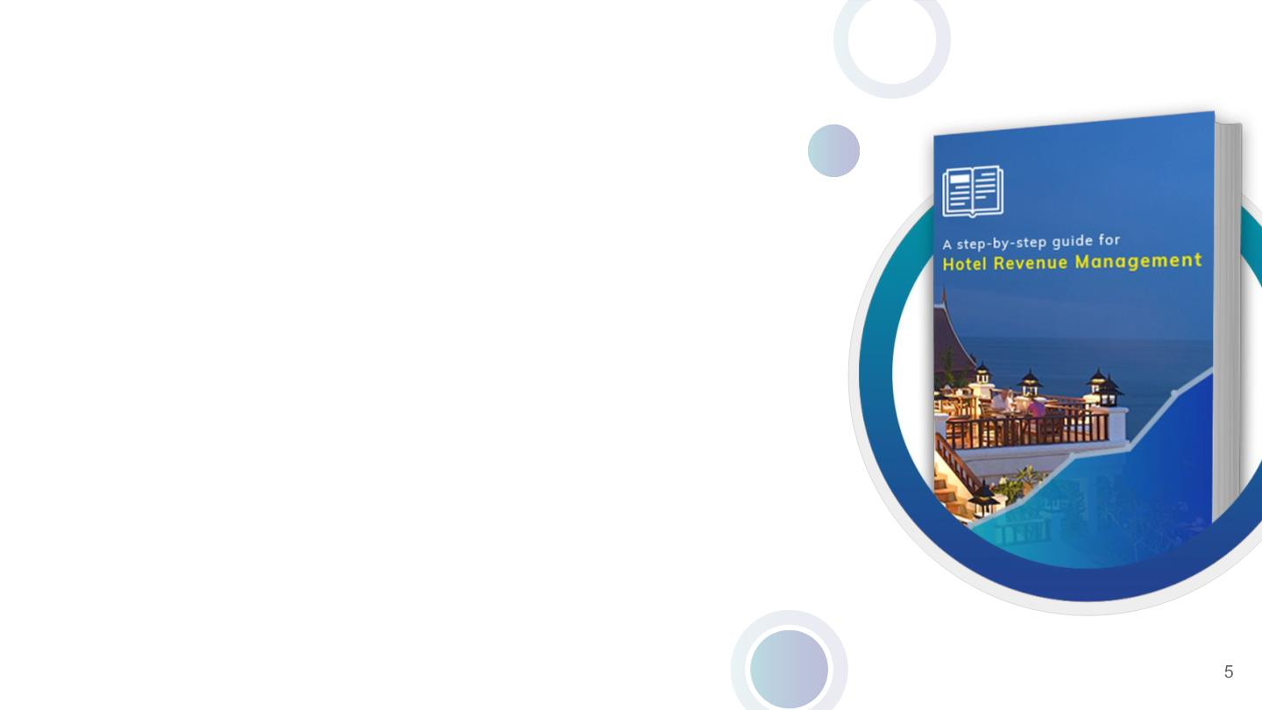
How to use this guide?
1.
Go through all the strategies and action
steps in this guide.
2.
3.
4.
Implement them.
Analyse results.
Continue strategies that performed
well.
Disclaimer: The strategies mentioned in this guide are
generalized for all property types. All strategies are not for
everyone. Choose the strategies on the basis of the
mentioned points and your convenience.

Slide 6

Let’s go through basic revenue
management strategies
6

Slide 7

1. T hink again on OTA connections
First things ﬁrst, choose the right OTAs for your property.
For example: If you’re a hostel in China then,
A. Connect to the relevant regional and global OTAs
●
●
A regional OTA like Ctrip.
Global OTAs such as Expedia and Booking.com.
B. Select the OTAs as per your accommodation type
●
List yourself on Hostelworld and Hostelbookers where your potential customers are.
C.
Choose the OTAs that fall into your budget
●
Select the OTAs that are not heavy on your pockets.
#Note: You can negotiate the commission rates with the OTAs. But with less commission, they might cost you the
visibility on their platform.
7

Slide 8

#UltimateSecret: Don't limit yourself to 2-3 OTAs.
If you do so, then…
➔
➔
➔
➔
➔
Your hotel does not get required exposure.
You do not get more bookings.
You do not get right guests.
You do not get more reviews.
Your online presence will scale down.
8

Slide 9

2. Perform smart
inventory distribution
Too much dependency on an allocated inventory
distribution, walk-ins or one booking source is now an
old-school method. Avoid doing that.
Do inventory distribution smartly.
Adopt a uniform distribution method (AKA pooled
inventory concept) and list all your inventories on all
channels.
Use a channel manager to practice this pooled
inventory distribution method.
Let’s understand it better by an example.
99

Slide 10

Without uniform distribution With uniform distribution
method
method
Consider you have 25 rooms. Out of that, you’ve listed
15 rooms on OTAs and kept 10 rooms for walk-ins or
website.
In the uniform distribution method, if you’ve 25
rooms, then list all the 25 rooms on all the channels.
Scenario 1
Only Scenario
●
You might receive than 15 bookings from
different OTAs.
Since you’ve listed only 15 rooms, you will
receive 15 bookings only.
Let’s say you received 3 online bookings, then
the channel manager will update the inventory
across all the platforms.
You still have 22 rooms across all the channels
to accept bookings.
●
●
●
Scenario 2
●
You might receive more than 10 ofﬂine bookings
via walk-ins or through phone calls.
But you don't have enough available inventories.
Since the inventory is managed centrally, you don't
have to worry about overbookings, or remaining
underbooked.
●
So, you lose potential booking opportunities.
In this way, you get bookings from every source.
10

Slide 11
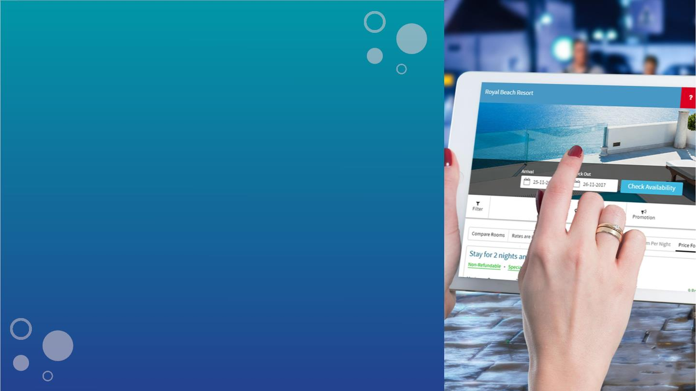
3. Focus on direct bookings
Perform these steps to acquire direct bookings:
1.
Get a hotel website that is attractive, responsive, and
navigable
2.
3.
4.
5.
Add appealing photos and videos
Optimize it using different SEO strategies
Integrate a booking engine to gain direct bookings
Make signiﬁcant efforts to increase your direct bookings
through promotions and offers
11

Slide 12

Here are some tricks to increase your direct
bookings:
1.
2.
Get listed on metasearch engines like TripAdvisor and Trivago
Give discounts on direct booking
3.
Showcase your online reviews
4.
Have a chatbot to attend to all your guests’ inquiries
Highlight your amenities
5.
6.
Enroll with Google Hotel Ads only via Authorized Integration Partner
Start social media marketing for your hotel
Collaborate with local partners
7.
8.
9.
Make the most of email marketing
10.
11.
Try your hands on radio ads and television ads (only if it suits your budget).
Consider hosting events at your hotel
12

Slide 13

4. Upsell, upsell, upsell
Earn revenue apart from room rates via upselling.
Upsell your meeting and event spaces, F&B
services, recreational services, and other such
activities.
#ActionStep: Using your guest database, gauge
their nature.
●
●
If one of your groups is of corporates, then
upsell your meeting spaces.
If your upcoming guests are a family, then
offer your spa or pool services.
13

Slide 14

5. Use reviews
Delivering the best-in-class guest experience
should be the ONLY aim of the hotels.
Reason being, it plays a signiﬁcant role in improving
your hotel’s reputation.
The quality service impels your guests to give
favourable feedback for your hotel.
And more the positive reviews, higher are your
chances to get selected by guests.
Thereby, you shoot two birds with one arrow!
Earn a good reputation and revenue.
14

Slide 15

Let’s go through advance revenue
management strategies
15

Slide 16

1. Perform demand
forecasting
Demand forecasting is the prediction of future
business performance. In which, data is of utmost
importance.
This is how you can perform demand forecasting:
Data Collection: Gather data such as peak and weak
season, long weekends, festivals and so on.
Analysis: Find out how you’ve performed on these
occasions. Then predict how you’ll be able to perform
in the coming year.
Set your rates based on these two activities.
16

Slide 17

6 tips to make you a
PRO at forecasting:
●
●
●
●
●
●
Keep accurate records
Make use of historical data
Consider upcoming events and holidays
Pay attention to market trends
Competition analysis
Analyse guest segments (types)
17

Slide 18

2. Competition analysis
Perform competition analysis. Because…
●
●
It helps you understand the strengths and
weaknesses of your competitors as well as
yours.
You can know your position among your
competition and eventually work to get ahead
in the race.
18

Slide 19

How to select your competitors?
Select your competitors by referring to the following parameters.
Note: Even if 7 parameters are meeting out of 10, then you can consider those
properties as your competitors.
19

Slide 20
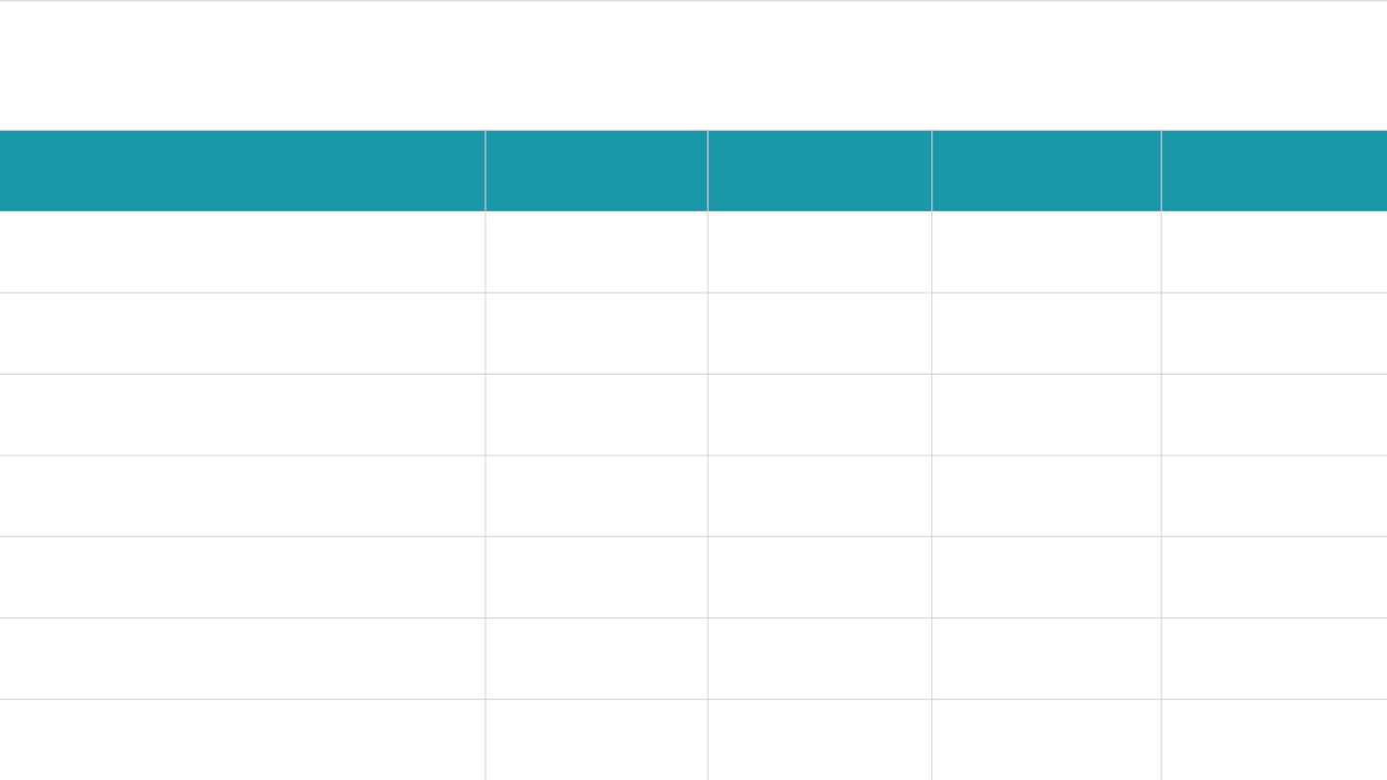
Parameters to deﬁne your competition set
Competitor 1
Competitor 2
Competitor 3
Competitor 4
No.of rooms
Room types
Location
Accommodation type
Size of property
Brand afﬁliation
No. of OTA connections
20

Slide 21
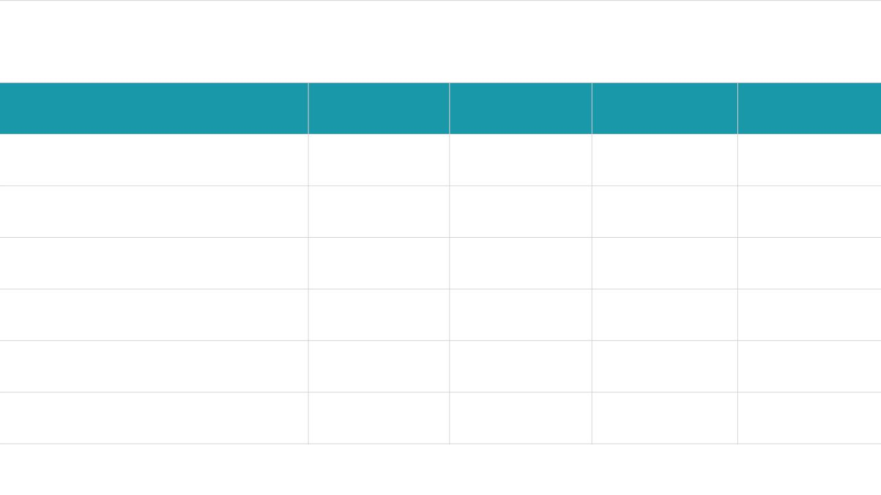
Parameters to deﬁne your competition set
Competitor 1
Competitor 2
Competitor 3
Competitor 4
Number of services
Any special amenities
Marketing strategies
Average ratings
Social media presence
Number of reviews
21

Slide 22

3. YIELD MANAGEMENT: W hat, how and why?
Determining the right hotel room pricing is called “yield
management strategy”.
In simple words, increase the room rate when the
occupancy increases and vice versa.
#MYTH: Yield management = Revenue management.
No. Yield management is NOT the same as Revenue
Management.
Yield management only encompasses the revenue
generated from the room rates or occupancy, whereas
revenue management involves a lot more than just
occupancy.
22

Slide 23
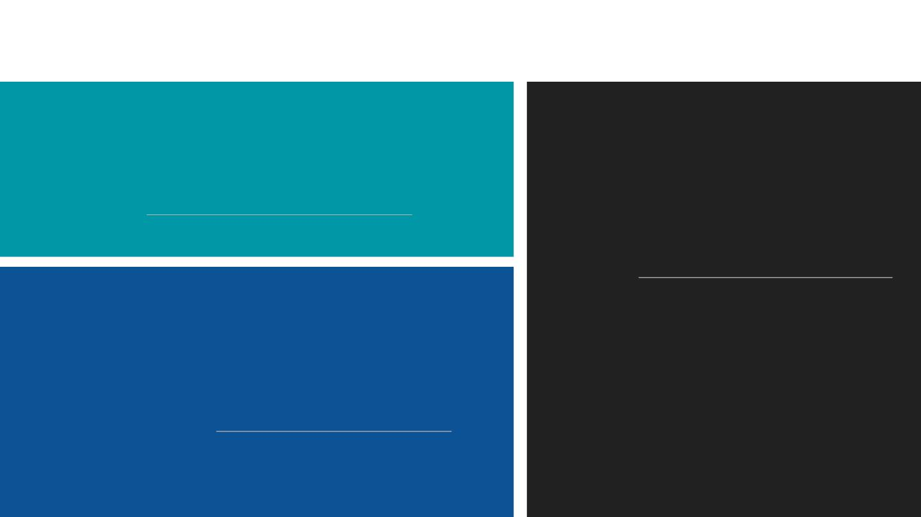
Yield management revolves around these metrics
A. Occupancy
Occupancy is the key parameter to measure your hotel’s
performance. It can be calculated as:
B. Average Daily Rate (ADR)
ADR is a metric that measures the average
revenue earned from the occupied rooms on a
day. It can be calculated as:
Number of occupied rooms
Occupancy % =
*100
Total number of available rooms
Revenue earned from rooms
ADR =
C. Revenue per Available Room (RevPAR)
Number of rooms sold
RevPAR is a measurement of a hotel’s average daily rate and its
ability to ﬁll its rooms. There are two basic formulas to calculate
RevPAR:
(*ADR does not count:
1.
Vacant rooms, complimentary rooms,
hotel use rooms.
Room’s revenue
2.
3.
‘No shows’ and forfeited deposit rooms.
Canceled bookings and charges levied
for the same)
1.
2.
RevPAR =
Number of available rooms
RevPAR = Average daily rate * Occupancy percentage
23

Slide 24

4. Pricing Strategies
Basically, your ultimate goal should be:
●
●
Increased occupancy with high revPAR
High revPAR with maximized yield
The only way to achieve this is to apply various pricing strategies.
24

Slide 25
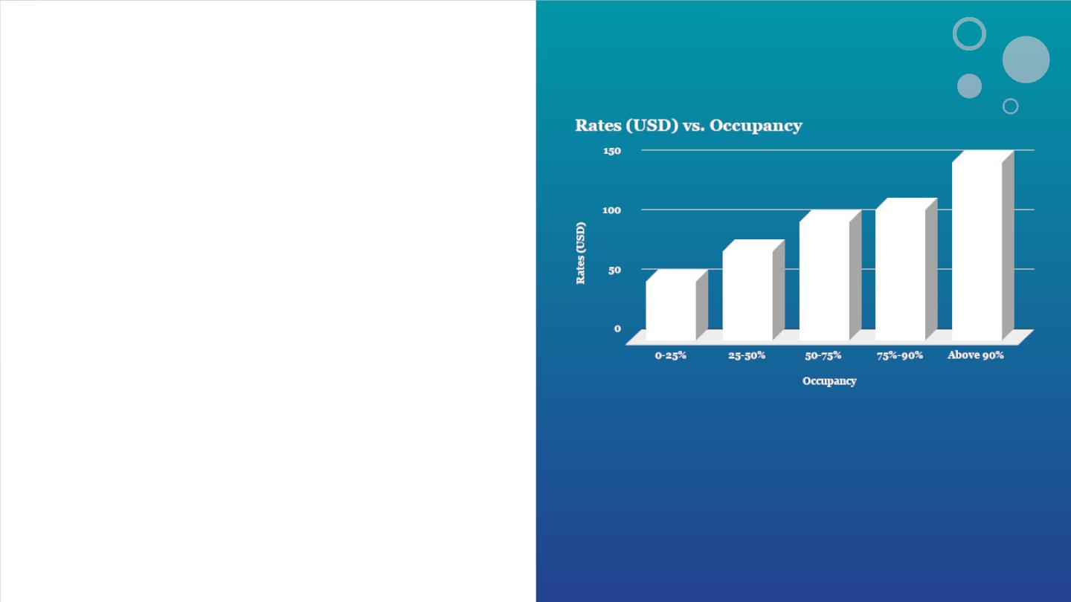
Strategy 1:
Dynamic pricing as per
occupancy
Dynamic pricing is also known as slab-wise pricing. In
this strategy, different pricing slabs are made
according to the occupancy percentage.
For example:
Your basic room rate is 50 USD. If your occupancy lies
between 0-25%, keep the same room rate. (Refer
graph.)
IMPORTANT NOTE: This is not a standard slab.
Depending upon the trends and your hotel’s data, you
can deﬁne your slab-wise pricing.
Then, as the occupancy increases, increase your room
rates.
#ProTip: Adopt technology such as hotel software
and booking engine to practice this pricing strategy.
25

Slide 26

Strategy 2:
Segmented rates
Strategy 3:
Discounted rates
In this strategy, segment your customers and offer
different rates to each customer's segment.
In this pricing strategy, sell your rooms on a discounted
price for a short period.
For example:
For example:
1.
Following the rate parity strategy, the rates for
the open market should be the same.
1.
Offer nominal discounts few months before the
peak season. This will help you acquire assured
reservations in the peak season beforehand.
2.
On the other hand, offer negotiated rates to the
corporate segment and in return ask them to
commit a certain number of rooms for the
negotiated rates.
Book now at 30% off and enjoy your Christmas
to New Year eve at Avalanche Resort.
2.
Run attractive ﬂash discount hours for a limited
period. Offer big discounts on booking directly
via your hotel website.
3.
Connect with a tour operator and sell them some
rooms at special rates.
#ChristmasDiscount: Get ﬂat 25% off on
booking. Offer available till 20 DEC only.
26

Slide 27

Strategy 4:
Strategy 5:
Rates as per length of Packages
stay (LOS)
A package is a room rate clustered together with other
products and services.
Adjust your prices on the basis of your guests’
length of stay.
By offering packages, you can create a value perception
among your guests.
For example:
For example:
Mandate the length of your guest's stay by
offering them good prices.
Package 1: Free meal
If your guests have selected a European plan, then offer a
free meal for the ﬁrst day as a package.
1. Decrease the rates in weak seasons
Package 2: Pick up and Drop-off facilities
Get 3N/2D stay at Avalanche Resort and at 200
USD only.
Offer them pickup and drop-off facilities from the airport
as a package.
2. Increase their length of stay in peak seasons
Package 3: Cancellation policy
Stay for a minimum of 4 nights and at the cost of 3
nights only.
Offer your packages at high rates with a refundable
condition and vice-versa (with a non-refundable condition).
27

Slide 28

Bonus Strategy:
Run loyalty programs
Loyalty programs cannot be excluded from your
revenue management. It is the best way to get
business from repeat guests.
Also, running a loyalty program is a no-brainer. All
you have to do is offer attractive rewards to
increase your sales.
Running loyalty programs for your property beneﬁt
you in several ways. You can,
1.
2.
3.
4.
Retain your old customers
Attract new guests
Promote your brand value
Most importantly, increase your revenue

Slide 29

That’s it!
The lock, stock and barrel of revenue
management is sorted.
Want revenue experts to give you a
free consultation on this?
Get started
29

Slide 30
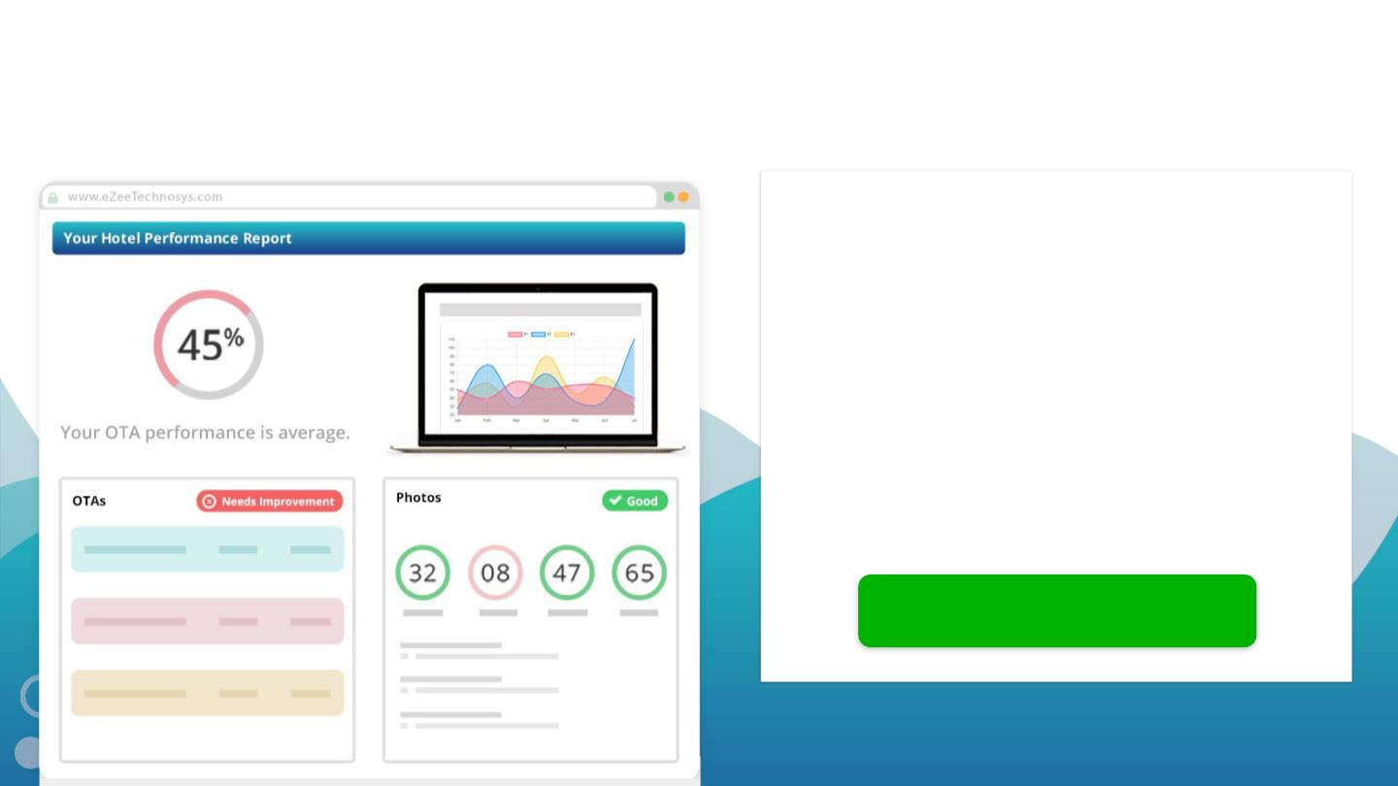
Know how your hotel’s doing with a
FREE hotel performance report
Get your hotel’s reality check done by
industry experts on 45 parameters such
as...
1. OTA connections
2. Direct bookings
3. Online reputation management
4. Metasearch connectivity and so on...
Get advice on how to improve your
performance.
Get your report today!
30

