Slide 1
BASIC SAFETY TRAINING
EFA, FPFF, PST, PSSR

Slide 2
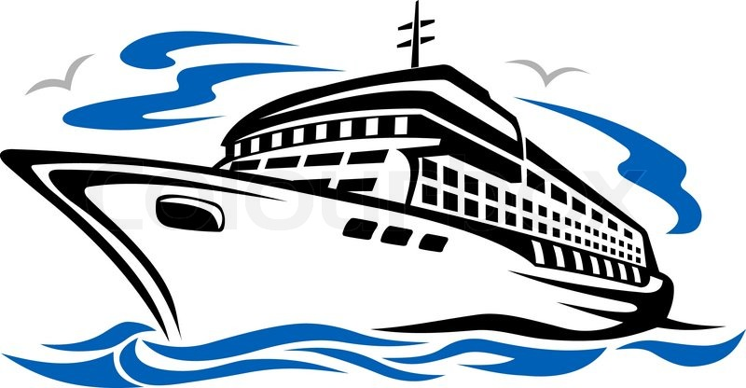
Accidents and casualties both at sea and in port were dogging the international shipping during crisis in the 1980’s.
It is well established fact that the seafarer’s competence is among the most critical factors in safe and efficient ship operation.

Slide 3
Therefore, the International Maritime Organization (IMO) adopted in July 1995 substantial amendments to the International Convention on Standards of Training Certification and Watchkeeping for seafarer’s of 1978 (STCW ’78).

Slide 4
The International Convention on Standards of Training, Certification and Watchkeeping for Seafarers (STCW), requires that seafarers be provided with "familiarization training" and "BASIC SAFETY TRAINING" which includes basic:
    Elementary First Aid (EFA)
    Fire Prevention and Fire Fighting (FPFF)
    Personal Survival Techniques (PST)
    Personal Safety and Social Responsibility (PSSR)

Slide 5
This training is intended to ensure that seafarers are aware of the hazards of working on a vessel and can respond appropriately in an emergency.

Slide 6
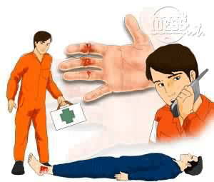
Elementary First Aid
(EFA)

Slide 7
First Aid - is the emergency treatment given to the ill or injured person before professional medical services can be obtain.
A first aider fills the gap between the victim and physician; it should not compete or take the place of the physician, the role of the first aider ends when the services of the physicians begin.

Slide 8
A good first aider must be:
Resourceful
Gentle
Sympathetic
Cheerful
Observant
Tactful

Slide 9
Purpose in administering first aid to ill or injured person:
To prevent death
To prevent further injury
To counteract shock
To relieve pain
To prevent severe bleeding
To prevent asphyxiation

Slide 10
All crew members aboard ship should have proper training and sufficient knowledge of first aid.
Crew members should be able to administer emergency treatment until medical assistance arrives.
As first aider, crew members should be aware of their ABILITY and LIMITATIONS.
Crew members should not attempt to administer first aid procedure and techniques which they are not properly trained or that are beyond their ability because it will further harm the victim or victims.

Slide 11
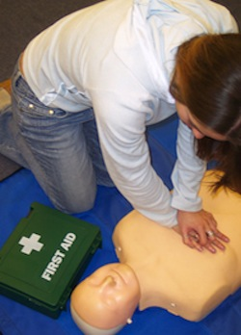
Aboard ship first aid must be immediately administered to:
Restore breathing and heartbeat
Control bleeding
Remove poisons
Prevent further injury to the patient

Slide 12
Fire Prevention and Fire Fighting (FPFF)

Slide 13
Fire Prevention and Fire Fighting course deals with the necessary precautions to minimize the risk of fires aboard ship, how fires are caused and the first means of extinguishing them.
The course includes practical training in the use of firefighting equipment and the use of breathing apparatus for fire fighting and rescue.

Slide 14
You will also be able to:
Maintain a state of readiness to respond to emergency situations involving fires
Fighting and extinguishing a fire
Act as a member of a fire party, including use of self-contained breathing apparatus.

Slide 15
Location of fire-fighting appliances and emergency escape routes
The elements of fire and explosion (the FIRE TRIANGLE)
Types and sources of ignition

Slide 16
Flammable material, fire hazards and spread of fire
Fire and smoke detection and automatic alarm systems
Classification of fire and applicable extinguishing agents

Slide 17
Perform rescue operation/s on a smoke-filled spaces wearing the
  CABA (Compressed Air Breathing Apparatus) or
  SCBA (Self Contained Air Breathing Apparatus)

Slide 18
Personal Survival Techniques (PST)

Slide 19
Survival - is the ability of a seafarer to stay alive when life is threatened in a shipping casualty.
  It is an action, ability or effort exerted by a person or group of persons in order to continue to live in the midst of disastrous situation.
  It is a struggle for existence.

Slide 20
Essentials for survival at sea:
Have a strong will to survive.
Have survival knowledge and techniques:
  Proper use of life-saving appliances and equipment
  Actions to be taken when abandoning a ship
  Survival knowledge and techniques required when drifting
  Cautions required by a person being pick-up
Have excellent life-saving appliances which are always maintained in good condition.

Slide 21
Life-saving appliances:
Lifeboat
Life raft
Buoyant apparatus
Lifejacket (rigid)
Lifejacket (inflatable)
Lifebuoy / Life ring
Lifejacket light
Immersion suit
Thermal Protective Air (TPA)

Slide 22
Things to remember:
Know your duties in an emergency.
Be prepared - an emergency can arise anytime.
Knowledge and Training gives you the best chances to cope with an emergency.

Slide 23
Personal Safety & Social Responsibility (PSSR)

Slide 24
Due to the vastly different environment on a ship as compared to ashore, this course is designed to prepare new personnel for a life at sea.
Working at sea can be a hazardous occupation for the uninitiated.

Slide 25
The course will provide an insight into the various elements of a ship and Operating Procedures onboard so that adjustment can be made to the shipboard environment, and are better prepared to cope with any unforeseen circumstances.
This course is planned to provide knowledge of shipboard life before personnel step on board.

Slide 26
The student successfully completing the course will be able to:
comply with emergency procedures
take precautions to prevent pollution of the marine environment
observe safe working practices
contribute to effective human relationships on board ship

