Slide 1
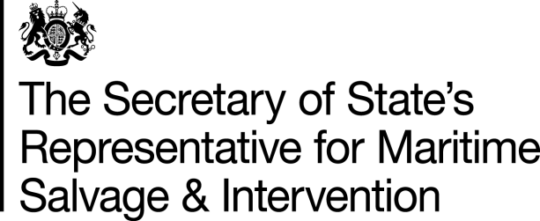
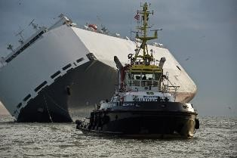
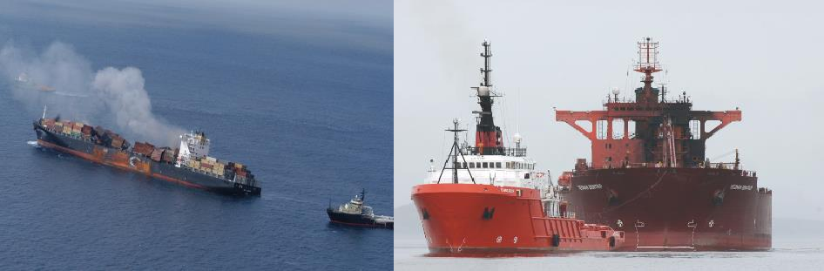
Maritime Emergency Response in the UK
British Ports Association Briefing, 7 May 2021

Slide 2
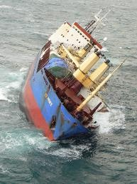
Overview
The role of the State & the NCP;
SOSREP - role and responsibilities;
Case studies;
Current and future challenges.

Slide 3

The role of the State
UK strategic overview:
- responsible for maritime safety policy;
Directorate HM Coastguard: maritime Search and Rescue; Counter Pollution, Receiver of Wreck etc.;
Maritime Services – S&I, Nav Safety Training, Certification,
Flag etc.

Slide 4
National Contingency Plan - NCP
As a Party to the UN Convention on the Law of the Sea (UNCLOS), the UK has an obligation:
‘to protect and preserve the marine environment.’
NCP provides the incident response framework;
To ensure that there is a timely, measured and effective response to incidents;
Parallel command structure – no single incident commander;
NCP Section 15: Harbour authority response, powers and co-operation;
Department for Transport (DfT) and Department for Business, Energy and Industrial Strategy (BEIS) are the Lead Government Departments for the NCP.

Slide 5
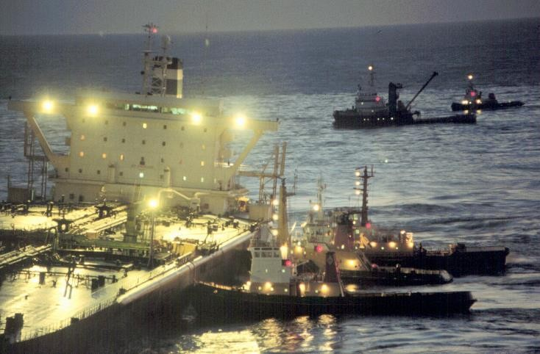
Introduction of the SOSREP system
Command and control deemed inefficient & inefficient;
Lord Donaldson’s Review of Salvage and Intervention and their Command and Control.
15 February 1996, Sea Empress grounded approaching Milford Haven

Slide 6


There should be ‘ultimate’ control of salvage by a Secretary of State’s Representative acting in the overriding public interest
SOSREP

Slide 7
SOSREP function
One person to represent and act on behalf of Secretaries of State;
No recourse to higher authority;
Decisive voice and ultimate control;
Cannot choose to ignore a situation;
Tacit approval;
During operations must be fully supported by Ministers or have intervention powers removed.

Slide 8
SOSREP role & responsibility
Monitor and evaluate incident response
  risk to safety and/or risk of significant pollution at sea/in port;
Ability to take control if deemed to be in UK interest;
Response must be commensurate with the risk;
Formal salvage plan approval;
Stakeholder management – keep all parties appraised of developments.

Slide 9
Powers of Intervention - Use
Purpose:
  Removing, preventing or reducing the risk to safety or of pollution;
  Securing safety of a ship/installation, persons or property;
Application:
  Safety – UK Territorial Waters (12 miles);
  Pollution – UK Exclusive Economic Zone, 200 miles/median line;
  Pollution - Offshore Installations – UK Continental Shelf;
Directions:
  Ship / installation take specific actions; enable use of (land) facilities; remove from UK waters;
  Destruction of a vessel or installation!
Served to:
  Masters, owners, offshore operators, managers, insurers, persons in control of land etc.

Slide 10
Stakeholder interests
Ambulance Service / NHS
Public Health Bodies
Environment Agency (EA)/Scottish Environment Protection Agency (SEPA)/Northern Ireland Environment Agency (NIEA)
Marine Scotland / Marine Management Organisation (MMO)
Department for Agriculture and Rural Affairs (DEFRA)
Department for Transport (DfT)
Department for Business, Energy and Industrial Strategy (BEIS)
Offshore Regulator for Environment and Decommissioning (OPRED)
The Health and Safety Executive (HSE)
Port Authority
Scottish Natural Heritage (SNH) / Natural England (NE)
Joint Nature Conservation Committee (JNCC)
The Crown Estate
Devolved Administrations
Other Coastal States
European Maritime Safety Agency (EMSA)
COBR / SGoRR
Etc. etc.
Ship owners
Ship charterers
Ship managers
Hull & Machinery Insurers (H&M)
Protection & Indemnity Clubs (P&I)
Cargo owners
Cargo insurers
Salvage Company
Classification Society
Maritime and Coastguard Agency (MCA)
  HM Coastguard (SAR & Counter Pollution)
  Maritime Services
  Investigations
  The Receiver of Wreck (amongst others)
Marine Accident Investigation Branch (MAIB)
Local Authority
Strategic Coordinating Group (SCG)
Police
Fire and Rescue

Slide 11
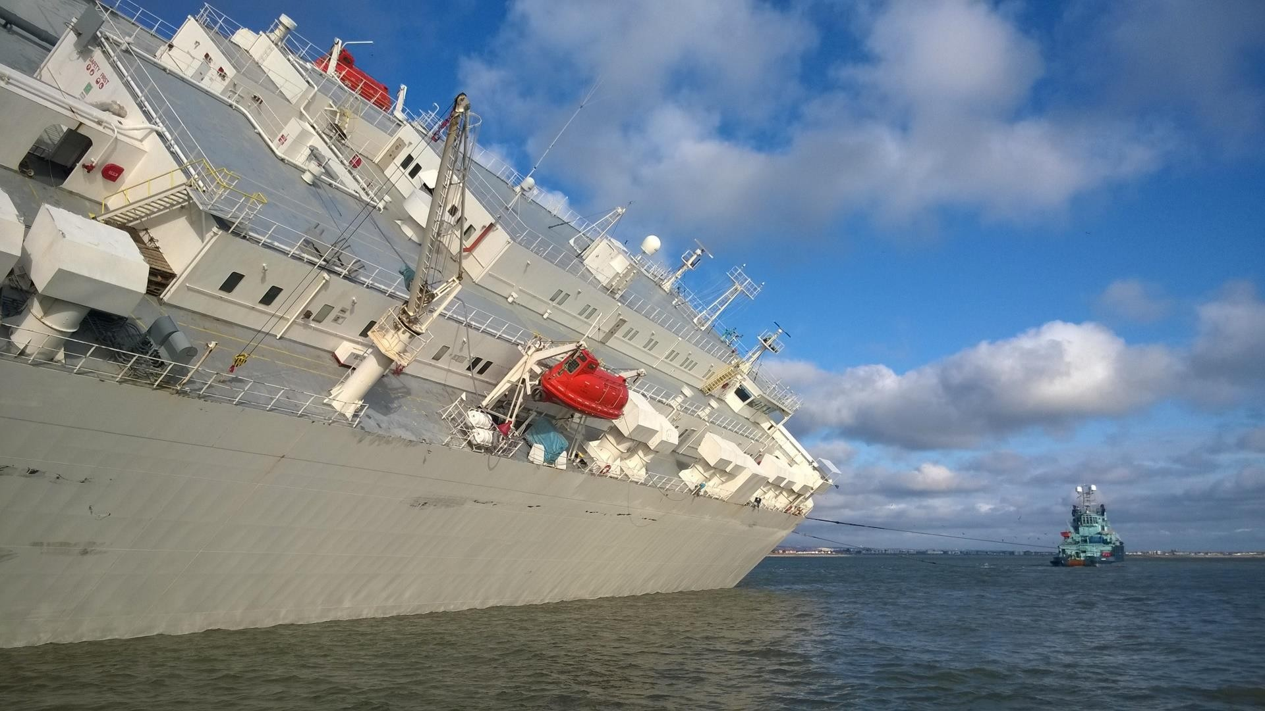
Incident response

Slide 12
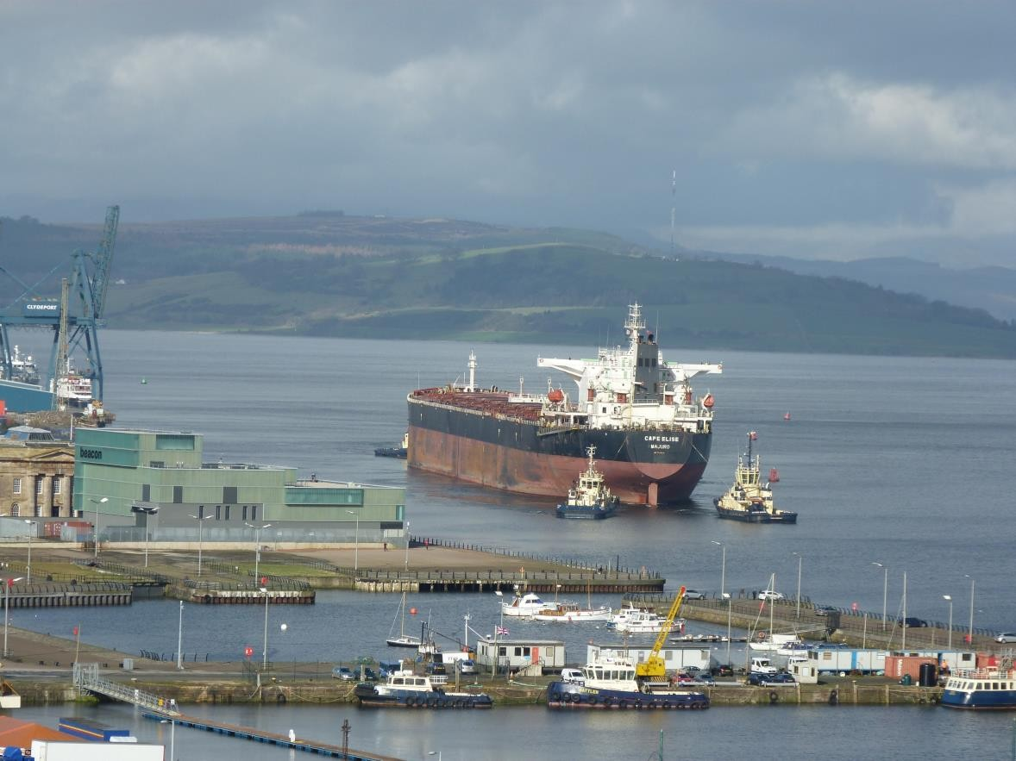
SOSREP incident involvement
MCA Duty Counter pollution & salvage officer liaises with ship / owners / insurers / port etc.
SOSREP kept appraised of plans & intentions –
incident monitoring;
Support for all parties;
Intervention Warning;
Safety Direction – Schedule 3A MSA 1995;
Temporary Exclusion Zone – S 100A MSA 1995;
Formal response cell set-up under NCP
arrangements.

Slide 13
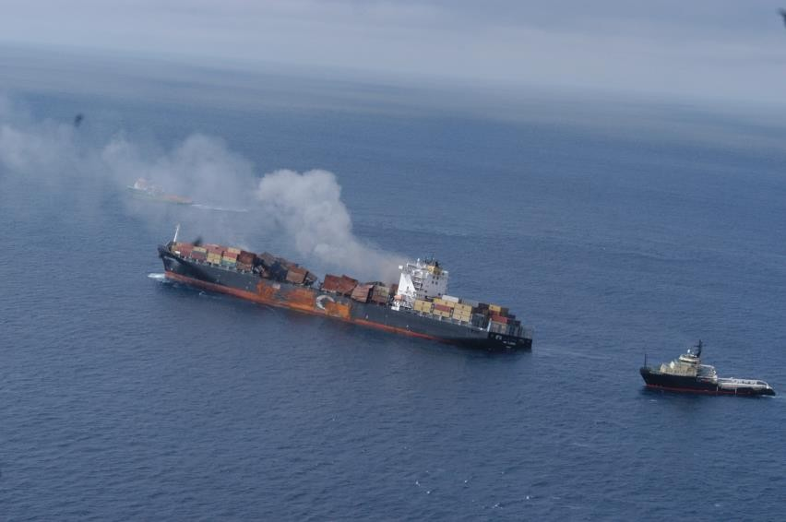
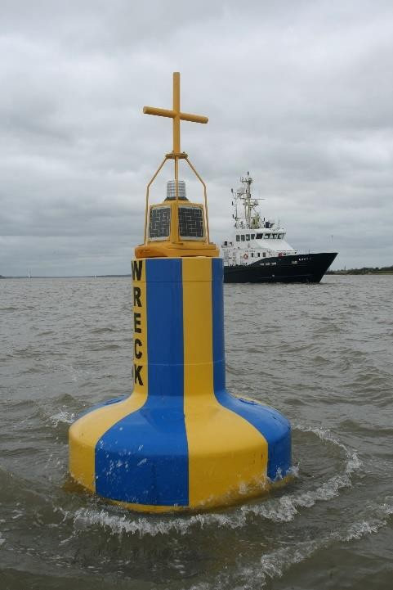
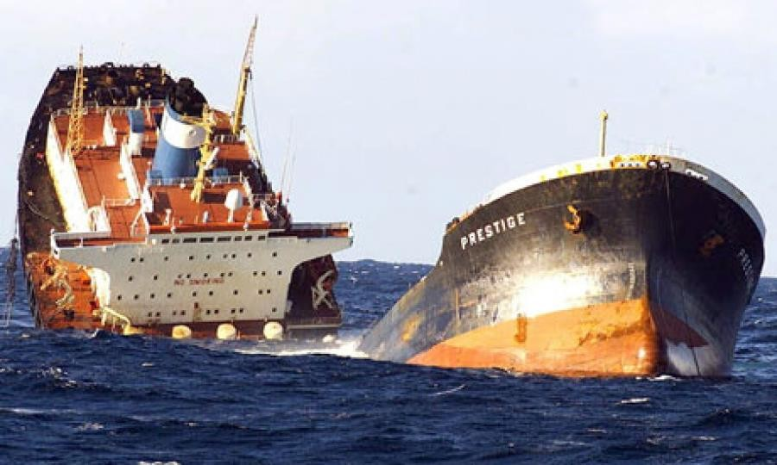
Also responsible for:
Designation of a place of refuge for a ship in need of assistance;
Wreck removal – s255D MSA 1995;
Support in maritime security incidents.

Slide 14
SOSREP & port interaction
Where did the incident originate?
What legal powers are available and
appropriate?
general directions (HM);
special directions (HM);
Dangerous Vessels Act 1985 (HM & SOSREP);
Schedule 3A MSA 1995 (SOSREP).
Managing expectations.
Is the response / recovery within the port’s capacity?
Cooperation, support and guidance.
S15 Schedule 3A MSA 1995 – cost of compliance with direction recovered from the ship owner.

Slide 15
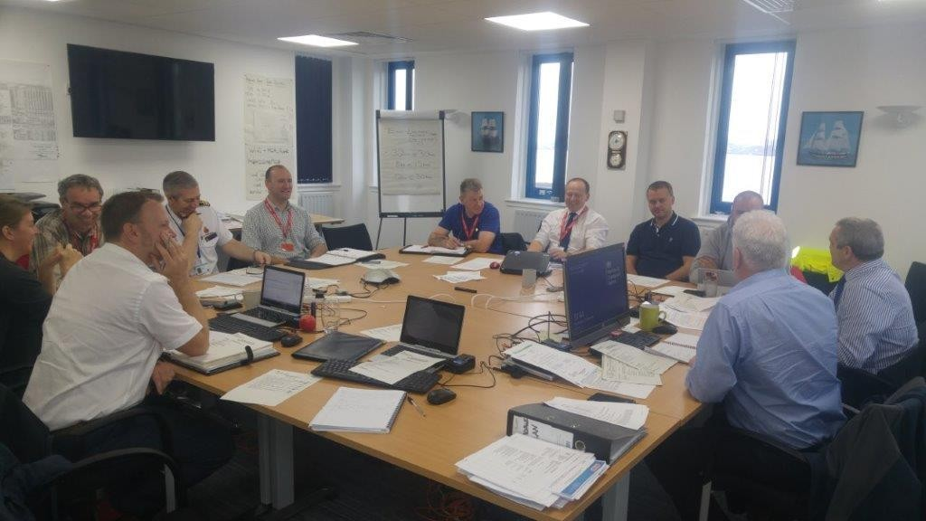
SOSREP response cells
Salvage Control Unit (SCU) for shipping incidents (49 SCUs since 1999);
Operations Control Unit (OCU) for offshore incidents (2 OCUs since 1999);
Cell purpose:
  Monitor and focus on operations;
  Approve salvage/containment plans;
  Discussion forum for relevant parties;
  Provide an avenue for state intervention – if necessary;
Not a committee.
Accurate record of key decisions via minutes/actions.

Slide 16
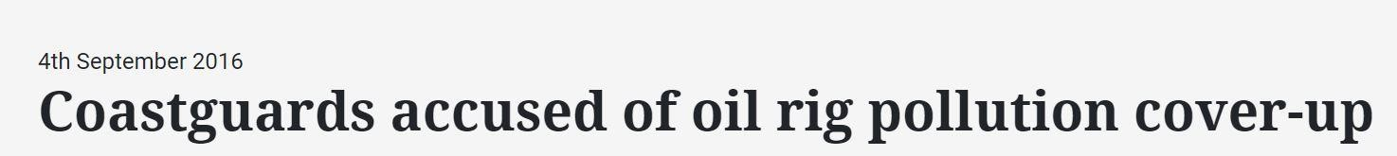
SOSREP communications & media
SOSREP SITREPs and ministerial briefings;
Media crisis team (see NCP);
Openness, transparency and trust are key factors in successful operations.
But no matter how hard you try...
… the accusation was untrue.

Slide 17
Selected incidents since 2007

Slide 18
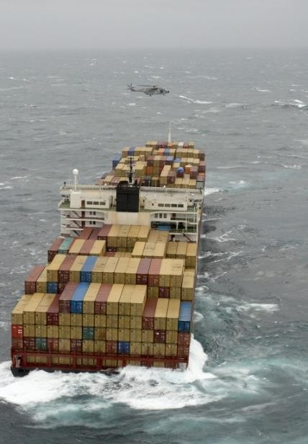
MSC NAPOLI
18.01.2007
275m LOA
2300 TEU
Structural damage, crack in the hull;
26 crew rescued;
3500mt bunkers;
Place of Refuge: Portland
Breaking apart whilst grounding Lyme Bay;
SCU established.

Slide 19
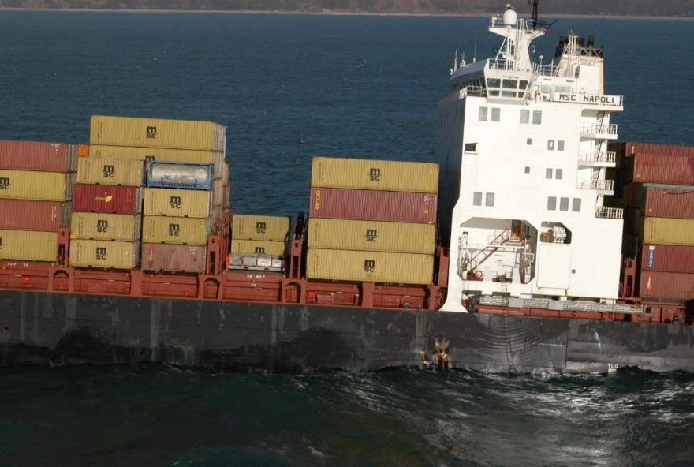
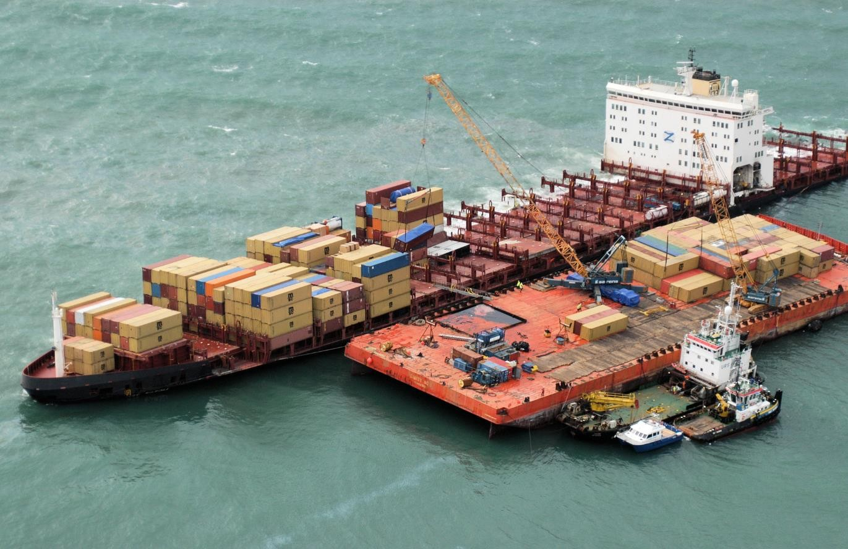
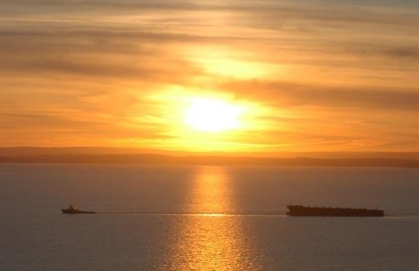
After 924 days the last piece of wreck was removed.

Slide 20
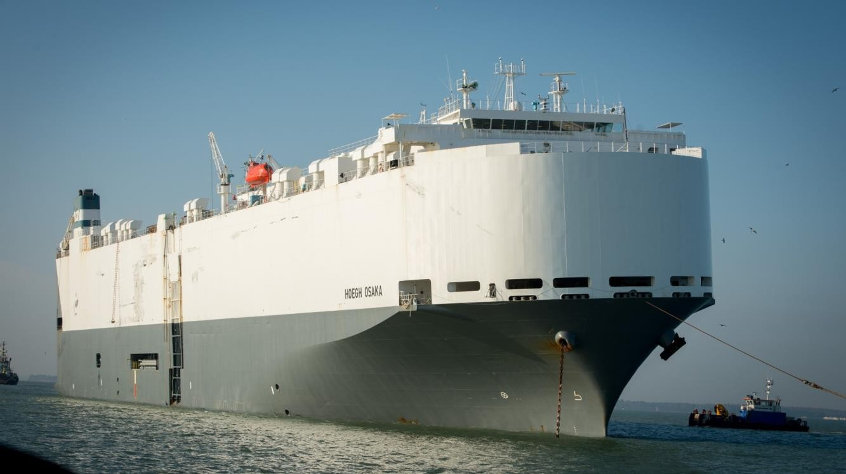
Hoegh Osaka
03.01.2015
Pure car and truck carrier (PCTC);
180m LOA;
List, flooding and grounding;
52° list aground on Bramble Bank in the Solent;
Crew and pilot taken off ship;
500mt bunkers;
1450 vehicles on board.

Slide 21
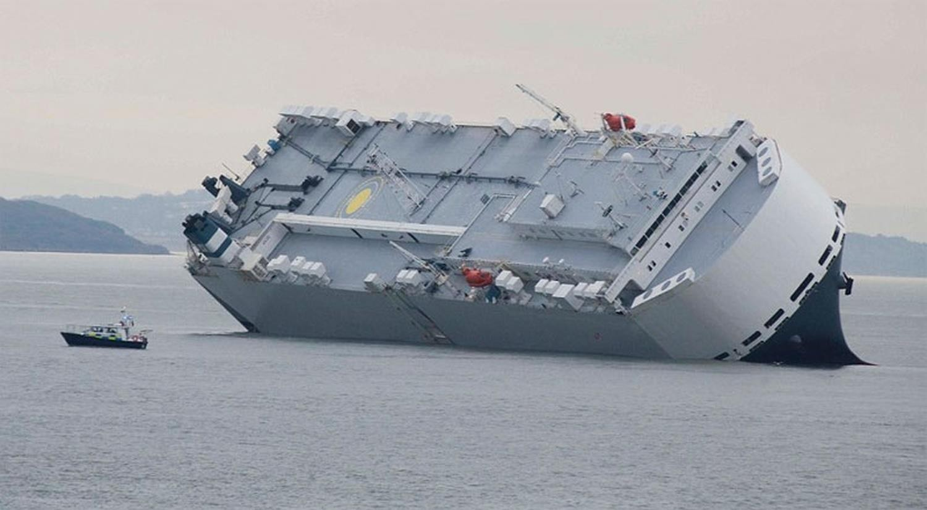
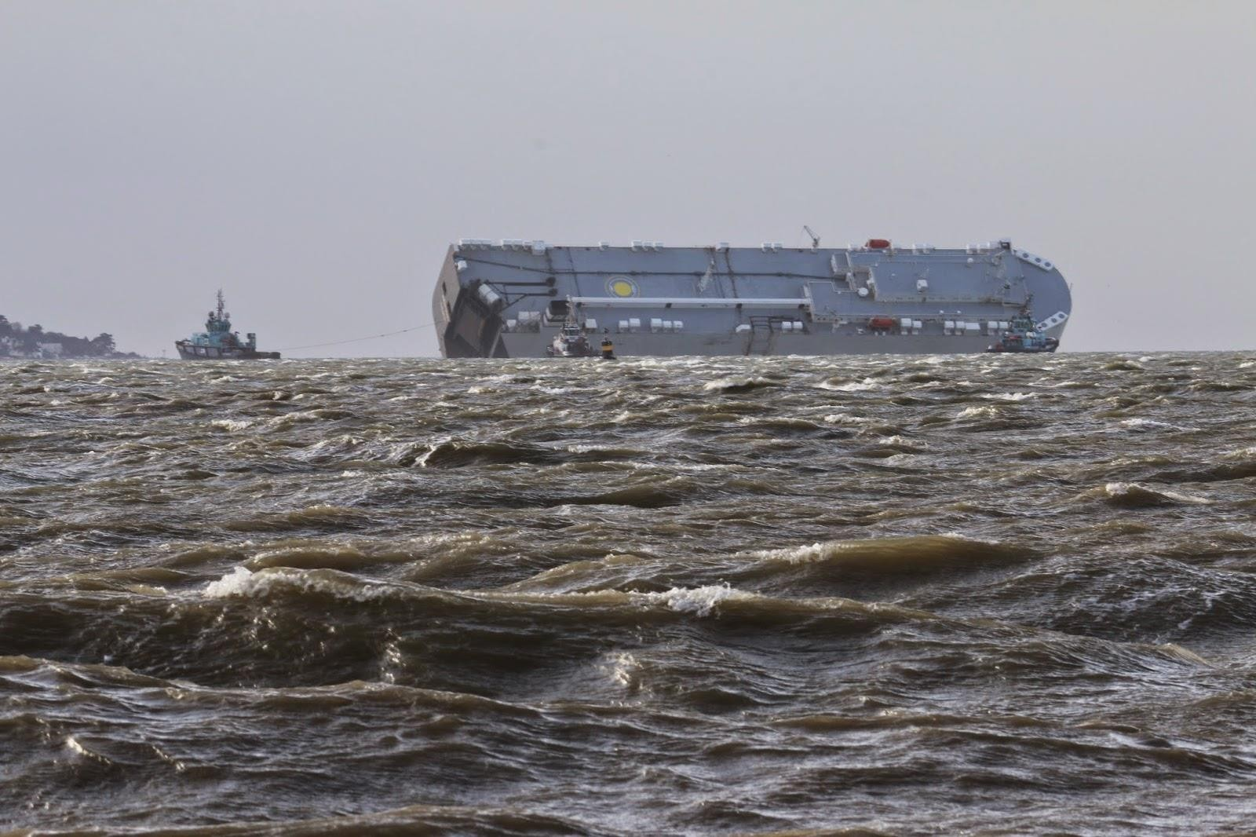
SCU established at ABP Southampton in agreement with HM;
  29 SCU meetings; 5 press conferences;
  Refloated and berthed Southampton 22 January.

Slide 22
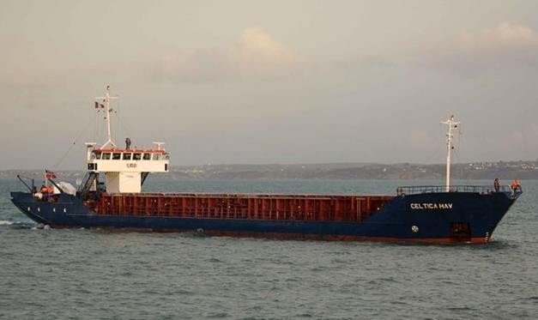
Celtica Hav
27.03.2018
82m LOA;
Grounded in approaches to the River Neath;
Bound for Briton Ferry;
2000mt anthracite;
20mt MGO;
Crew + pilot remained on board.

Slide 23
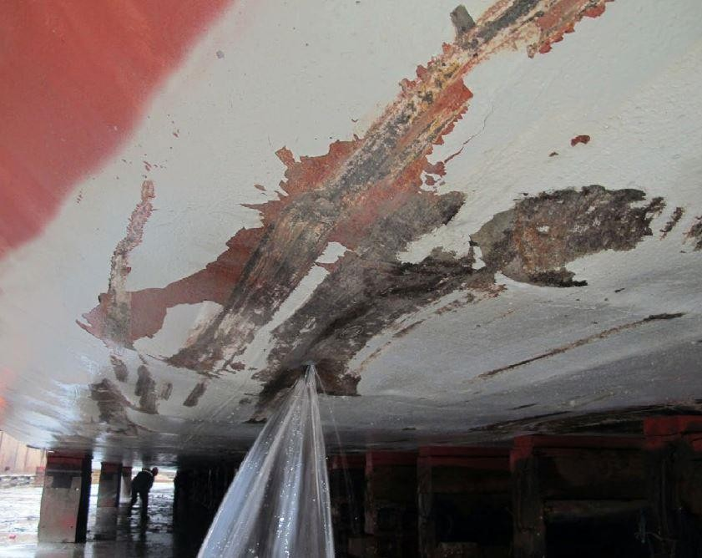
Refloated;
Damage to shell plating with water ingress into double bottom WB tanks and engine room;
Nine pumps stemming ingress;
Swansea Harbour approached as a Place of Refuge;
Following negotiations between HM, MCA & SOSREP and ship’s P&I
insurers, HM Swansea made available a berth.

Slide 24
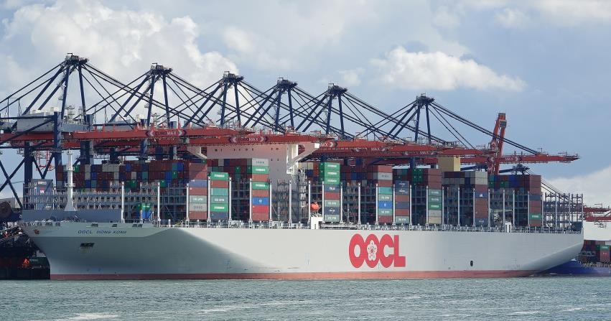
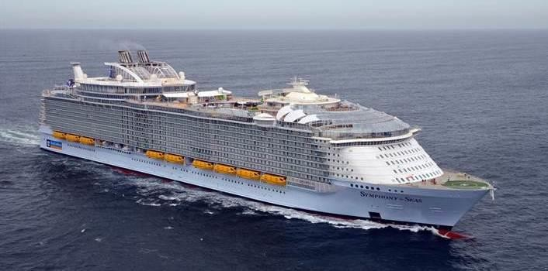
The challenges
Larger ships – fewer options for Places of Refuge;
  Container ships 21,000+ TEU AND increase in DG quantity;
  Cruise ships 9,000 people carrying capacity;
Remote locations – access, transport etc.;
Skill fade, loss of experience.

Slide 25
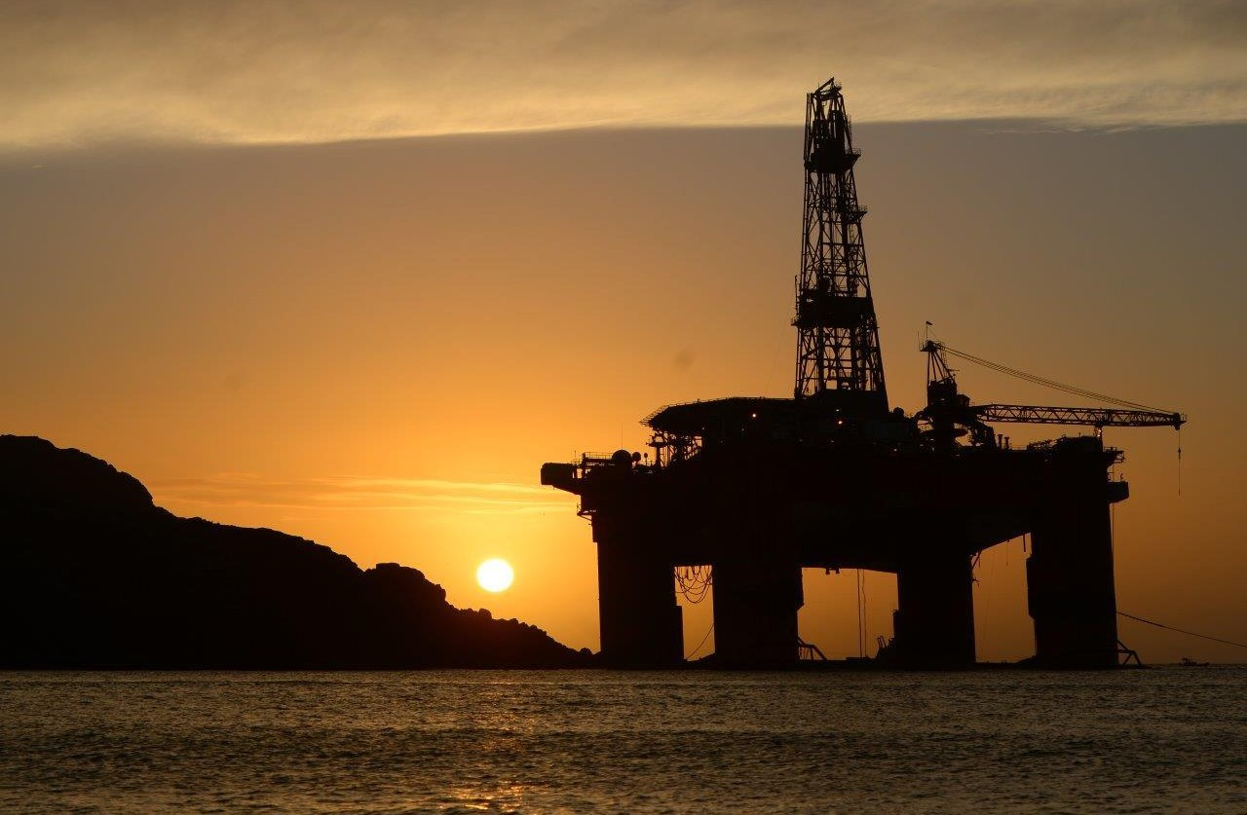
Thank you for listening.
Thank you for listening.
stephan.hennig@mcga.gov.uk
Stephan.Hennig@mcga.gov.uk

