Slide 1
Prediction on
Back to Normal Hotel Business, what we will do?

Slide 2
Section Break
Introduce the Speaker

Slide 3
01
Look Local Business Opportunity
Agenda Discussion
02
Break Down Silos
03
Turn Data Into Knowledge
04
Focus On Transient Business
05
Stay Agile
06
Do your best in Digital Marketing

Slide 4
5 Predictions For Revenue Success,
So then do your best
The situation of hospitality business during the pandemic even requires recovery time back under normal circumstances such as 2016 to 2018 is still in prediction and many reliable marketers are difficult to ensure that in the next two years there will be a normal recovery, optimists believe that there will be a recovery in 2023, while conservative groups say recovery will occur in 2025.
In such a situation as this slide, then we need light. So let predictions stay predictions, but we still need predictions that can still support our Hospitality Business.
Now how should we keep doing Perhotel Business while waiting for the recovery of occupancy rates to return to normal, let's discuss this issue.
Don't think too much about finding ways and theories, but act in order to get business.

Slide 5
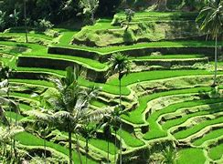
Look Local Business Opportunity
Look at your drive market. People don’t want to fly - they don’t feel safe. Focus on the guests that are in a 500-mile radius from your hotel. They can do day trips to your resort, or stay a night or two, then go home. Consider their total spend, including ancillary revenue from F&B and gaming.
The hotels that have a database of local guests need to use this, targeting those very limited marketing dollars where they are most likely to convert. There is pent-up demand and it is going to be very focused on close proximity to your hotel. Those targeting locals will be the most successful and the fastest to recover.

Slide 6
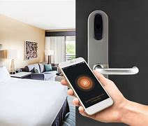
Break Down Silos
Just like any business, every hotel needs to pay more attention to profitability rather than just top line room revenue, and for that to happen we need to see increased adoption rates of revenue management technology.
In addition, within hotels, there needs to be further breaking down of silos and the building of better synergies between departments.
Bring these together – technology and teamwork - and you will see success.

Slide 7
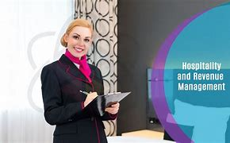
Turn Data Into Knowledge
Technology is rapidly changing the hotel pricing function. However, automation does not replace the knowledge and analytical skills that commercial revenue management and sales staff need to succeed. The revenue function will evolve into ‘Revenue Management 2.0’ and with this the field will track people with a wider range of skills than ever before with an emphasis shift to critical thinking. Therefore, hotel commercial strategy focused platforms will be challenged to provide a collaborative venue to turn data into knowledge and knowledge into hotel asset profit.

Slide 8
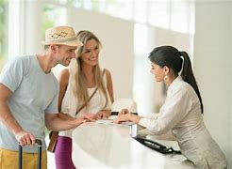
Focus On Transient Business
First, the human element of revenue isn’t gone. There is light at the end of the tunnel for those that have been furloughed and these revenue professionals will be back.
Revenue is often viewed as the back seat of sales but the reality of the business mix is that there’s not as much corporate and there’s not as much group business out there today, so the focus is on transient business. And this is where the role of the Director of Revenue Management comes into play.

Slide 9

Stay Agile
If the last 12 months have taught us anything it is to expect the unexpected. Make sure that you are agile in your strategy, and in your technology. Demand is volatile, customers are unsure and their decisions are ever-changing.
Now is the time to build up your tech stack so that, when demand increases, you are equipped to deal with each and every subtle change.

Slide 10
Do Your Best in all Marketing
Do more in Marketing
In carrying out marketing in difficult situations, we must use all means. Be it the traditional way, Digital, Mobilize and more helpful is Event Marketing.
Do for:
B2C – direct to customers
B2B - with OTA’s and Corporate
Traditional Marketing\
Outbound marketing
Personalized marketing
Direct mail
Partner marketing
Telemarketing
Public relations (PR) marketing
Word of mouth marketing
Stealth marketing
Brand marketing
Cause marketing
Digital Marketing
Inbound marketing
Searching engine marketing
Content marketing
Affiliate marketing
Social media marketing
Email marketing
Mobile marketing
Event Marketing
    Experiential marketing
    Interactive marketing

Slide 11




SOCIAL MEDIA POSTS:
Templates for Hotels
Facebook & Instagram
www.eZeeTechnosys.com

Slide 12
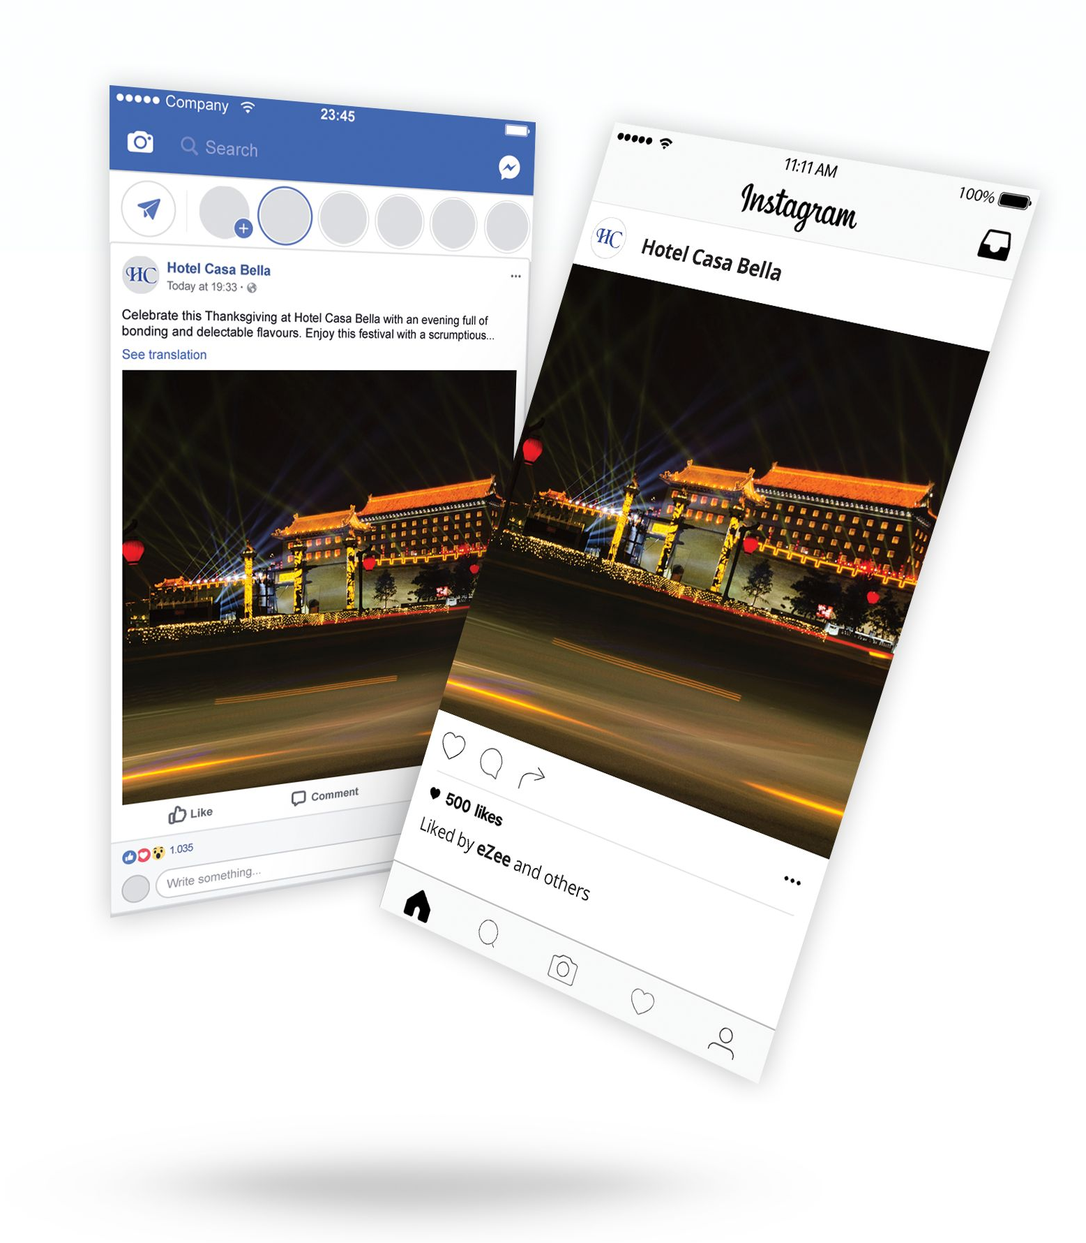

How to use these templates?
Find the type of post you want to do. (i.e. Facebook or Instagram)
See what type of audience you want to target.
Choose the template you think is best suitable.
Mix and match templates with the hashtags
The content in [brackets] is variable. Modify it as per your requirements.
Start posting!
We recommend you to be dynamic while posting. Don’t stick with one template for all your posts on various social media platforms.
Using these templates with a touch of your creativity will work wonders.
Bonus Tip:
Posting attractive images with these templates will create miracles!!
eZee Technosys

Slide 13

Trending #Hashtags
Weekly hashtags like these can help build consistency when posting on social media and are great for getting your content seen!
#MondayBlues
#TravelTuesday
#WineWednesday
#WeddingWednesday
#WayBackWednesday
#ThrowbackThursday
#FlashbackFriday
#SaturdaySpecial
#SaturdayNight
#SundayFunday
Other trending hashtags for hoteliers
#hotel(s)
#besthotel(s)
#luxuryhotel
#boutiquehotel
#resorts
#hotelpool
#pool
#poolside
#hotelroom
#photooftheday
#hotelsuite
#hotellobby
#hotelbar
#luxurytraveller
#travel
#hoteldeals
#vacation
#holiday
#hoteldeals
#luxuryhotels
eZee Technosys

Slide 14


Eﬀective Tips you can use for #Hashtags
Keep it simple and relevant.
Utilize trending hashtags!
Use hashtag on multiple social media marketing channels i.e. for
  Facebook: Use 2-4 hashtags on Facebook, try one popular hashtag and one custom hashtag for your brand. Facebook posts can be either short or long!
  Instagram: It allows up to 30 hashtags, but keep it to not more than 11 per post for the highest level of engagement. Let the post be short and sweet!
Search the hashtag before you use it.
Don't over use any hashtags.
Be speciﬁc and unique.
Create brand engagement.
Tip:
Create a speciﬁc hashtag just for your hotel brand! Include them in all your posts! This would help in generating engagement on social media with potential and previous guests of your hotel. (eg: #HotelCasaBella)
eZee Technosys

Slide 15
Facebook & Instagram Posts

Slide 16
Festive Posts for Facebook
Templates:
Put on your masks, grab your costumes and gear up for a fun-ﬁlled trick or treat at [hotel name] this Halloween.
Enjoy this festival with a scrumptious meal accompanied by your dear ones.
Wishing you a spook-tacular [special day name]!
Celebrate [special occasion] at [hotel name] with an evening full of bonding and delectable ﬂavours.
Join us for a magical [party name] celebration with [guest name / DJ
Hashtags:
# [HotelName]
# [Location]
#HappyHalloween
#HappyThanksgiving
#BookNow
#ChristmasCelebration
#Festive
#Festivalsof [location]
#NewYearsEve
#Happynewyear
#Diwali2020
#HappyDiwali
name] at [hotel name], [location]
New Year's Eve countdown and celebration at away the ﬁnal night of the year in true style!
Book Now: [phone number]
[hotel name]! Party
Plan your next holiday now and celebrate [festival name] with us at the [hotel name], [location]
NOTE: The content in [brackets] is variable. Please modify it according to your requirement.

Slide 17


Festive Posts for Instagram
Templates:
Hashtags:
This Diwali, experience the warmth and joy of togetherness at @[hotelname], [location]
Make your # [partyname] magical with us by booking your stay at @[hotename], [location]
This [special day name] book your stay at @[hotelname]! Dance, drink, and dine with a spectacular view of [location].
What's better than spending [occasion name] in style with us @[hotelname], located at the most stunning #[location] of the city!!
Link in Bio!
[Hotel Name] is open for friends and family, everything - on this Christmas. For reservations, please call: [phone number]
# [HotelName]
# [Location]
#HappyHalloween
#HappyThanksgiving
#BookNow
#ChristmasCelebration
#Festivals
#Festivalsof [location]
#NewYearsEve
#FunFilledEvening
#Happynewyear
#Diwali2020
#HappyDiwali
NOTE: The content in [brackets] is variable. Please modify it according to your requirement.

Slide 18

Examples of Festive Posts:
See how we mixed and matched templates!

Slide 19

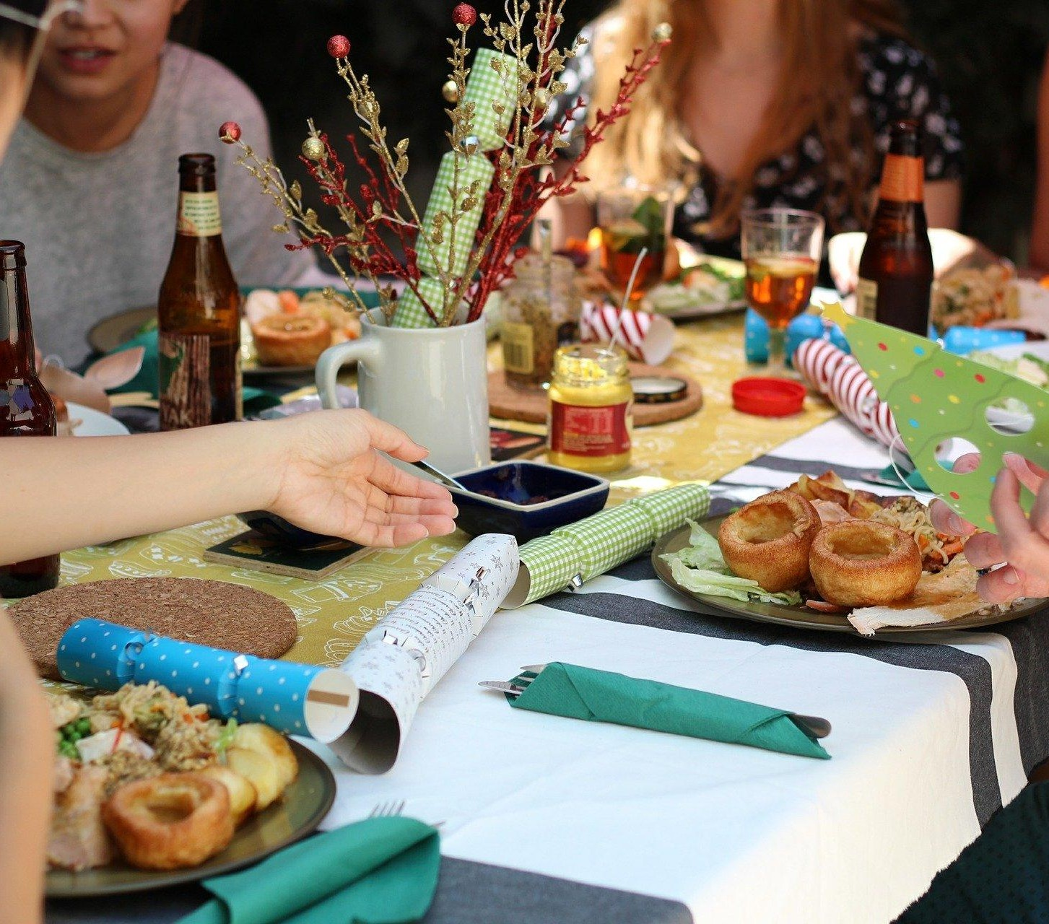










H
Hotel Casa Bella
Tuesday at 10.00 AM
H
Hotel Casa Bella
H
Hotel Casa Bella
Saturday at 12.00 PM
Wednesday at 02.15 PM
Join us for a magical Christmas party celebration with Santa at Hotel Casa Bella! Experience a truly traditional English Christmas with touch to our Indian heritage in the spectacular banqueting suites. Enjoy a fabulous fun ﬁlled festive with your loved ones, share the gift of happiness and create unforgettable memories in the heart of Bali.
Book Now: 0123456789
#HotelCasaBella #Bali #ChristmasCelebration #Festive #Xmas #Party #Luxury
New Year's Eve countdown and celebration at Hotel Casa Bella! Party away the ﬁnal night of the year in true style! Get ready to dazzle by joining us for an evening of entertainment! DJ to electrify the air, exciting games, unlimited food & alcohol, lucky draw for free stays, music and dance! Hurry up and book your seats before the slots run out!
Book Now: 0123456789
#HotelCasaBella #Bali #NewYearsEve #NewYear #NewYearsparty #Celebrations #Nightlife #NewYearsResolution #NewYears2020 #Goodbye2019 #Hello2020 #Happynewyear
Celebrate this Thanksgiving at Hotel Casa Bella with an evening full of bonding and delectable ﬂavours. Enjoy this festival with a scrumptious meal accompanied by your dear ones.
#HappyThanksgiving #HotelCasaBella #Bali #ThanksGivingDinner #Family #Friends #Food
152
Like
16 Comments 5 Shares
186
Like
24 Comments 15 Shares
131
Like
12 Comments 7 Shares
Comments
Share
Comments
Share
Comments
Share

Slide 20

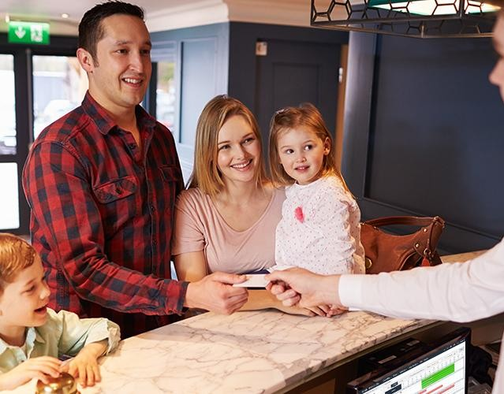
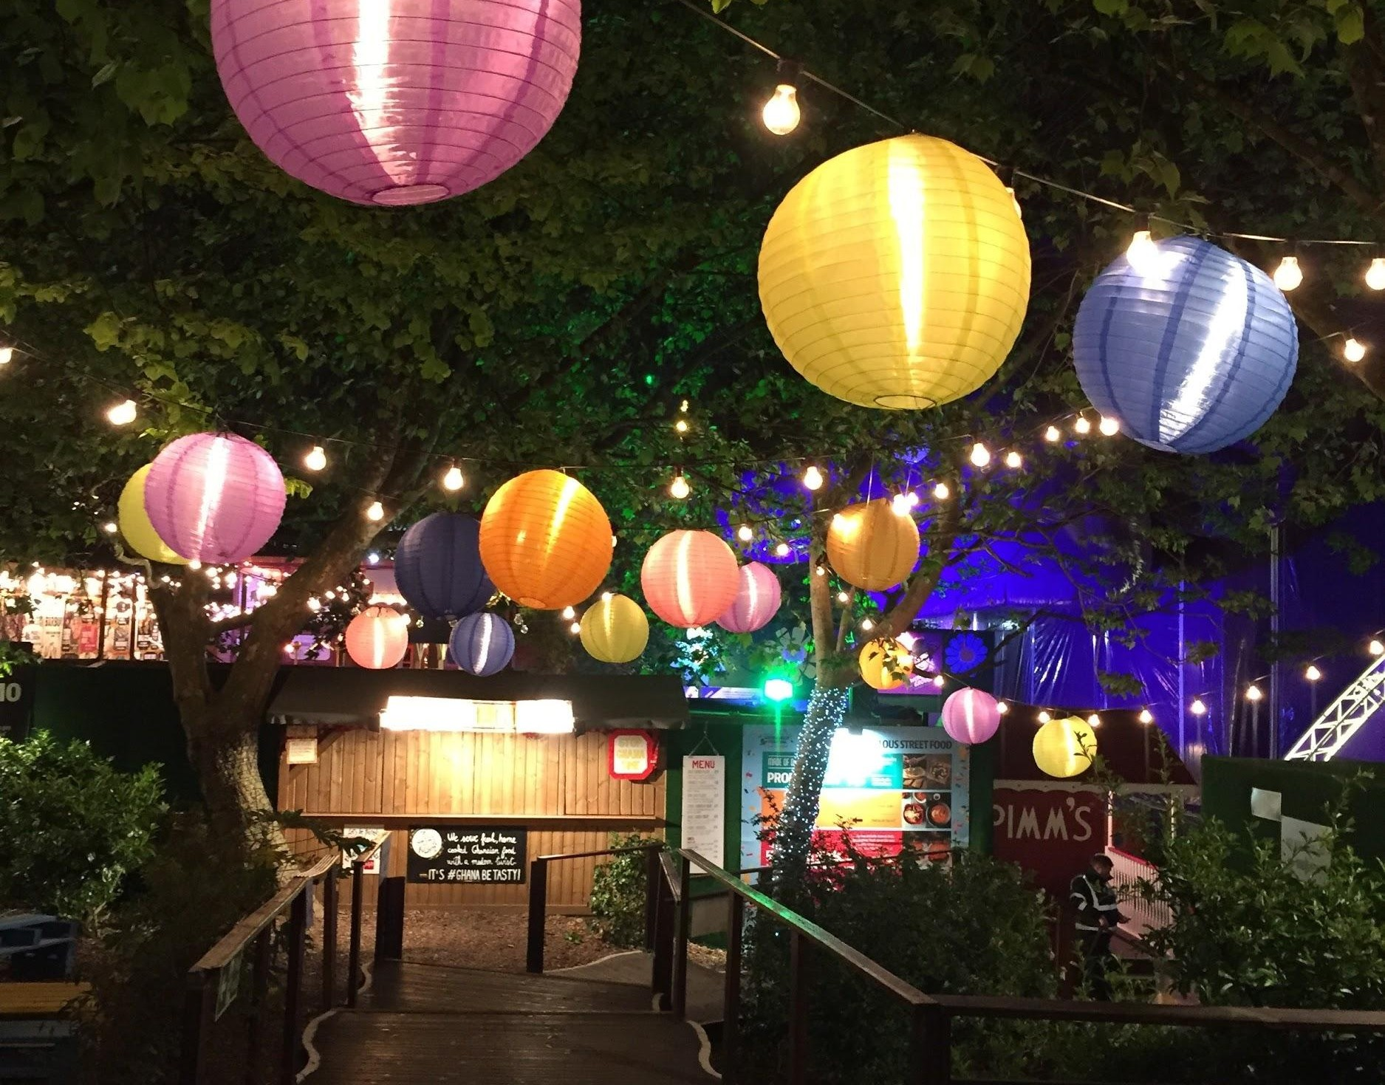









H
Hotel Casa Bella
Tourist Hotel
H
Hotel Casa Bella
Tourist Hotel
H
Hotel Casa Bella
Tourist Hotel
96 Likes View all 32 comments
Feeling the festive vibes as we get ready to welcome our guests for celebrating their holiday season! This Diwali, experience the warmth and joy of togetherness at @HotelCasaBella, Bali!
Book Now for #Diwali2020 : 0123456789 | Link in Bio!
#HotelCasaBella #Bali #Diwali2020 #HappyDiwali #Diwali #Celebrations #FestivalOfLights #BookNow
42 Likes View all 12 comments
Make your #ChristmasParty magical with us by booking your stay at @HotelCasaBella, Bali.
Book Now! Link in Bio!
#HotelCasaBella #Bali #ChristmasCelebration #Festive #Xmas #Party #LuxuryHotel
105 Likes View all 29 comments
This Halloween book your stay at @HotelCasaBella! Dance, drink, and dine with a spectacular view of Bali. The night features a buﬀet, live DJ, dance ﬂoors, full bars, a costume contest, giveaways, and more.
Happy Halloween! Link in Bio!
#HappyHalloween #HotelCasaBella #Bali #FunFilledEvening #BookNow

Slide 21
Exclusive Oﬀer and Service Posts for Facebook
Templates:
Hashtags:
# [HotelName]
# [Location]
#StayinStyle
#BestHotelDeals
#LuxuryHotels
#BookNow
#SpaService
#HolidaySeason
#HotelRoom#HotelPool
[Hotel Name] welcomes you to encounter, a perfect hideaway. Book now and let our in room dining facilities be the best excuse for you to enjoy in luxe.
Travelers looking to beat the heat in [location] can relax and rejuvenate with unique Spa services oﬀered at [hotel name].
No matter how far you travel to, reconnect with your loved ones this holiday season, with our [room type] and [room type] at [hotel name], [location].
An oﬀer so good, you just don’t want to miss out on - pay only for 2 nights and stay for 3!
Enjoy chilled beer sitting by the pool. Book your stay and get access to the inﬁnite pool at [hotel name], [location].
NOTE: The content in [brackets] is variable. Please modify it according to your requirement.

Slide 22
Exclusive Oﬀer & Service Posts for Instagram
Templates:
Hashtags:
Exclusive Villas built in harmony with nature! at @
[location].
[hotelname],
# [HotelName]
# [Location]
#LuxuryHotel
#Villas
#Vacation
#LuxuryHotels
#BookNow
#Spa
#Pool
#StayInStyle
#SpecialService
#HotelPool
Breakfast in Bed, lunch by the pool or self-care at the Spa?
Plunge into the pool while you take in the beautiful sunset view from @[hotelname], [location].
A special candle light dinner for that perfect moment to reconnect with your loved one @[hotelname].
From sweet treats to fun-ﬁlled outdoor games, there are great surprises at every corner for your little ones at @[hotelname]
Book your weekend stay at @ [hotelname] now. Link in bio!
NOTE: The content in [brackets] is variable. Please modify it according to your requirement.

Slide 23

Examples of Exclusive Oﬀer and Service Posts:
See how we mixed and matched templates!

Slide 24
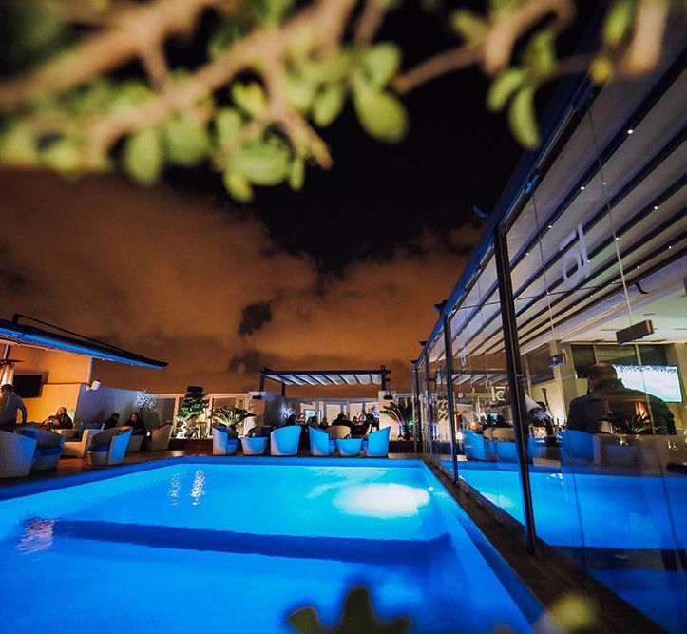
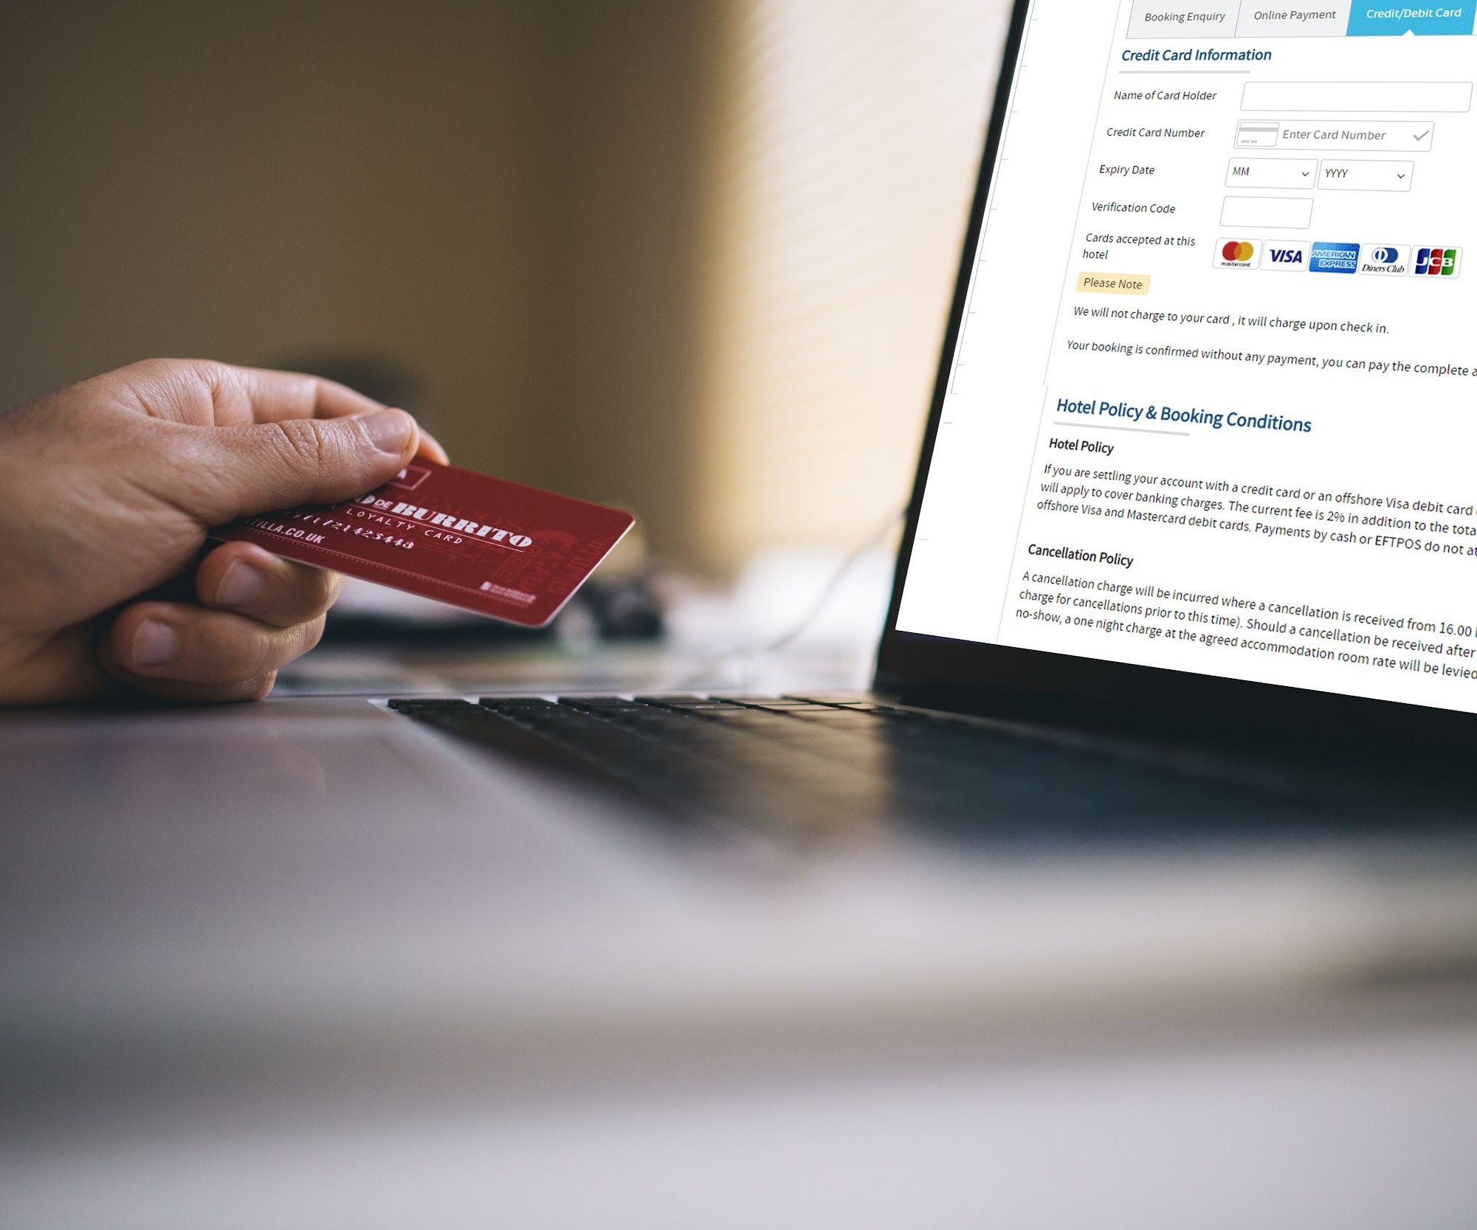
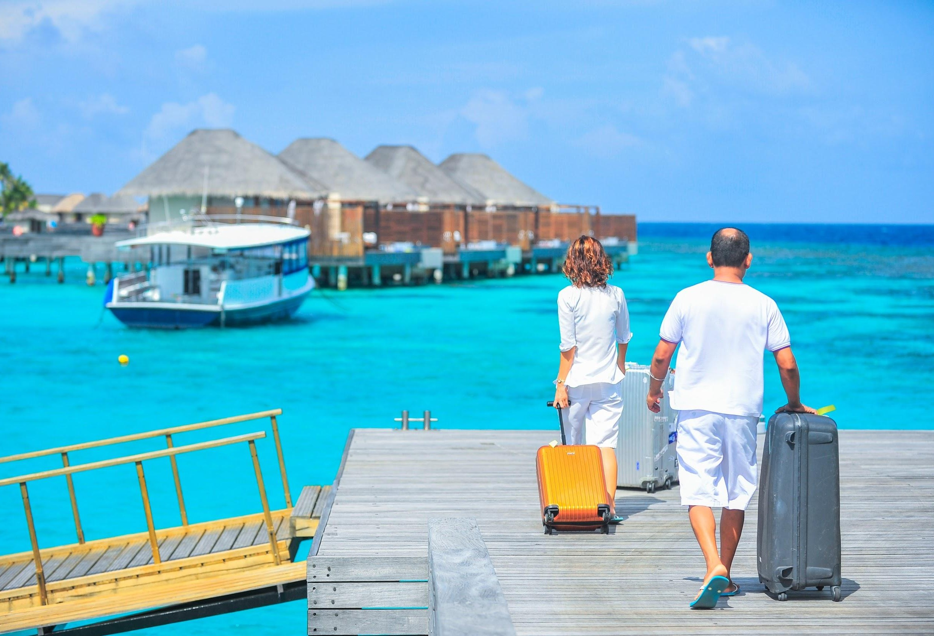
H
Hotel Casa Bella
Monday at 01.55 PM
H
Hotel Casa Bella
Tuesday at 11.35 AM
H
Hotel Casa Bella
Saturday at 10.30 AM
No matter how far you travel to, reconnect with your loved ones this holiday season, with our apartment-style spaces and residential-like settings at Hotel Casa Bella, Bali. Feel like a home away from home!!
Book your stay now and avail 10% discount.
0123456789 | www.casabellabali.com
#HotelCasaBella #Bali #Travel #HolidaySeason #HotelRoom #BestDeals #Discount #BookNow #BestOﬀers
Home is where the Pool is! What’s better than enjoying chilled beer sitting by the pool.
Book your stay and get access to the inﬁnite pool at Hotel Casa Bella, Bali.
0123456789 | www.casabellabali.com
#HotelCasaBella #Bali #HotelPool #Pool #Poolside #StayInStyle
An oﬀer so good, you just don’t want to miss out on - pay only for 2 nights and stay for 3! Grab this exciting deal when you book your stay at Hotel Casa Bella, Bali.
#HotelCasaBella #Bali #HotelRoom #Travel #Stay3Pay2 #Hotels #Travel
122
Like
11 Comments 5 Shares
74
Like
6 Comments 1 Shares
155
Like
18 Comments 9 Shares
Comments
Share
Comments
Share
Comments
Share

Slide 25
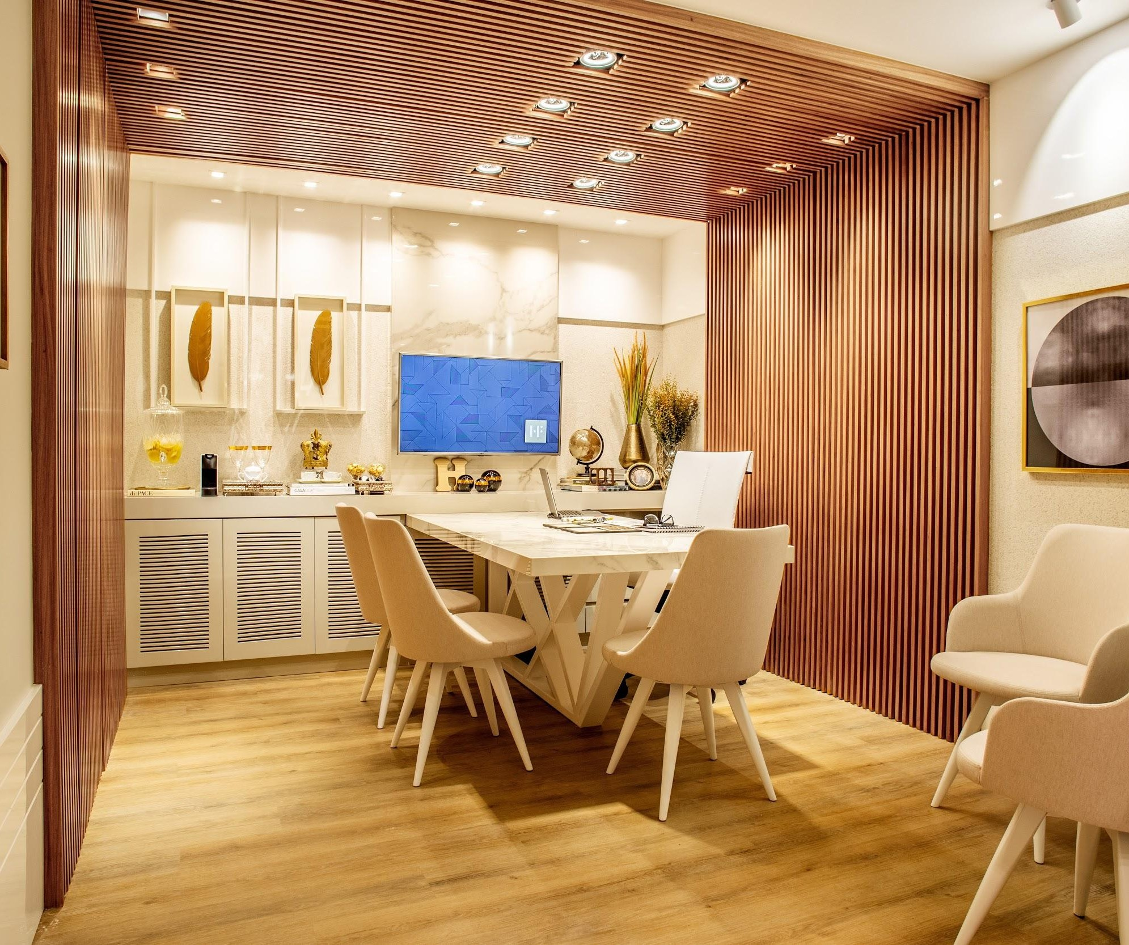
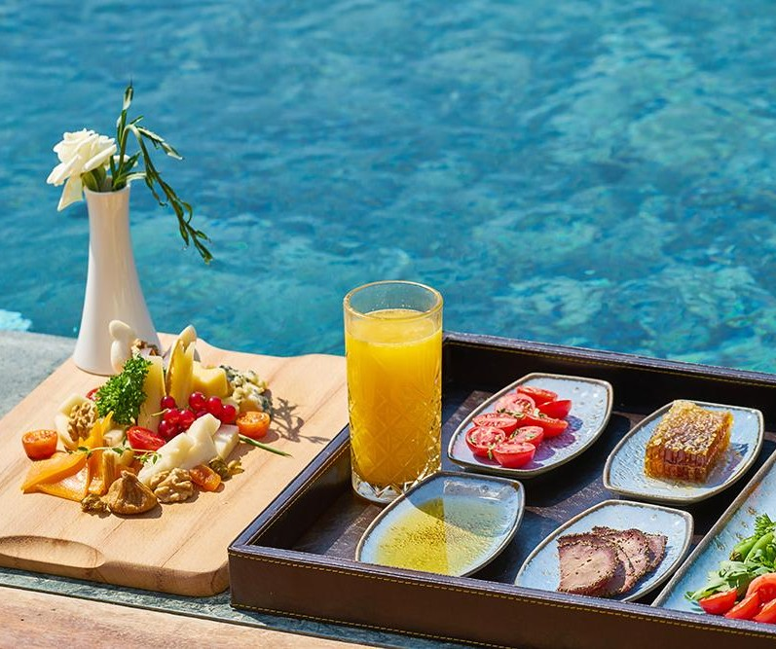





H
Hotel Casa Bella
Tourist Hotel
H
Hotel Casa Bella
Tourist Hotel
H
Hotel Casa Bella
Tourist Hotel
96 Likes View all 32 comments
Exclusive Villas built in harmony with nature! Experience a distinct blend of sustainability and luxury when you vacation at @HotelCasaBella, Bali.
Plan your holiday now! Book your stay, link in bio. #HotelCasaBella #Bali #LuxuryHotel #Villas #Travel #Vacation
42 Likes View all 12 comments
Breakfast in Bed, lunch by the pool or self-care at the Spa? What’s your staycation motivation? Book your weekend stay now at @HotelCasaBella. Link in bio!
#HotelCasaBella #Bali #LuxuryHotel #Spa #Pool #Relax #Experience #BookNow
105 Likes View all 29 comments
A special candle light dinner for that perfect moment to reconnect with your loved one @HotelCasaBella. Book your stay now, link in bio.
#HotelCasaBella #Bali #BookNow #CandleLightDinner #SpecialService

Slide 26
Location Posts for Facebook
Templates:
Hashtags:
View so nice, you would want to look twice.
Let our beautiful [view name] patio at [hotel name] take your next celebratory meal from great to sublime!
A room with a great view is just the kind of motivation you need in life!
A barefoot walk along the sandy shore is truly among the most pleasurable experiences you’ll ever have.
Mesmerizing landscapes await to embrace you at [hotel name]
A closer look at the beauty of God’s own country! Explore the best of nature at [hotel name]
# [HotelName]
# [Location]
#Travel
#View
#BestLocation
#BookNow
#DeliciousMeal
#Beach
#Ocean
#Nature
NOTE: The content in [brackets] is variable. Please modify it according to your requirement.

Slide 27
Location Posts for Instagram
Templates:
Hashtags:
Blue skies, azure waters and soft sands are just a few of the many luxuries awaiting for you at @[hotelname], [location]
Say hello to blue skies and the ultimate room with a view when you stay with us at @[hotelname], [location].
Book your stay now with us for the best rates, Link in bio!
What’s your idea of a perfect holiday? Quiet green paths with the sound of the sea for company @[hotelname]
Get ready to spend your holiday by the ocean/sea @ [hotelname], [location]!
# [HotelName]
# [Location]
#Travel
#BestView
#HotelLuxury
#Nature
#Wanderlust
#Vacation
#SightSeeing
#Beach
#LifeByTheOcean
#Nature
NOTE: The content in [brackets] is variable. Please modify it according to your requirement.

Slide 28
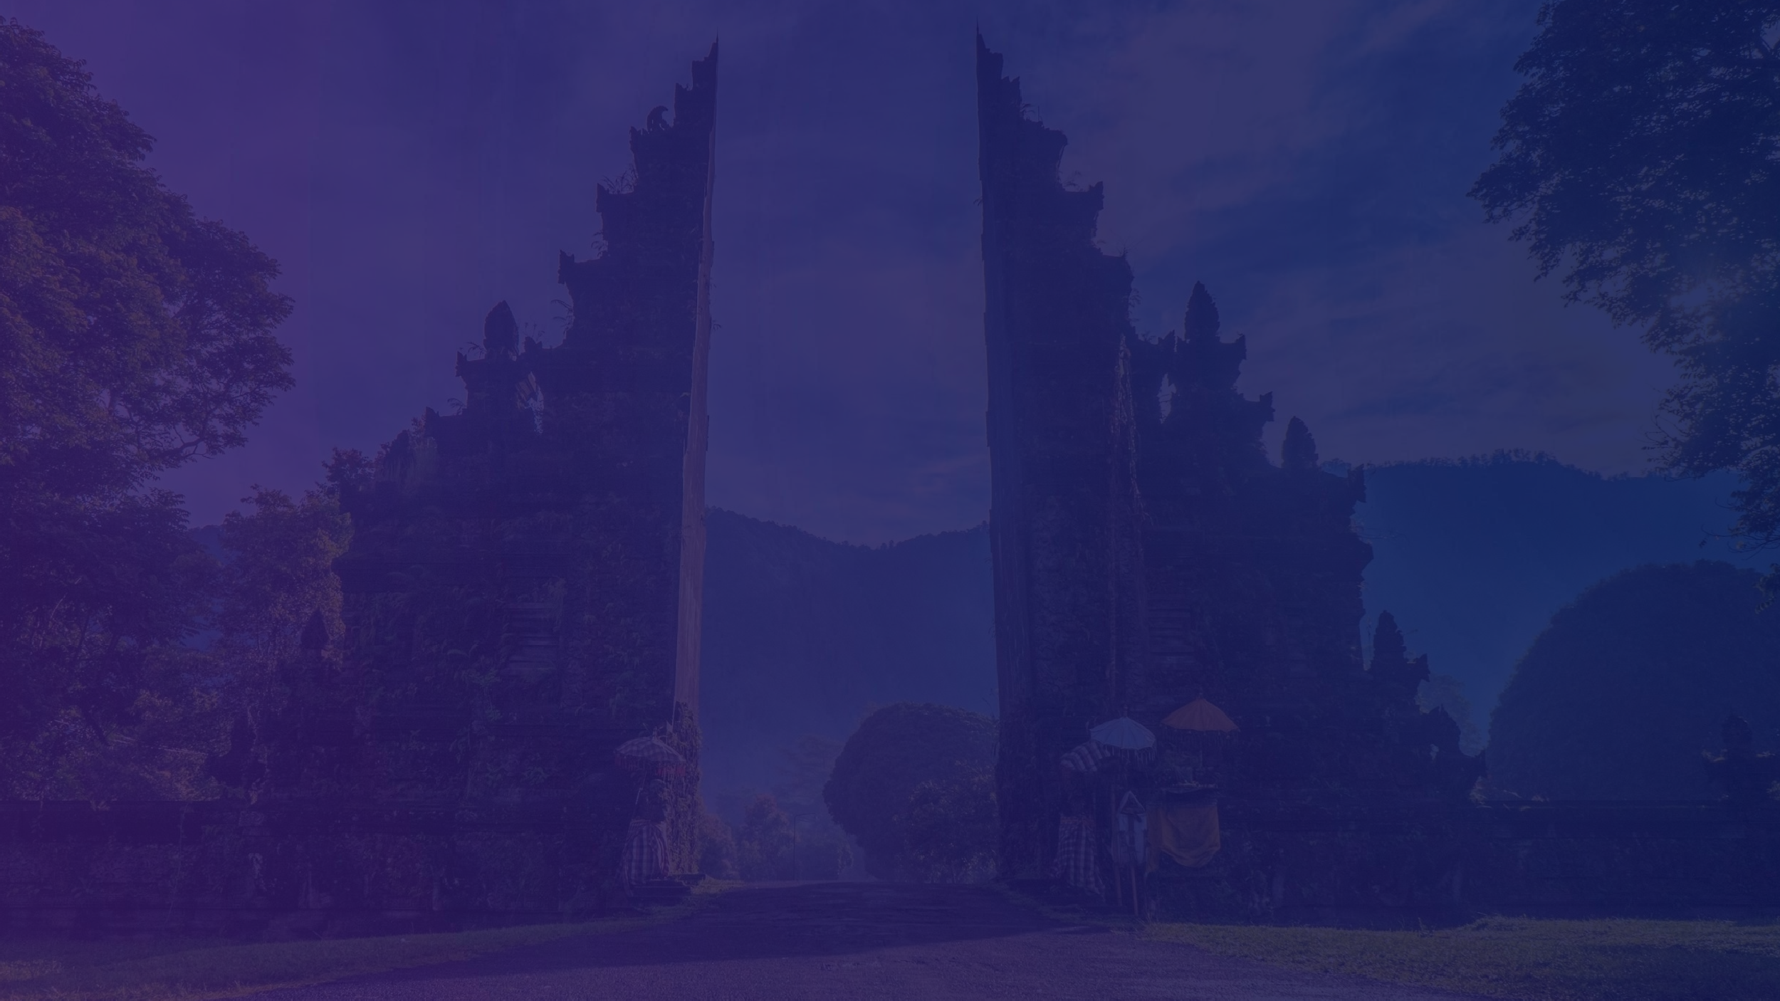
Examples of Location Posts:
See how we mixed and matched templates!

Slide 29
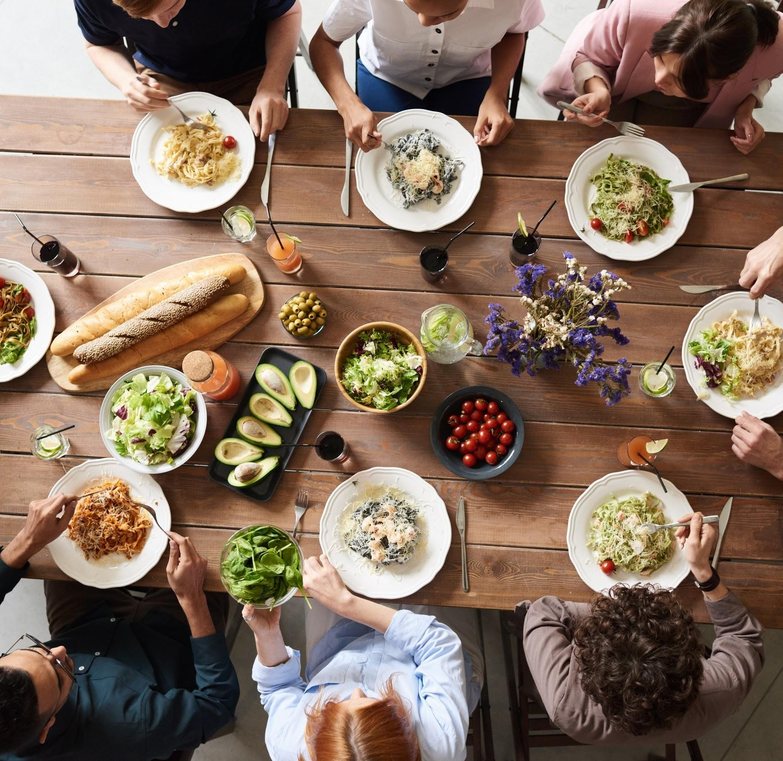
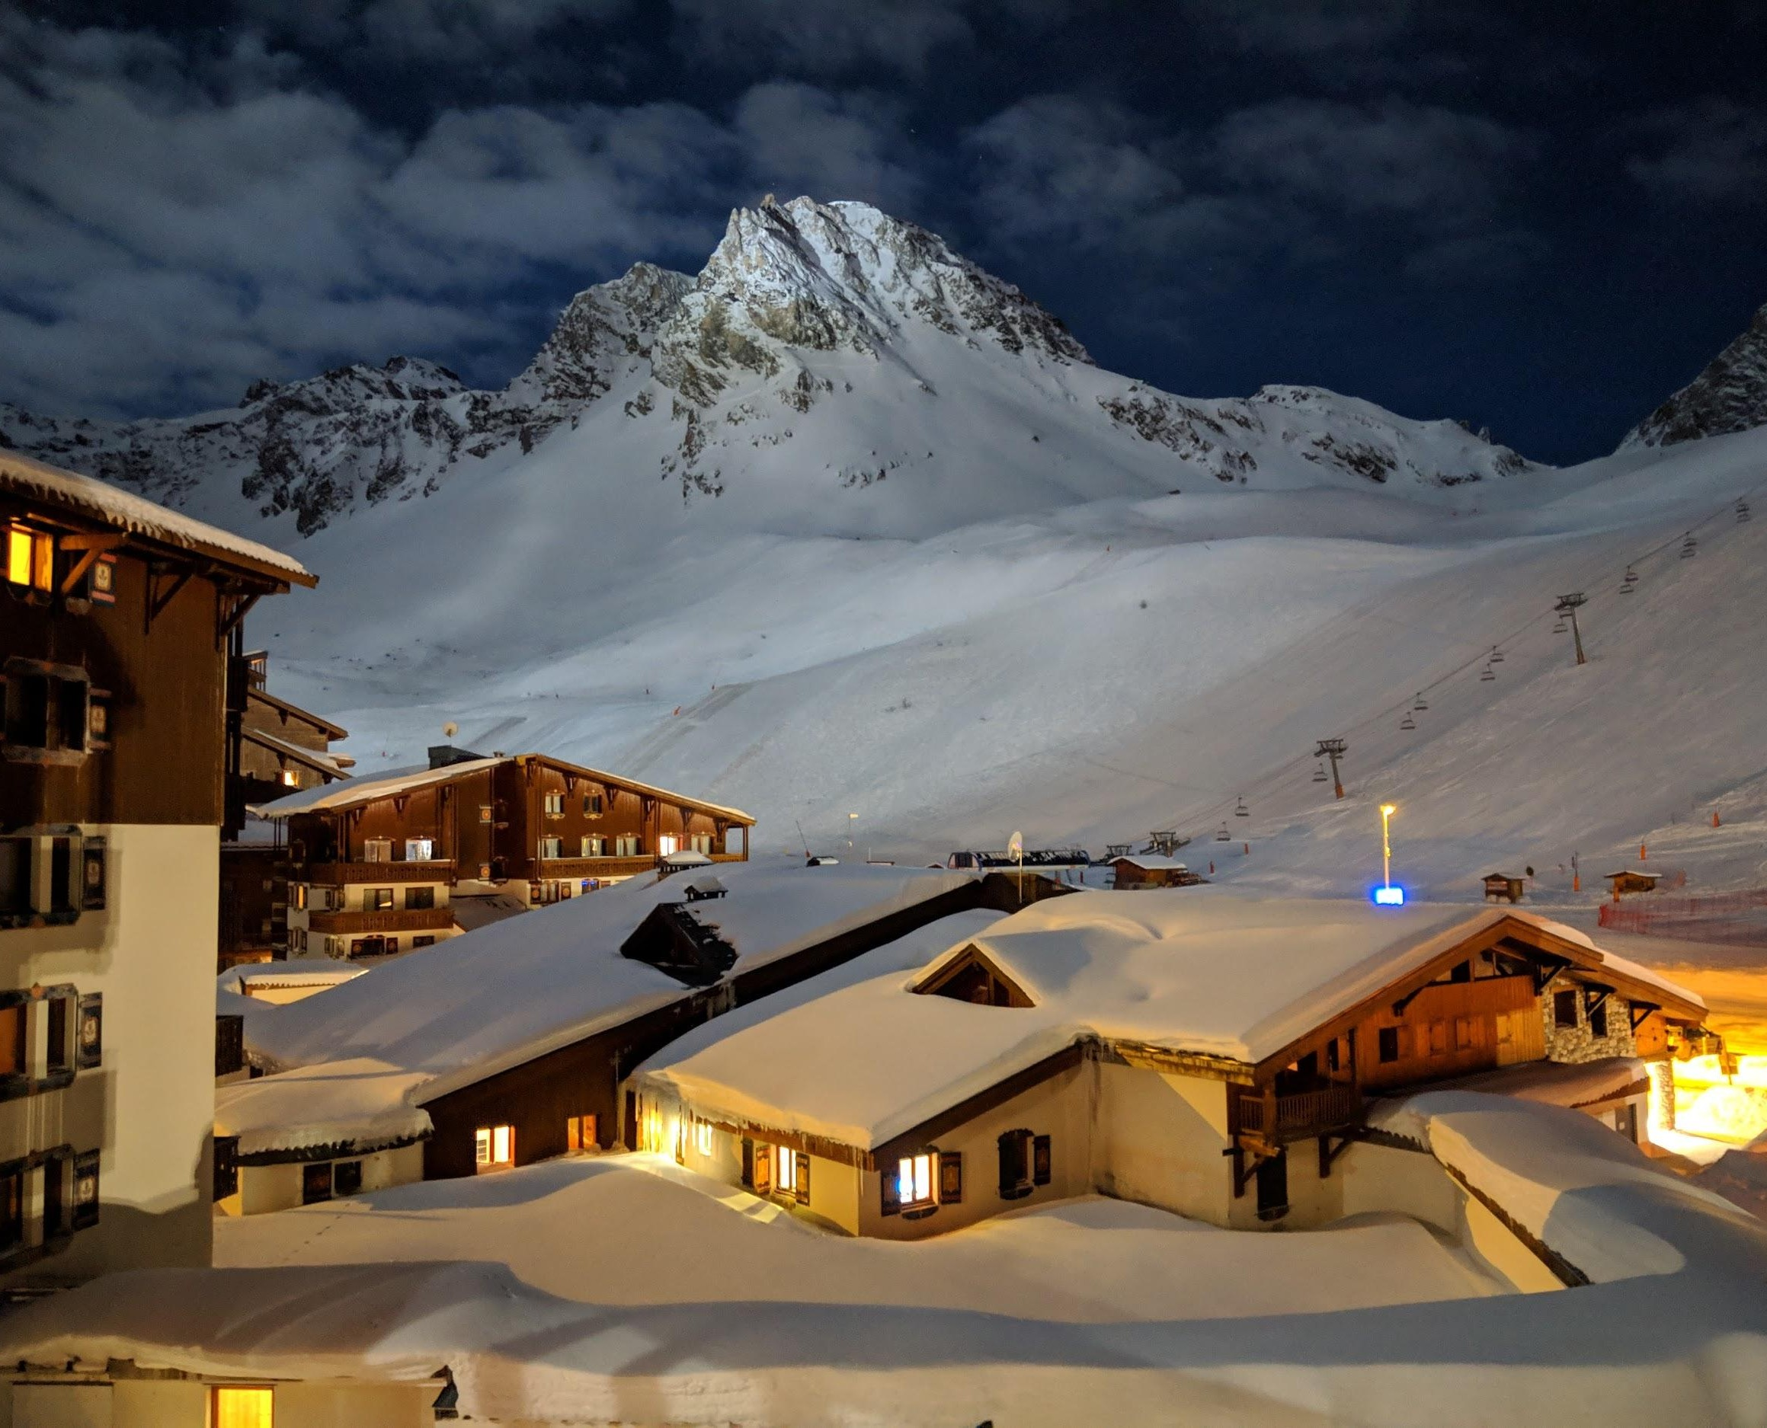
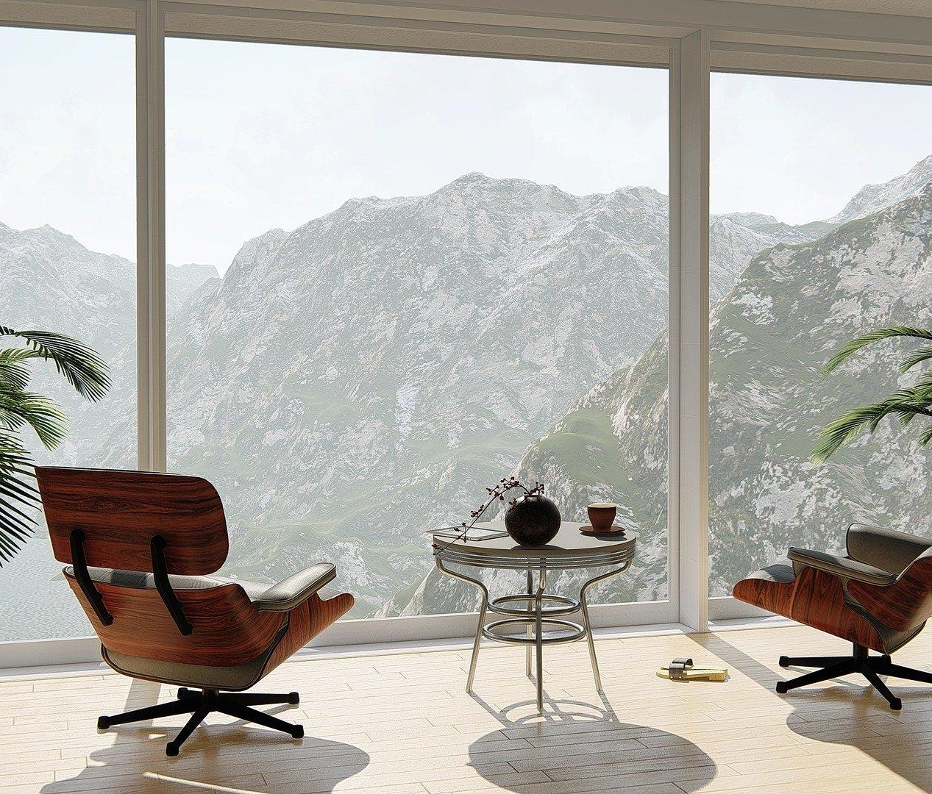
H
Hotel Casa Bella
Monday at 01.55 PM
H
Hotel Casa Bella
H
Hotel Casa Bella
Tuesday at 11.35 AM
Saturday at 10.30 AM
View so nice, you would want to look twice. Feast your eyes on the iconic Mountains, when you stay at Hotel Casa Bella, Bali.
Explore the city right at your doorstep, book your stay today!
www.casabellabali.com
Let our beautiful sea-facing patio at Hotel Casa Bella
take your next celebratory meal from great to sublime!
Book your stay now: www.casabellabali.com
A room with a great view is just the kind of motivation you need in life!
Book your stay now at Hotel Casa Bella, Bali! www.casabellabali.com
#HotelCasaBella #Bali #Hotel #Travel #View #BookNow
136
Like
28 Comments 13 Shares
118
Like
21 Comments 8 Shares
113
Like
6 Comments 2 Shares
Comments
Share
Comments
Share
Comments
Share

Slide 30
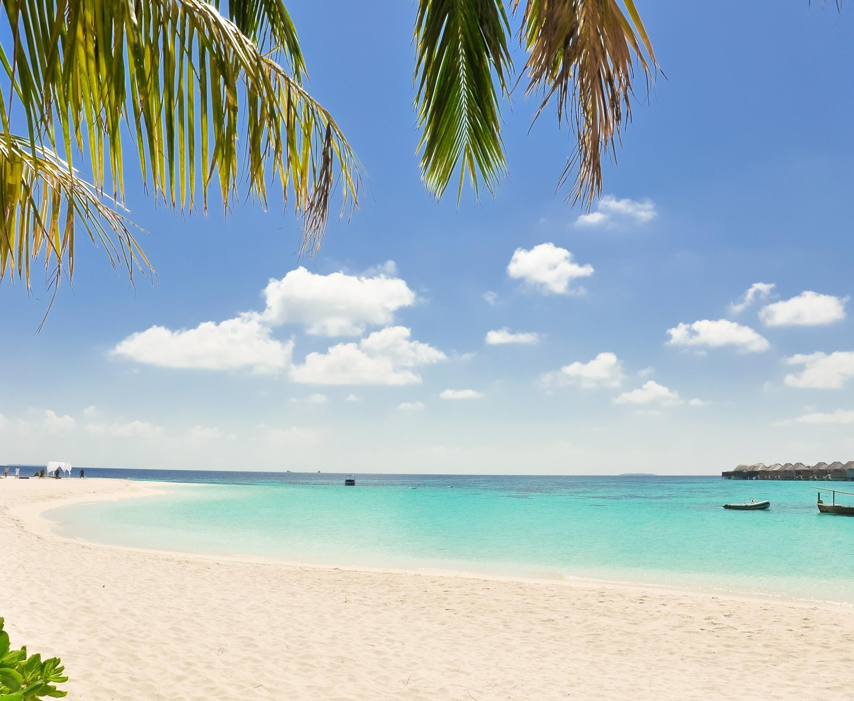
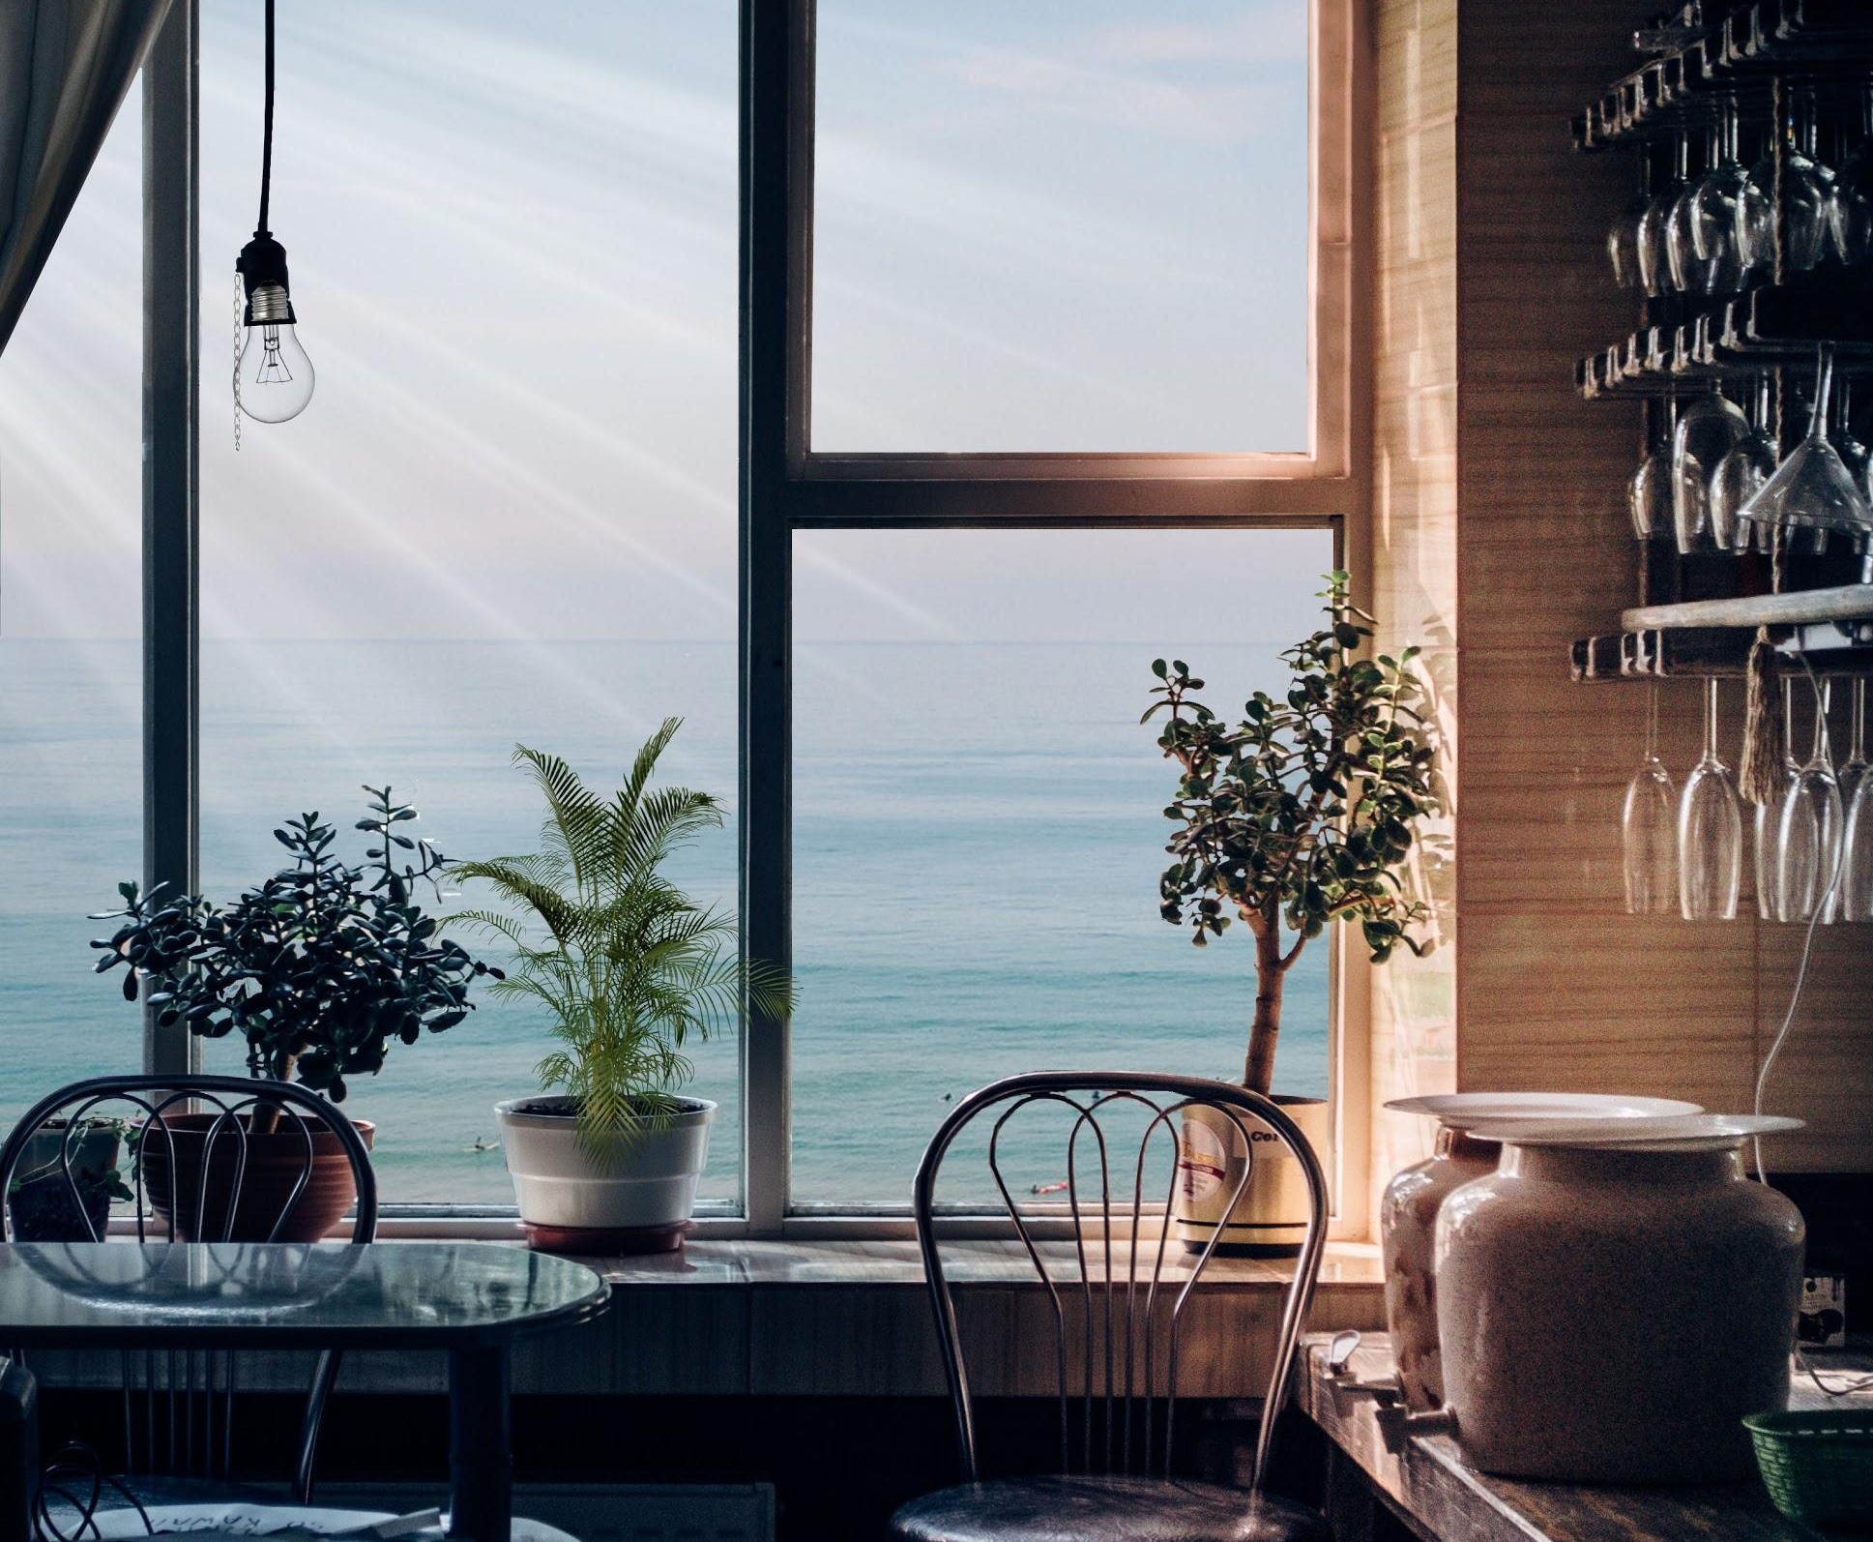
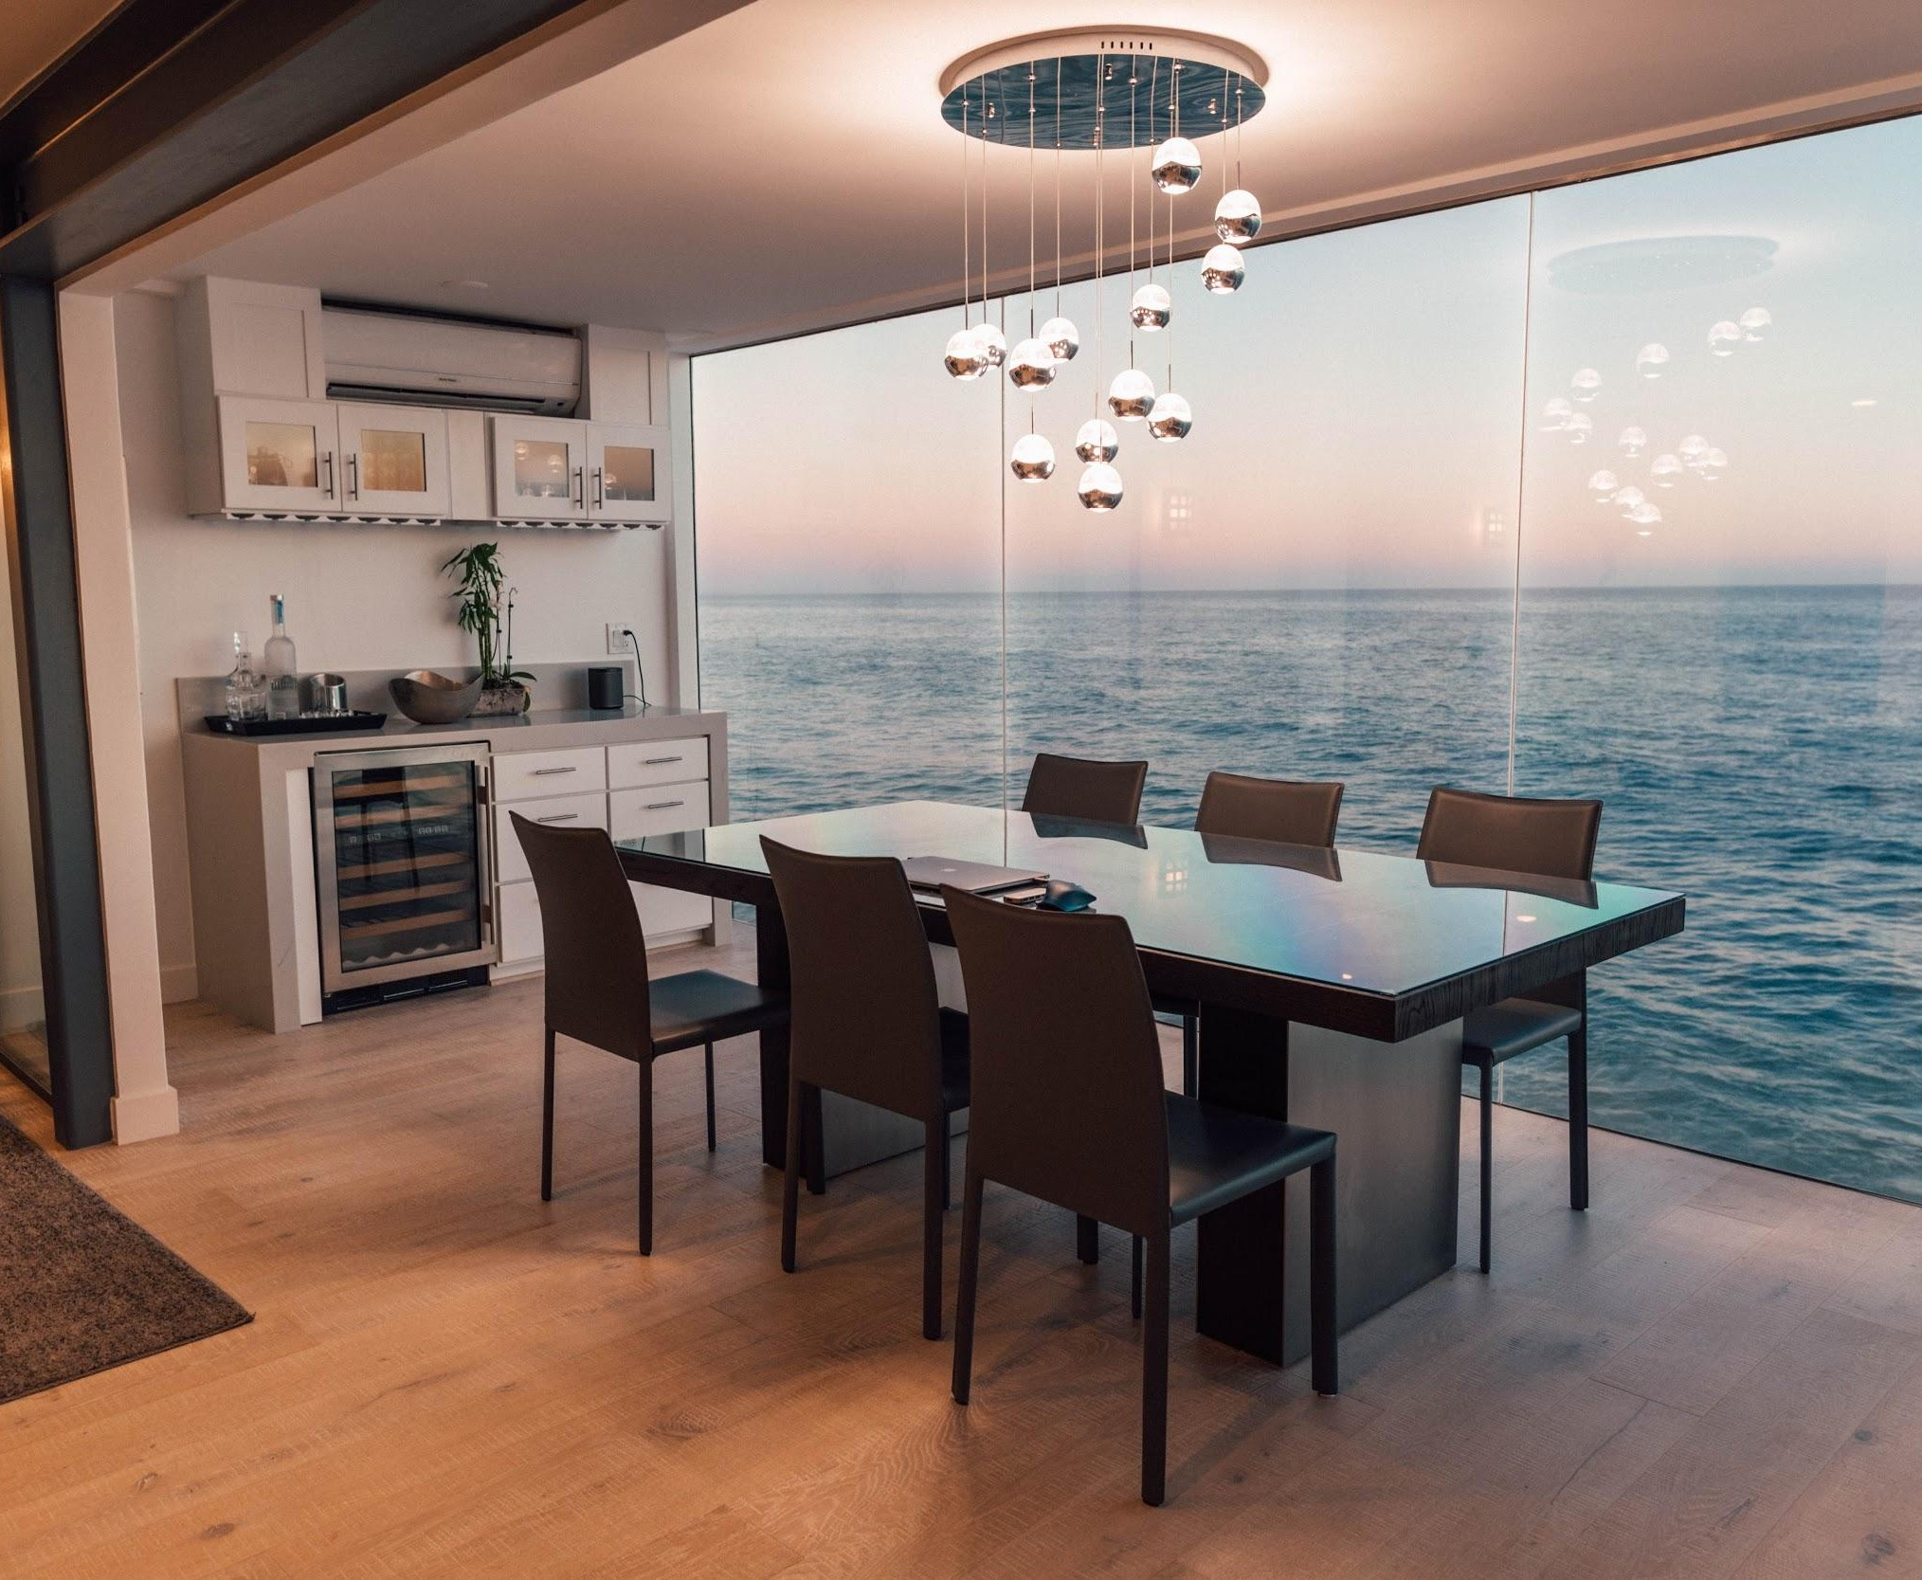
H
Hotel Casa Bella
Tourist Hotel
H
Hotel Casa Bella
Tourist Hotel
H
Hotel Casa Bella
Tourist Hotel
78 Likes View all 19 comments
Blue skies, azure waters and soft sands are just a few of the many luxuries awaiting for you at @HotelCasaBella, Bali.
Book Now! Link in Bio!
#HotelCasaBella #Bali #BestView #HotelRoom #HotelLuxury
92 Likes View all 13 comments
Quiet green paths with the sound of the sea for company. If this is your idea of a perfect holiday then visit @HotelCasaBella, Bali.
Book your stay now, link in bio.
#HotelCasaBella #Bali #BestView #Greenery #HotelRoom #HotelLuxury
108 Likes View all 32 comments
Salty breeze and sandy toes! Get ready to spend your holiday by the sea @HotelCasaBella, Bali. Book your stay now, link in bio. #HotelCasaBella #Bali #Sea #Beach #Vacation
#LifeByTheOcean

Slide 31
Event Posts for Facebook
Templates:
Hashtags:
Experience a fairytale wedding at the [hotel name], [location] by the beaches imprinted with romance for a lifetime.
You dream it, we execute it.
[Event name] night | Get ready to witness the city’s rising artists take over our #UnpluggedSessions at [hotel name], [location] this weekend!
For reservations: [phone number] | [direct link]
Holding big events for your business wouldn’t be a hassle anymore.
[Hotel name] is the ideal choice to plan out your next business meeting.
For you we have, big spaces for big events!
# [HotelName]
# [Location]
#Wedding
#DestinationWedding
#UnpluggedSessions
#HotelSuite
#FunFilledEvening
#CorporateEvents
#BusinessHotel
#BusinessMeeting
#BookNow
#MusicConcert
#CookingWorkshop
# [EventType]
NOTE: The content in [brackets] is variable. Please modify it according to your requirement.

Slide 32
Event Posts for Instagram
Templates:
Hashtags:
Choose gorgeous wedding venues that will leave you love-struck, at the @[hotel name], [location]
Enjoy [event name] Night every #SaturdayEvening @[hotelname],
[Location]
Plan out your next business event with @ [hotelname], [location]
and experience our heartwarming customer service!
We believe in turning your ideas into reality.
Book your corporate events with us @ [hotelname]
Planning to host a party for your special occasion? @ [hotelname] is the perfect destination to do so!
# [HotelName]
# [Location]
#WeddingDay
#DestinationWedding
#SaturdayEvening
#HotelSuite
#CorporateEvents
#BusinessEvent
#HotelRoom
#Destination
NOTE: The content in [brackets] is variable. Please modify it according to your requirement.

Slide 33

Examples of Event Posts:
See how we mixed & matched templates!

Slide 34
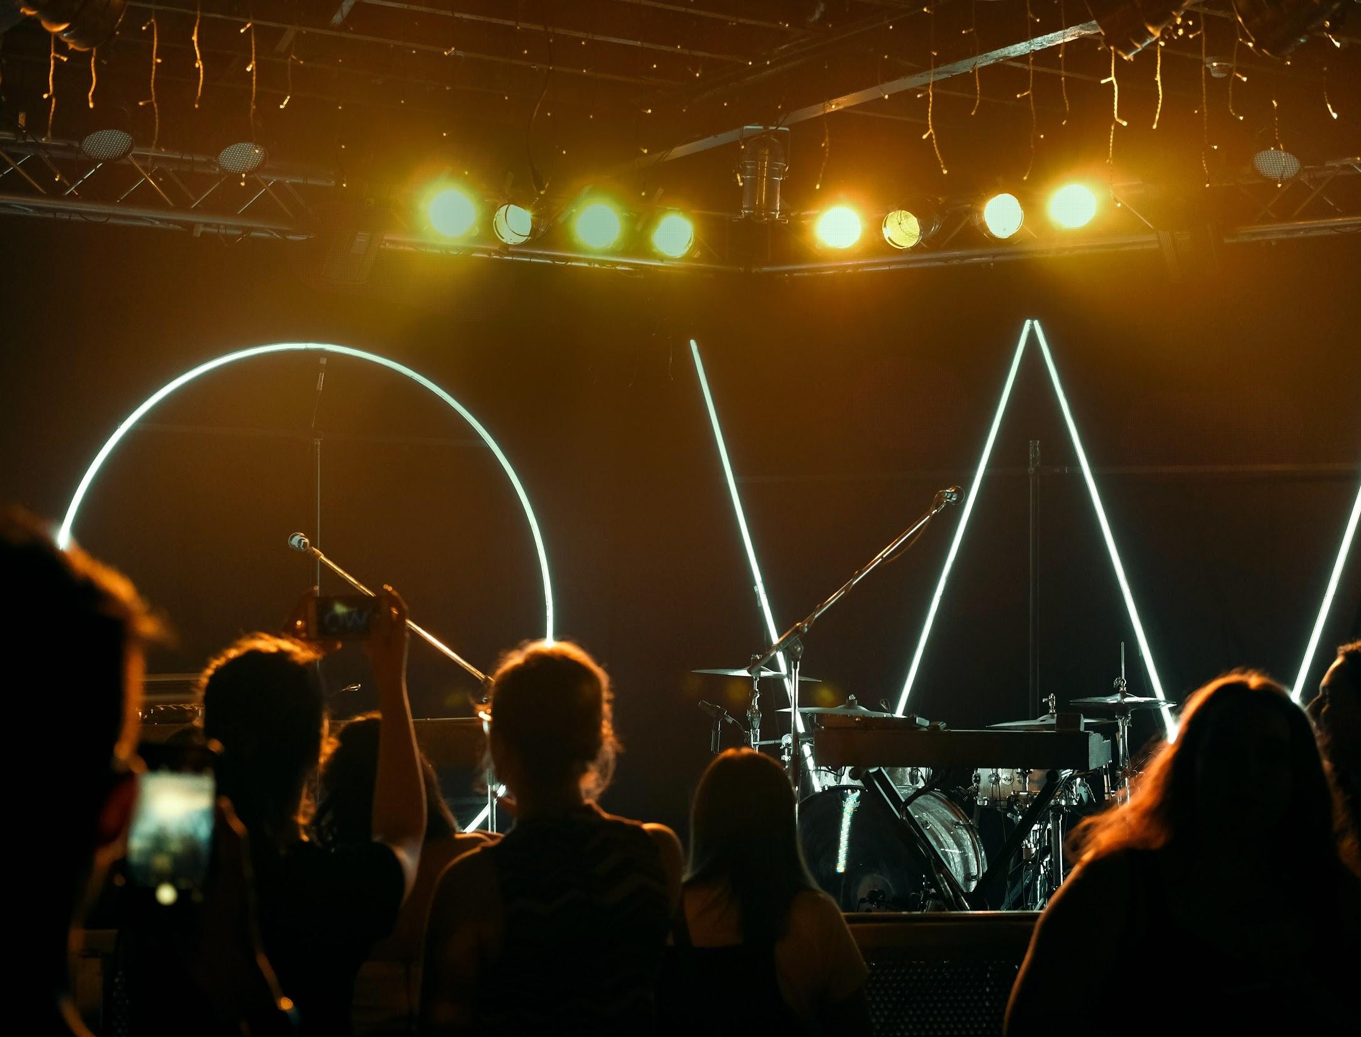
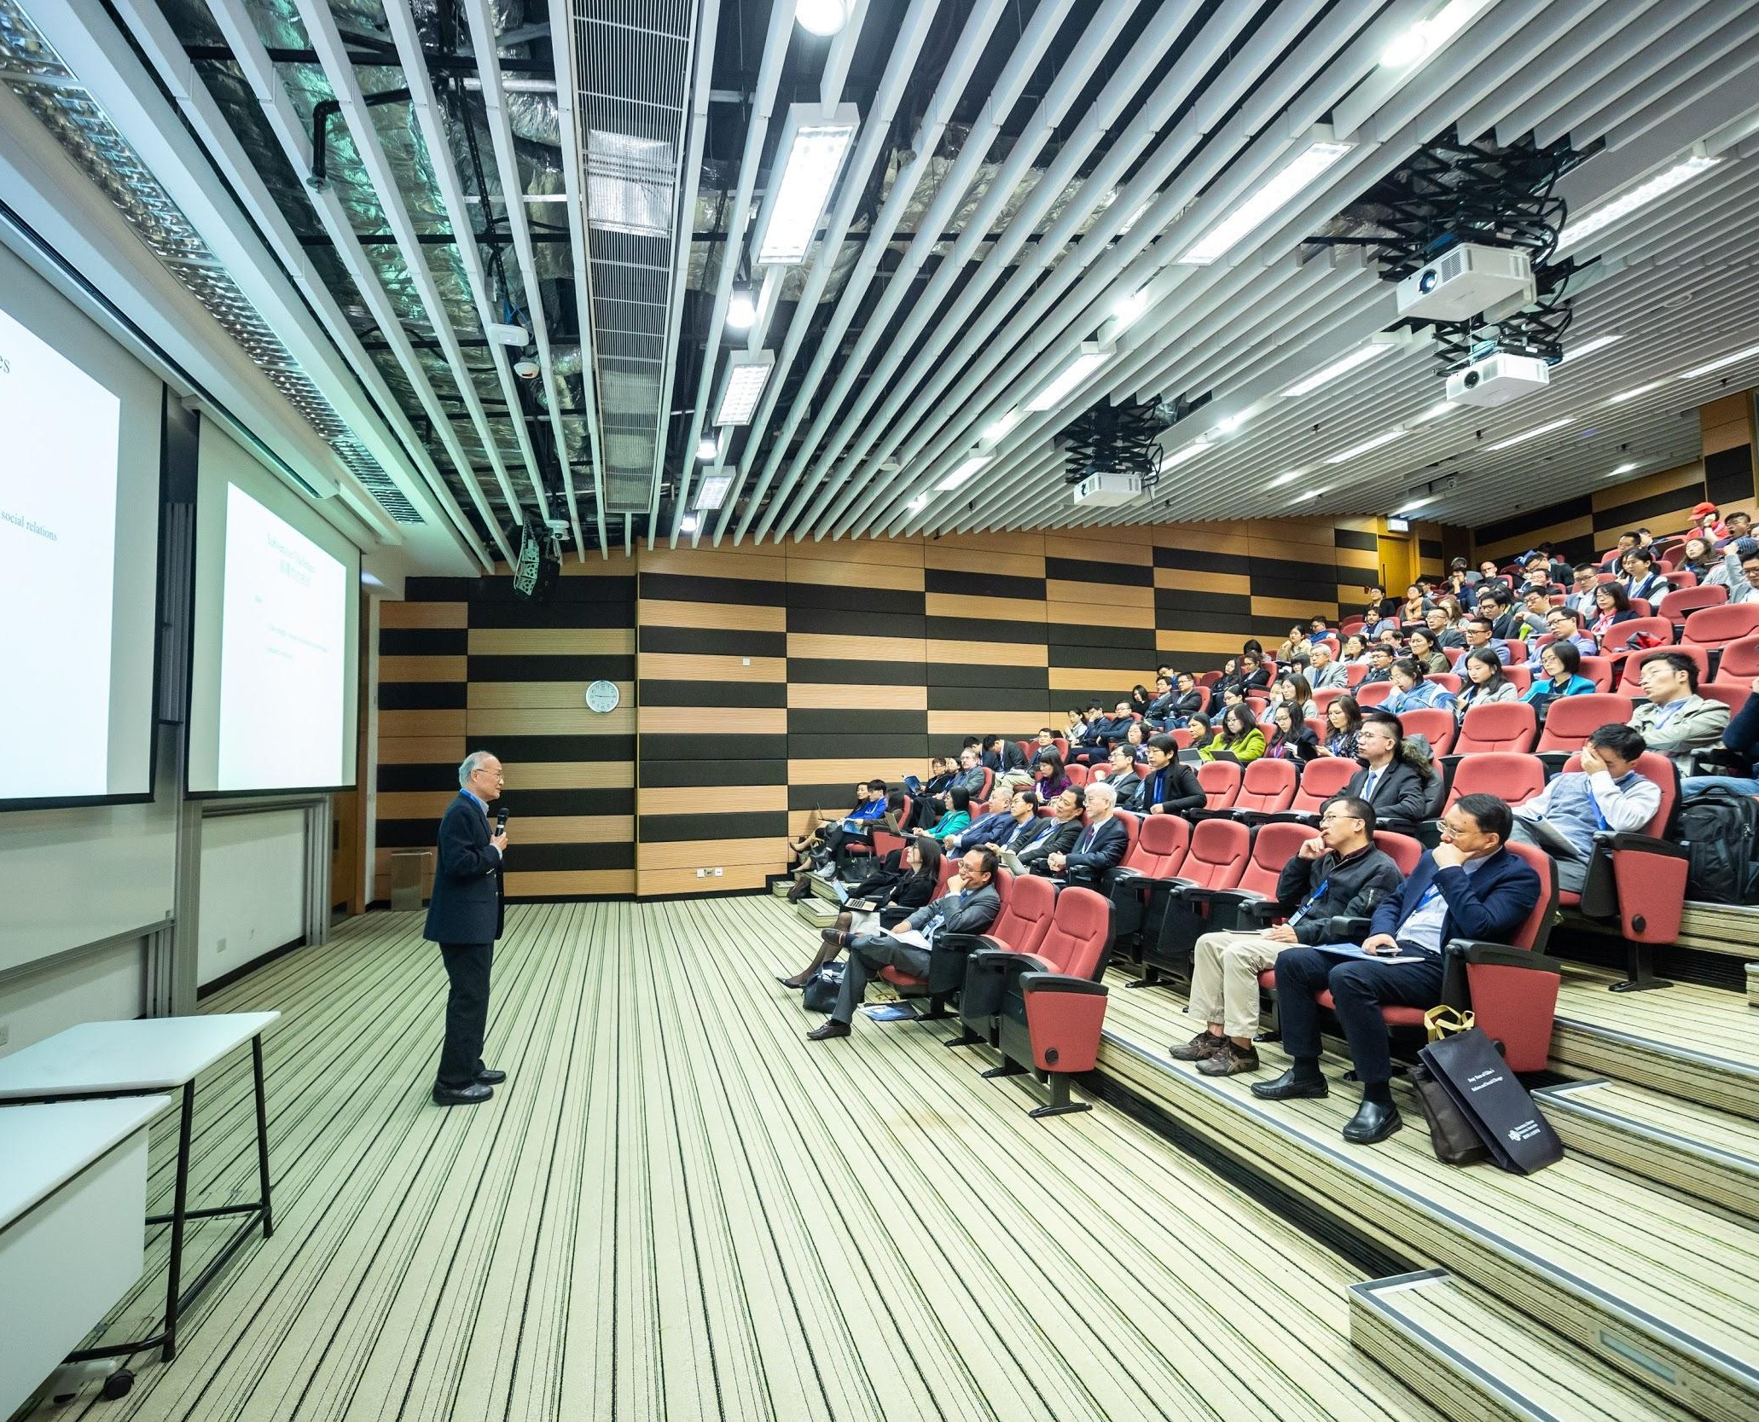
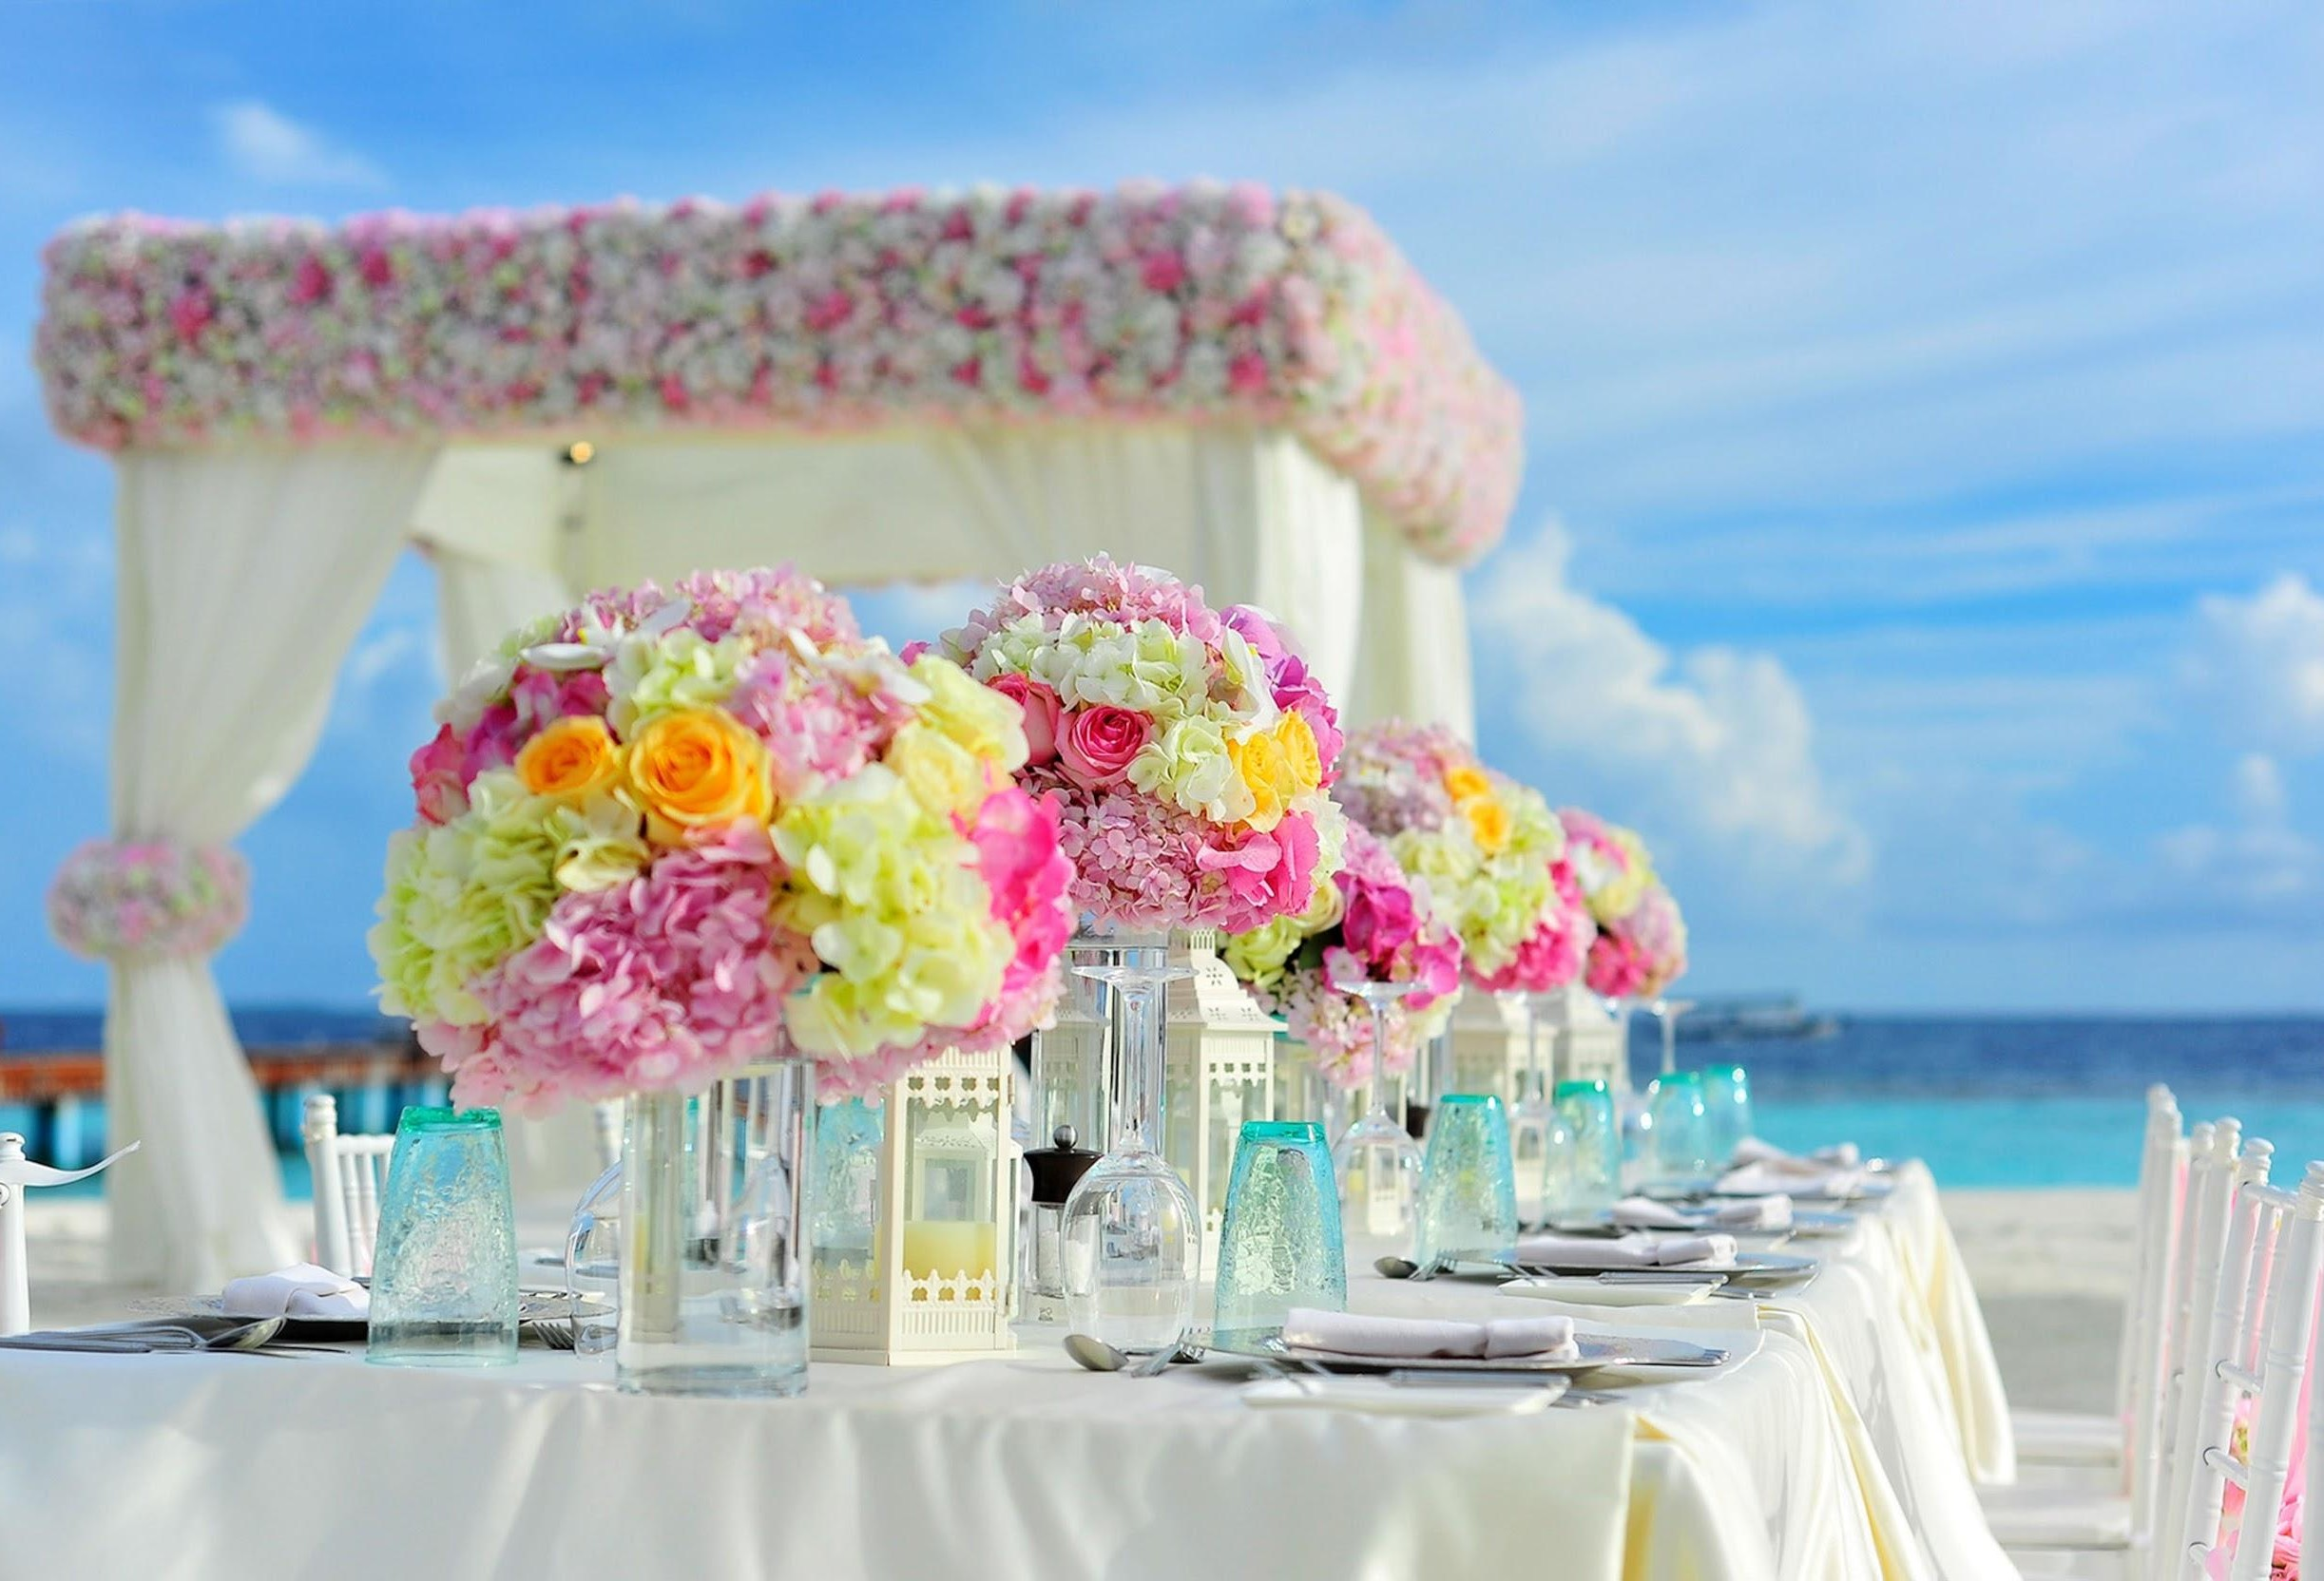
H
Hotel Casa Bella
Monday at 01.55 PM
H
Hotel Casa Bella
H
Hotel Casa Bella
Tuesday at 11.35 AM
Saturday at 10.30 AM
Experience a fairytale wedding at the Hotel Casa Bella, Bali by the beaches imprinted with romance for a lifetime. Book your stay and make your dream of the ultimate destination wedding come true. You dream it, we execute it.
.
For details call us on: 0123456789
#HotelCasaBella #Bali #Wedding #DestinationWedding #WeddingDay #Hotels #BestDestination #Food&Drinks #HotelSuite
Jam night | Ready to witness the city’s rising artists take over our #UnpluggedSessions at Hotel Casa Bella, Bali this weekend?
Book your stay now and sing along to the melodies of the DJ Caleb.
For reservations: 0123456789 | www.casabellabali.com
#HotelCasaBella #Bali #FunFilledEvening #HotelBar #Music #Singing #HotelRoom #BookNow
Holding big events for your business wouldn’t be a hassle anymore. Located at the best location of Bali, Hotel Casa Bella is the ideal choice to plan out your next business meeting.
For you we have, big spaces for big events!
Book now: 0123456789 | www.casabellabali.com
#HotelCasaBella #Bali #LuxuryHotels #MadeForBusiness #BusinessHotel #BusinessMeeting #Conference
136
Like
28 Comments 13 Shares
118
Like
21 Comments 8 Shares
113
Like
6 Comments 2 Shares
Comments
Share
Comments
Share
Comments
Share

Slide 35
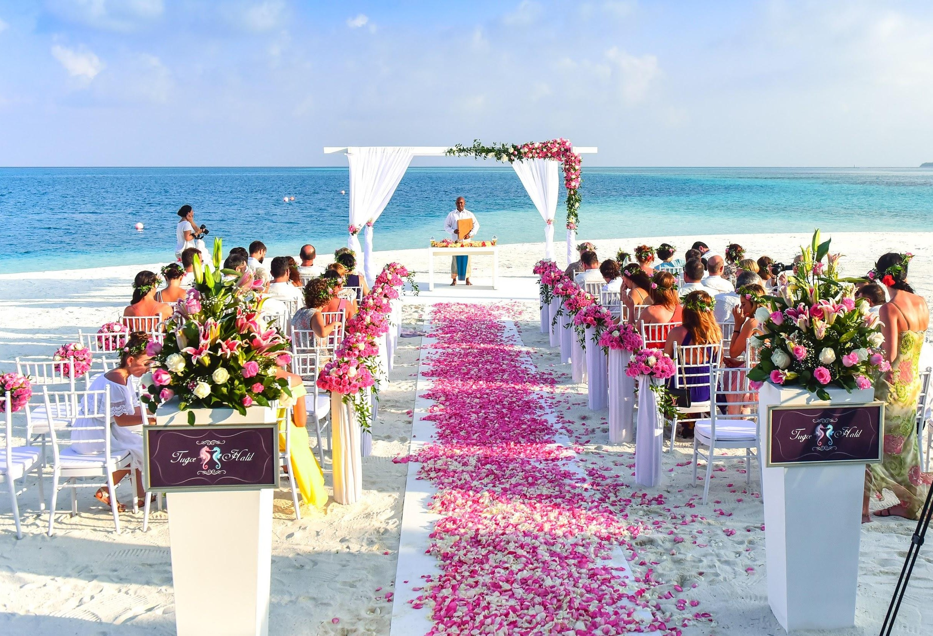
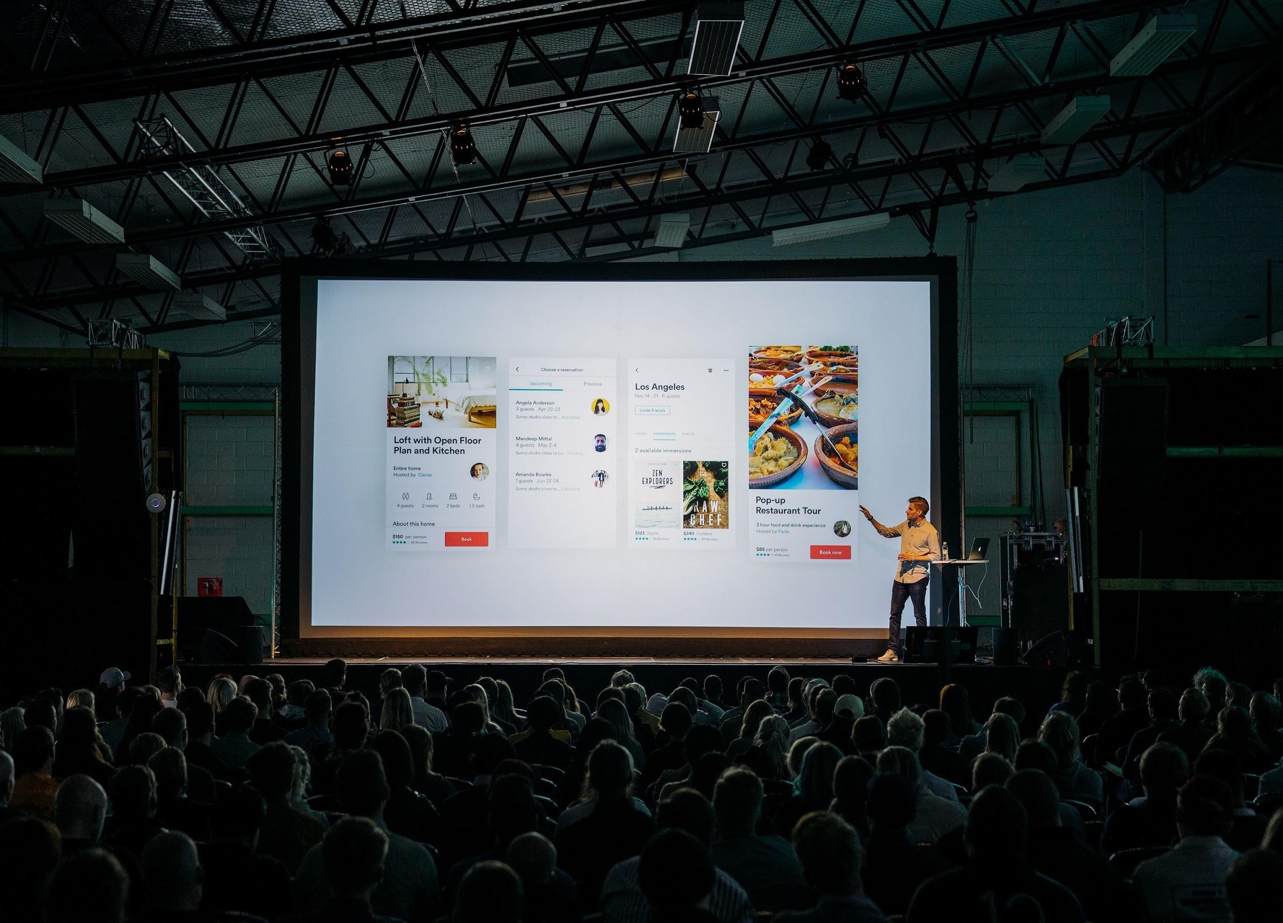
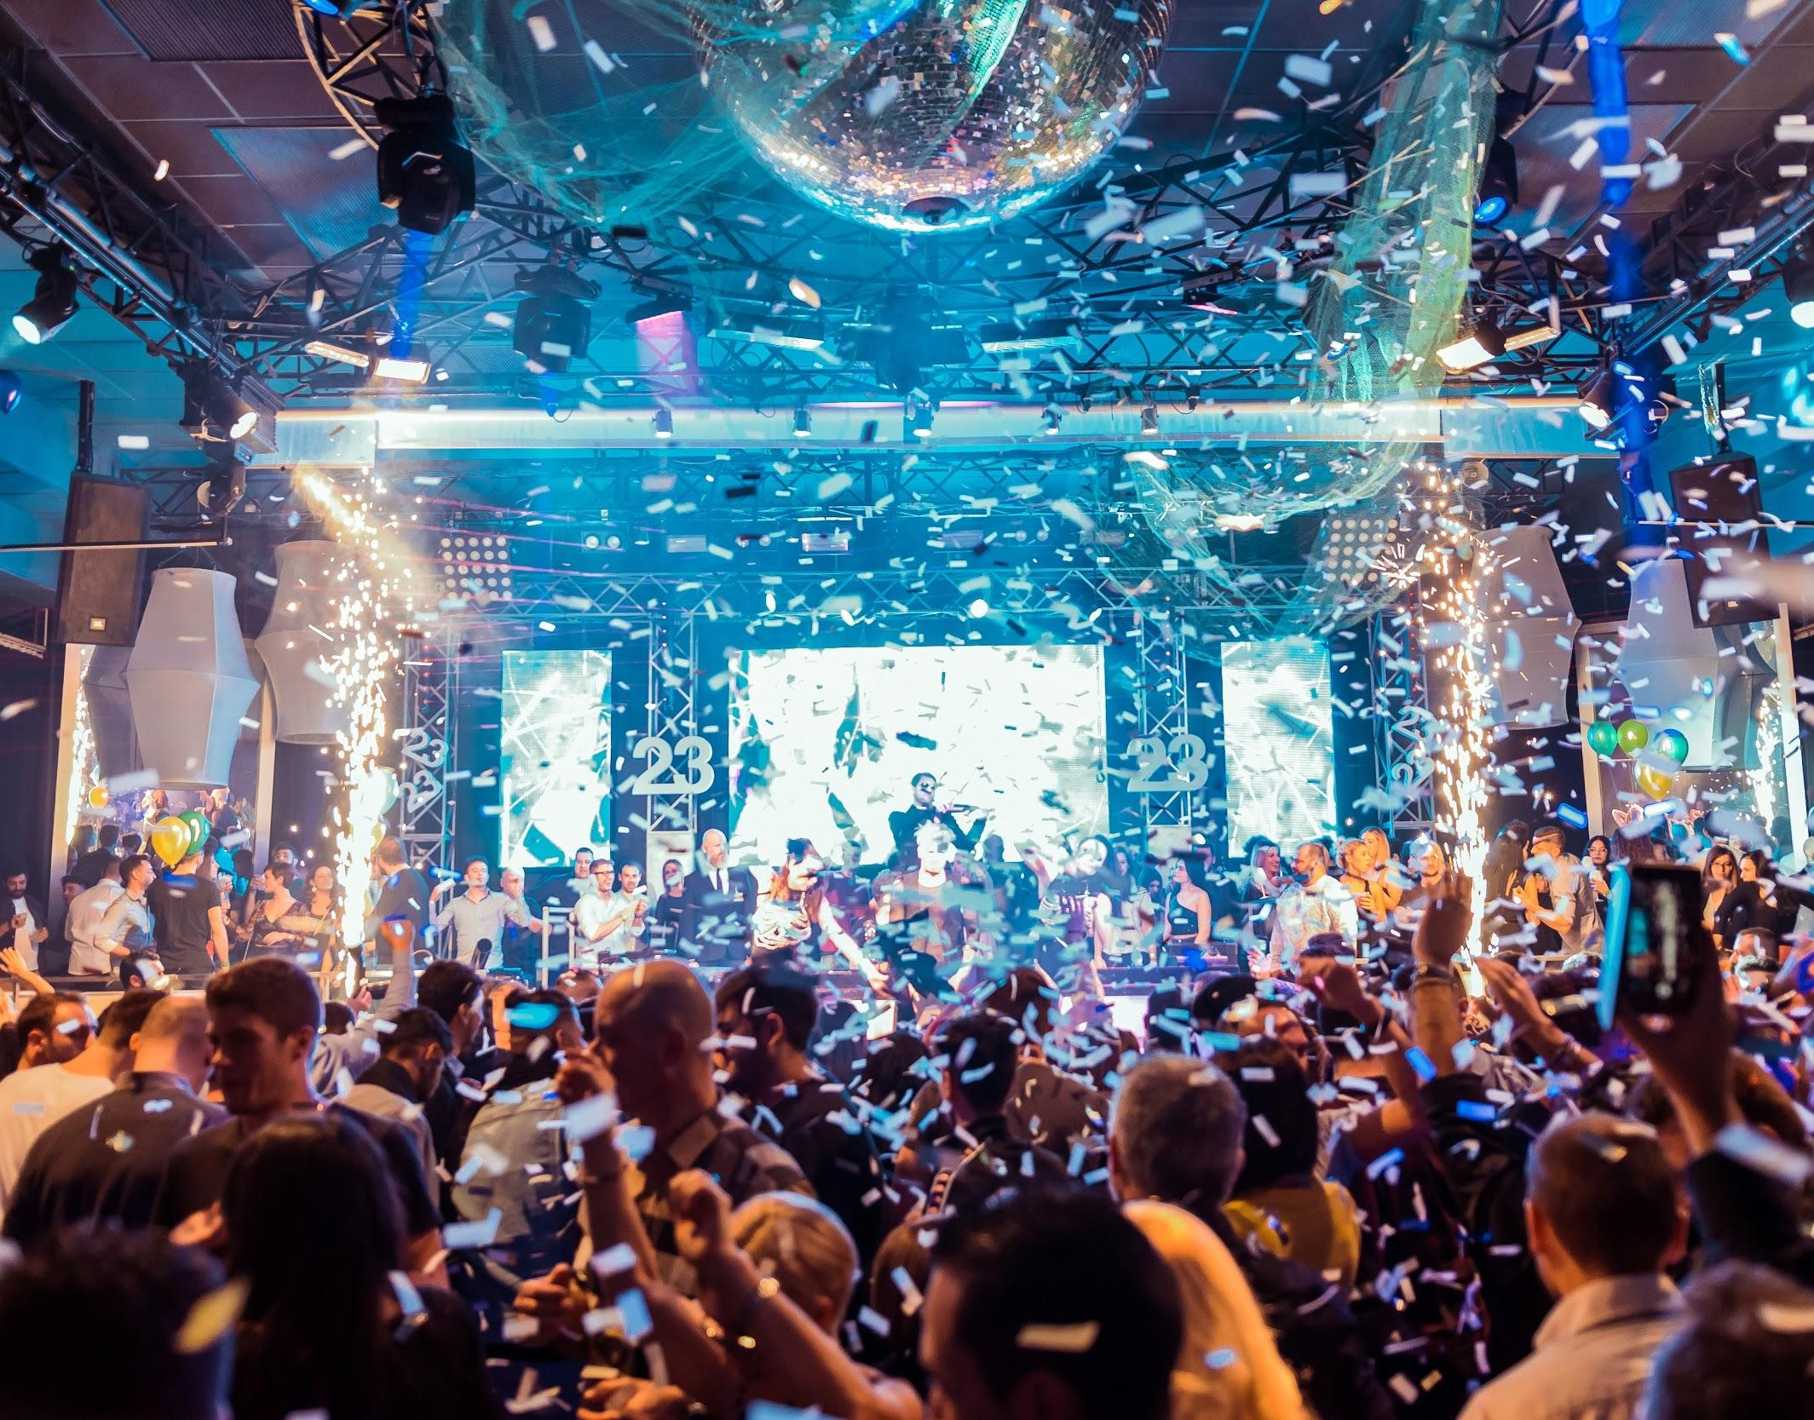





H
Hotel Casa Bella
Tourist Hotel
H
Hotel Casa Bella
Tourist Hotel
H
Hotel Casa Bella
Tourist Hotel
96 Likes View all 32 comments
From alluring to exotic, from dreams to reality! Choose gorgeous wedding venues that will leave you love-struck, at the @HotelCasaBella, Bali.
Check out our splendid and oﬀbeat destination to plan your wedding, link in bio!
For details call us on: 0123456789
#HotelCasaBella #Bali #Wedding #DestinationWedding #WeddingDay #Hotels #BestDestination #Food&Drinks #HotelSuite
42 Likes View all 12 comments
Looking for the perfect venue for your next business event? Plan it out with @HotelCasaBella, Bali and experience our heartwarming customer service!
For us it's not just about your ideas, it's about turning them into reality.
Book now! Link in Bio!
#HotelCasaBella #Bali #BestView #Greenery #HotelRoom #HotelLuxury
105 Likes View all 29 comments
Enjoy Jazz Night every #SaturdayEvening @HotelCasaBella, Bali. Book your stay now and sing in with the tunes of the best artists in town!
#HotelCasaBella #Bali #Jazz #SaturdayEvening #HotelBooking #HotelRoom

Slide 36
Oﬀ Season Posts for Facebook
Templates:
Hashtags:
Stay with us more, for less!
Enjoy up to [discount %] oﬀ when you book your next stay with us at
[hotel name], [location]
Oﬀer valid till [date] only!
Enjoy service upgrades and complimentary breakfast with a suite booking at [hotel name], [location]
The big break you deserve awaits!
Special oﬀer!! Book now and avail discount of [discount %]
Best Oﬀer for your oﬀ season escape!!
Last minute oﬀer! Book now and get upto [discount %] !
Save your money by travelling during oﬀ season!
# [HotelName]
# [Location]
#OﬀSeason
#HotelDiscount
#PromoCode
#BestDeals
#SpecialOﬀer
#HotelRoom
#SpecialDeals
#BookNow
NOTE: The content in [brackets] is variable. Please modify it according to your requirement.

Slide 37
Oﬀ Season Posts for Instagram
Templates:
Hashtags:
Make your monsoons truly magical by exploring the most exotic and charming locations of [location]
Redeﬁning style and comfort, @ [hotelname], [location] is the ideal destination for some time-oﬀ from your hectic schedule!
Find your perfect #WeTime with @ [hotelname]. Book your stay now and get [discount %] oﬀ, link in bio!
Sunny skies. Delicious cuisine. Cold drinks. That’s your recipe for a productive weekend at @[hotelname].
Disconnect from the hectic city life and retreat to the serene @[hotelname], [location].
# [HotelName]
# [Location]
#MonsoonOﬀer
#BestDeals
#DirectBook
#OﬀSeason
#HotelDiscount
#BestOﬀer
#WeTime
#BookNow
NOTE: The content in [brackets] is variable. Please modify it according to your requirement.

Slide 38

Examples of Oﬀ Season Posts:
See how we mixed and matched templates!

Slide 39
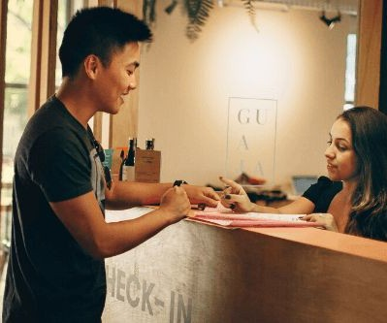
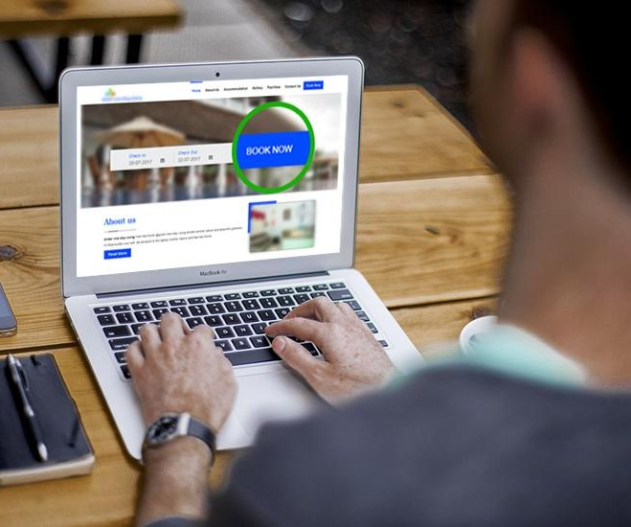

H
Hotel Casa Bella
Friday at 01.12 PM
H
Hotel Casa Bella
H
Hotel Casa Bella
Monday at 06.36 AM
Saturday at 05.30 PM
Create more memories. Stay with us more, for less!
Enjoy up to 30% oﬀ when you book your next stay with us at
Hotel Casa Bella, Bali. Promo code: DIS30
Oﬀer valid till 31st March 2020 only!
www.casabellabali.com
#HotelCasaBella #Bali #HotelDiscount #PromoCode #BestDeals
Exclusive Oﬀer | Book your stay from now until 31 March 2020 to enjoy room upgrades, early check-in & late check-out and complimentary breakfast with a suite booking at Hotel Casa Bella, Bali.
www.casabellabali.com
#HotelCasaBella #Bali #HotelDiscount #PromoCode #BestDeals
The big break you deserve awaits! Find new perspectives with you next travel journey.
Book with us at Hotel Casa Bella, Bali and save up to 20% for bookings until 31st May 2020.
#HotelCasaBella #Bali #SpecialDeals #BestDeals #HotelDiscount
73
Like
5 Comments 2 Shares
85
Like
8 Comments 4 Shares
66
Like
4 Comments 3 Shares
Comments
Share
Comments
Share
Comments
Share

Slide 40
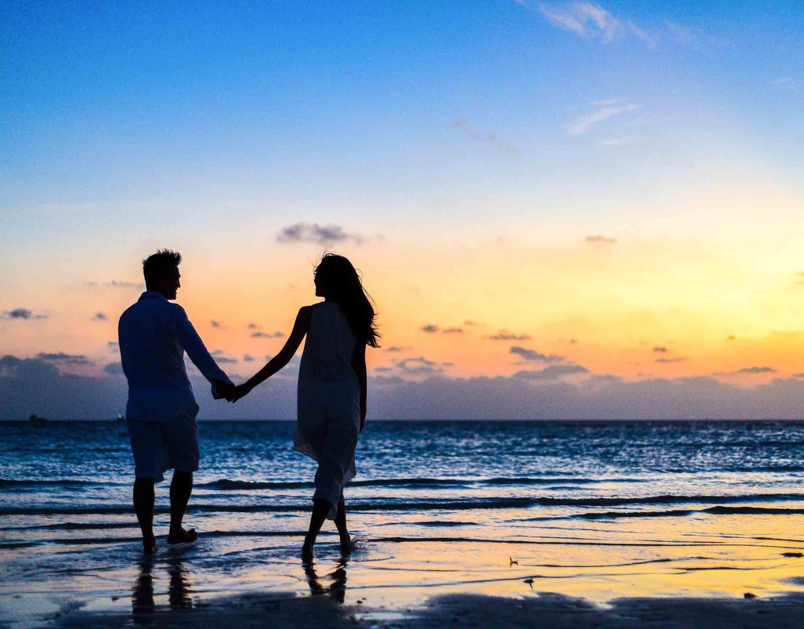
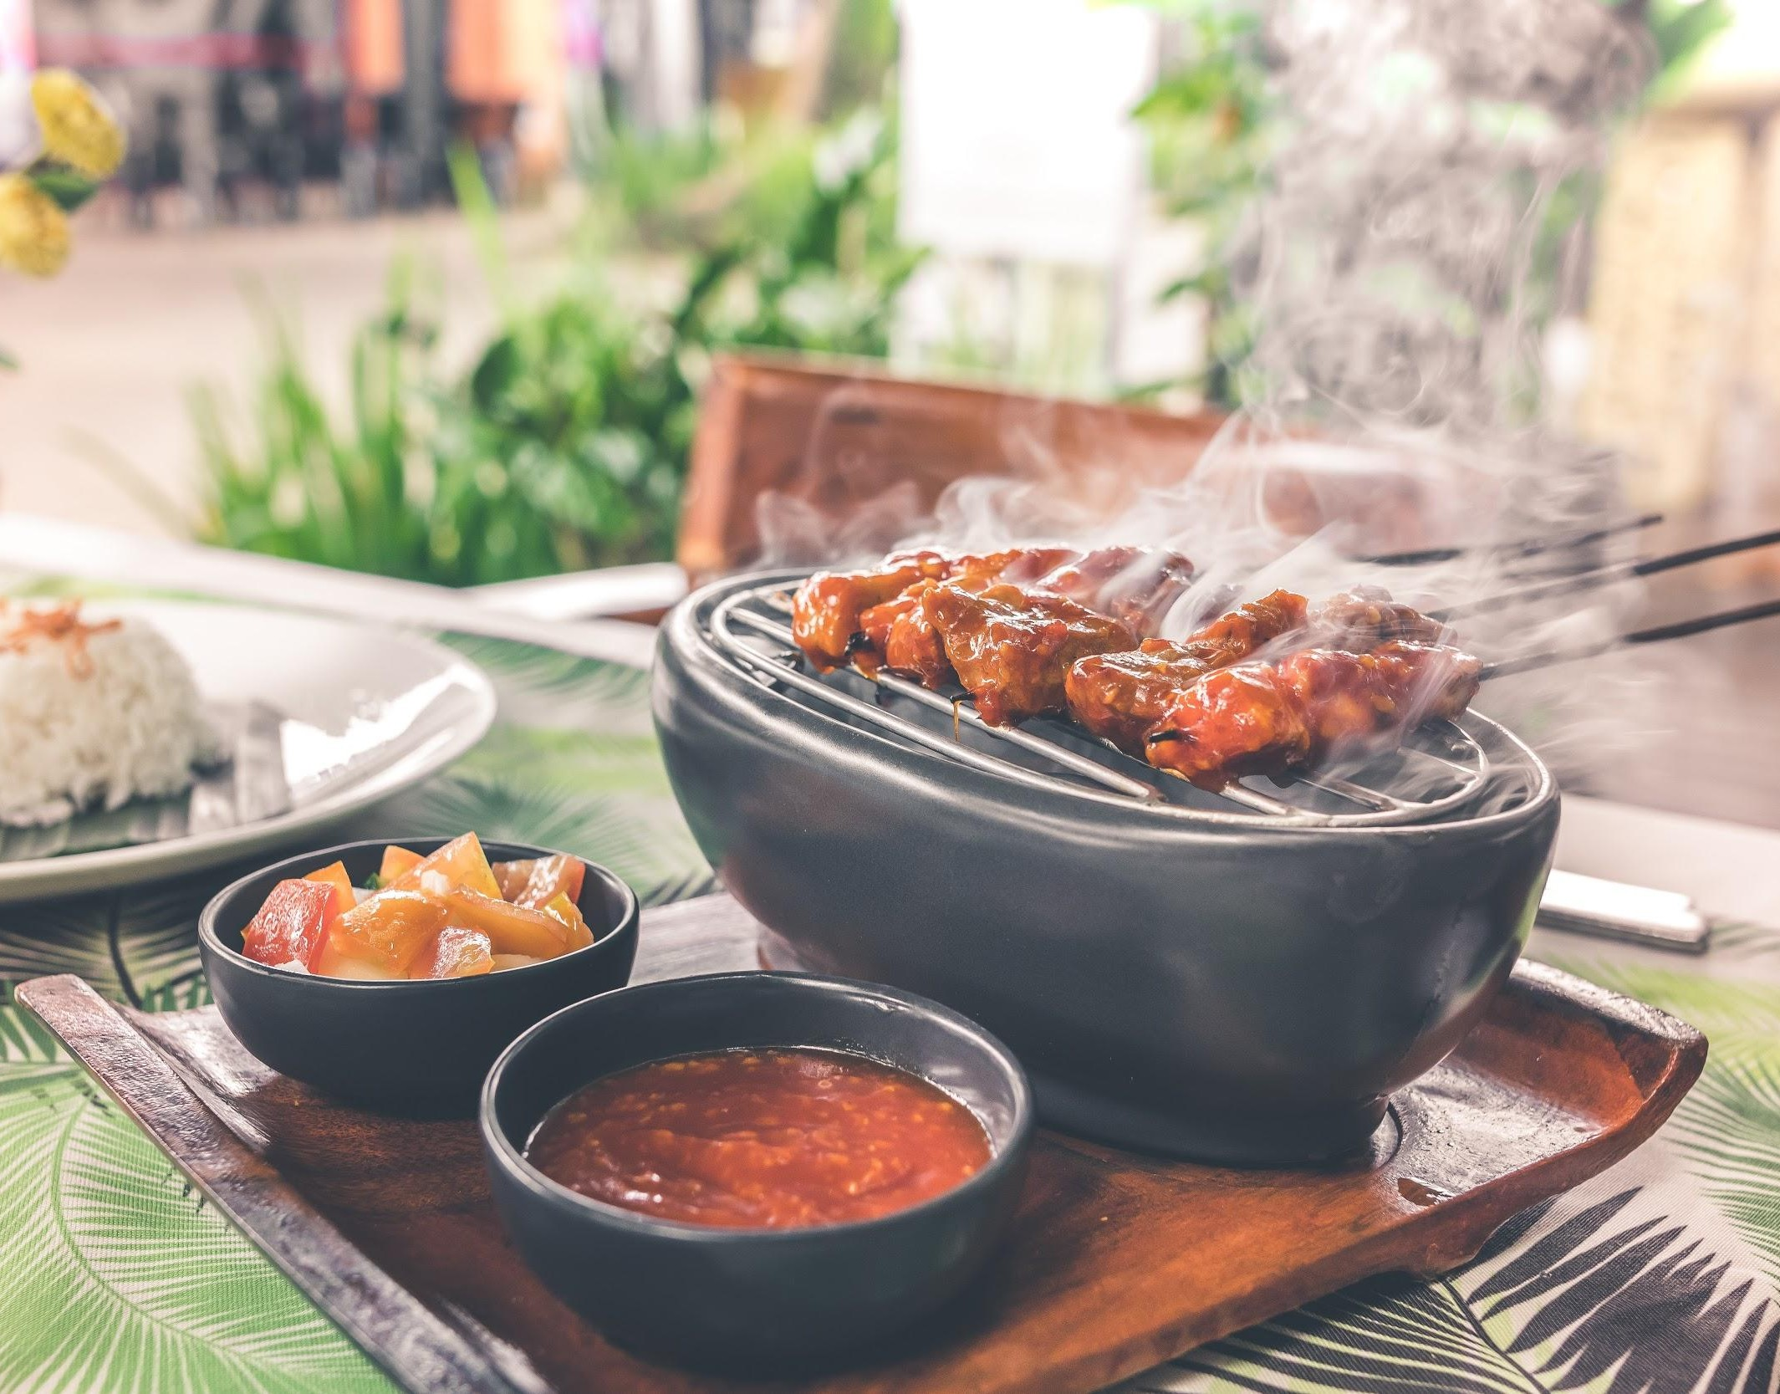
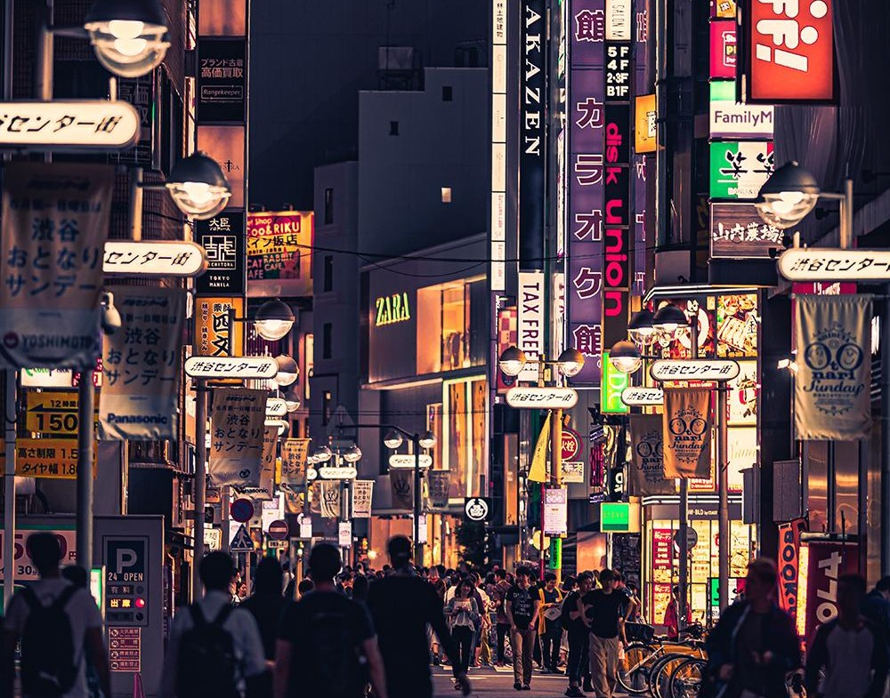
H
Hotel Casa Bella
Tourist Hotel
H
Hotel Casa Bella
Tourist Hotel
H
Hotel Casa Bella
Tourist Hotel
48 Likes View all 22 comments
Reconnect with your loved ones over an unforgettable getaway, when you vacation with us. Find your perfect #WeTime with @HotelCasaBella. Book your stay now and get 10% oﬀ, link in bio.
#HotelCasaBella #Bali #BestDeals #DirectBook #BookNow #HotelRoom #WeTime #BestOﬀer
32 Likes View all 19 comments
Sunny skies. Delicious Cuisine. Cold drinks. That’s your recipe for a productive weekend at @HotelCasaBella. Book your stay now and get 10% oﬀ, link in bio.
#HotelCasaBella #Bali #BestDeals #DirectBook #BookNow #HotelRoom
26 Likes View all 9 comments
Disconnect from the hectic city life and retreat to the serene @HotelCasaBella, Bali.
Enjoy additional 10% discount on direct booking. Link in bio! Book now!
#HotelCasaBella #Bali #Discount #HotelRoom #DirectBook

Slide 41

Twitter Marketing

Slide 42
Twitter Ads
Targeting
Looking to find your audience on Twitter? Twitter’s targeting options can help you reach the right people at the right time.
Instructions: Print or open this worksheet with a PDF editor to brainstorm and review targeting possibilities for your next campaign.
First, the basics.
The options in this section work together using “AND” logic. This means you will be targeting people who match all of the input criteria.
Ex: People who live in Canada AND speak French AND use Mobile-Android devices.
Demographics
Gender
Age
Location
Language
Any
Men
Women
Devices
Mobile - iOS
Mobile - Android
Desktop
Other mobile
All
Other device characteristics
(Carriers, device models)

Slide 43

Great! These basic parameters will be applied to the rest of your selections, which we will fill out now.
This last section uses “OR” logic, meaning you’ll target people who match any of the input criteria.
Ex. People who belong to a custom audience OR have a specific interest OR match a specific conversation topic.
Custom audiences
Use Audience Manager to upload CRM lists and manage audiences collected from your website or mobile app.
Targeting features
Keywords
Follower look-alikes
Interests
Movies and TV shows
Events
Additional options
Remarketing capabilities to re-engage with and move potential new customers down the funnel.
People who saw your past Tweets
People who saw and engaged with your past Tweets
Organic Tweets
Tweets from specific campaigns
Both

Slide 44
Tips
•
Consider the experience of your ad on mobile. Can people complete the action you’re promoting?
If not, consider limited actions to desktop only.
•
Avoid age and gender targeting unless your product/ service is age-restricted or gender-specific,
because these fields can unnecessarily limit your overall reach.
•
When targeting an event, consider running the campaign before, during, and after to maximize your
content and reach.
•
If you’re targeting multiple countries, make sure each country has its own ad group. This way you
can analyze the results from each market more easily and apply it to your next campaign.
•
Try a few targeting options and interests that seem a bit outside your focus. Advertisers are often
surprised by who their message resonates with. Let a few test campaigns show you where possible new audiences could be.
•
You can modify targeting at any point. After your campaign has run for 2-3 days, you’ll have a good
sense of what’s working and what should be turned off.

Slide 45

Before you go, here are the
Want to have more way to implement an update hotel marketing can invite in face to face training
Explore More
www.eZeeTechnosys.com

