Slide 1
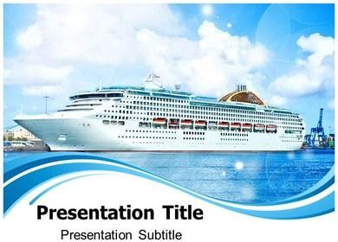
Patricia Aldavert Carla Ferretti
Cruise Ships and Sustainability

Slide 2
Statistics Worldwide
Number of cruise companies: 55 Cruise Ship Fleet: 296 ships Passenger Capacity: 21.4 Million
The cruise industries sales revenue for 2014 was estimated at $33.8 Billion

Slide 3



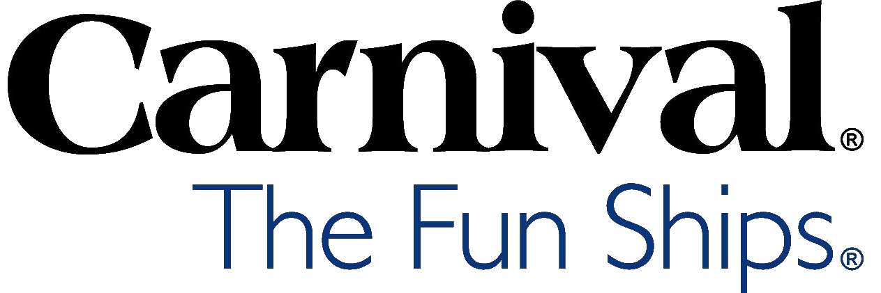
Largest Cruise line in the Industry
Carnival Cruise lines...
Largest fleet= 24 ships
Carry the most passengers = 4.5 million a year

Slide 4
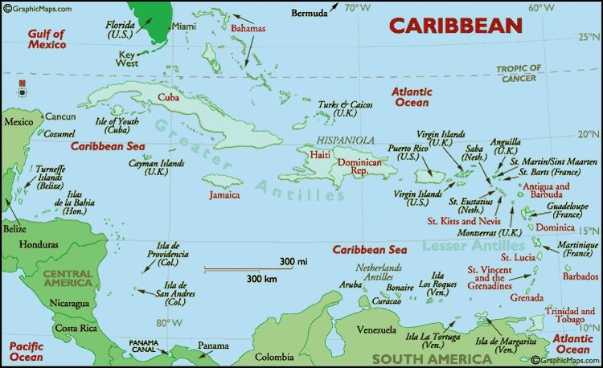
Receives 42.4% of world wide cruise business

Slide 5
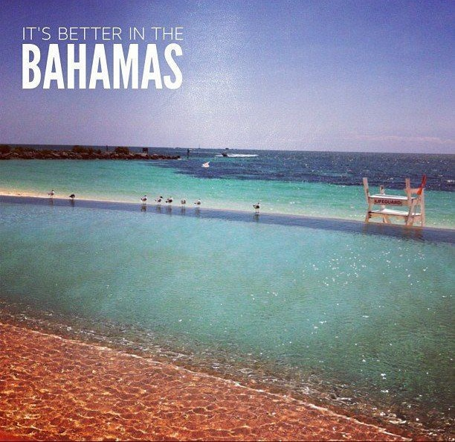
Bahamas was number one in destinations visited in the world by cruise ships in 2013 with 4,709,236 visitors

Slide 6

Unsustainable Issues

Slide 7
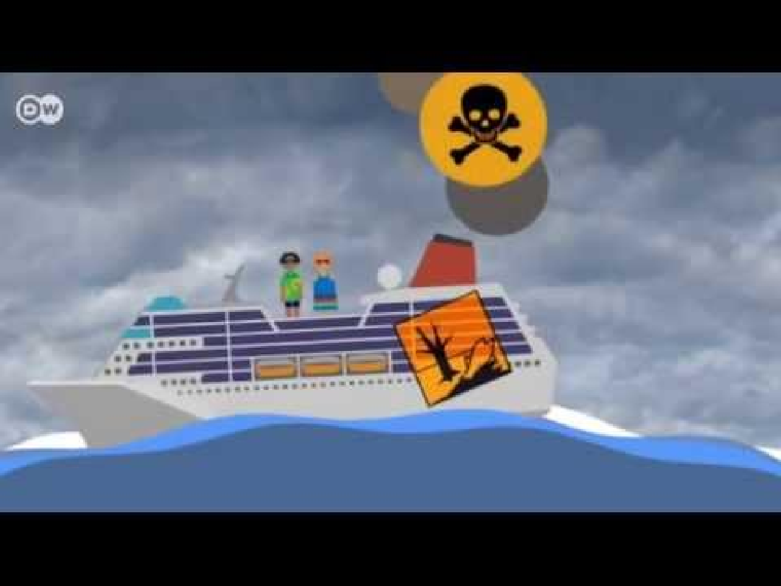

Slide 8
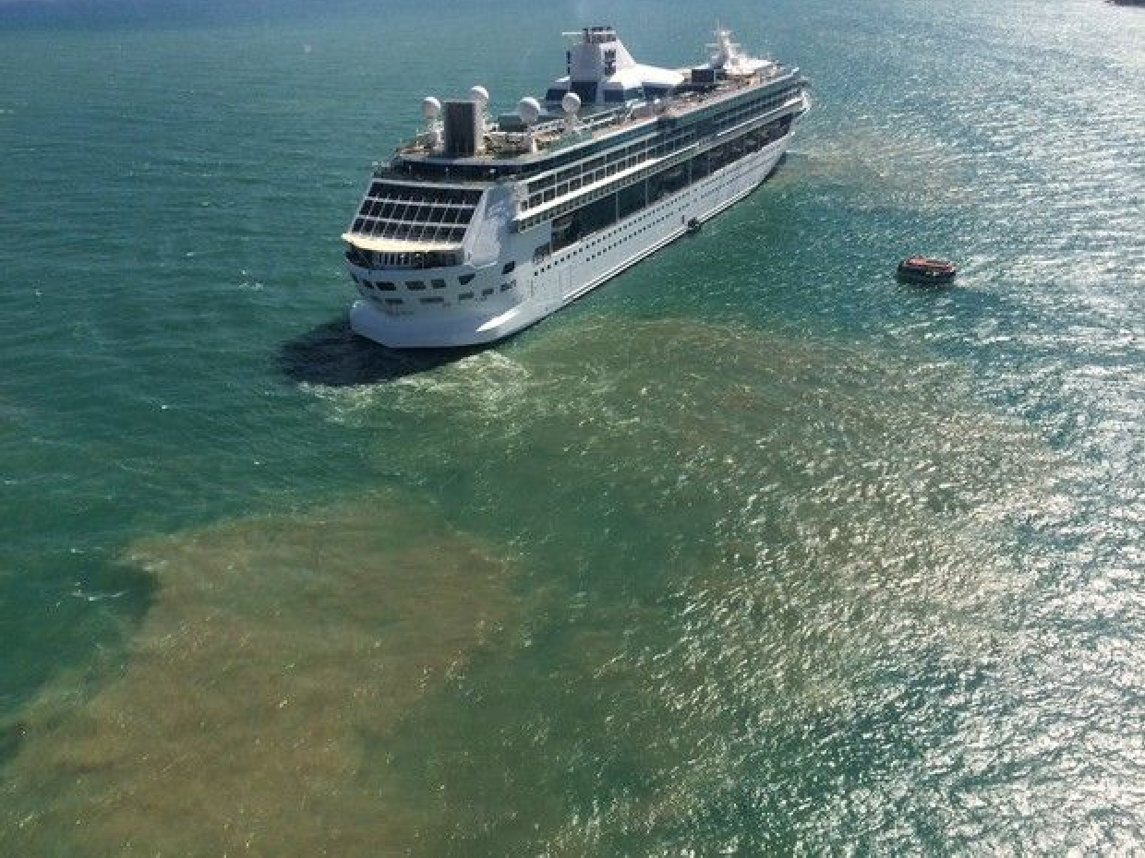
Toxic Waste on the High Seas
Cruise ships can dump all kinds of organic waste and untreated water when they are more than four miles out from the coast.

Slide 9

Oceana Environmental Group
According to the environmental group Oceana, the average cruise ship produces the following immense amount of pollution every day:
– 25,000 gallons of sewage from toilets;
143,000 gallons of sewage from sinks, galleys and showers;
7 tons of garbage and solid waste;
15 gallons of toxic chemicals; and
7,000 gallons of oily bilge water.

Slide 10
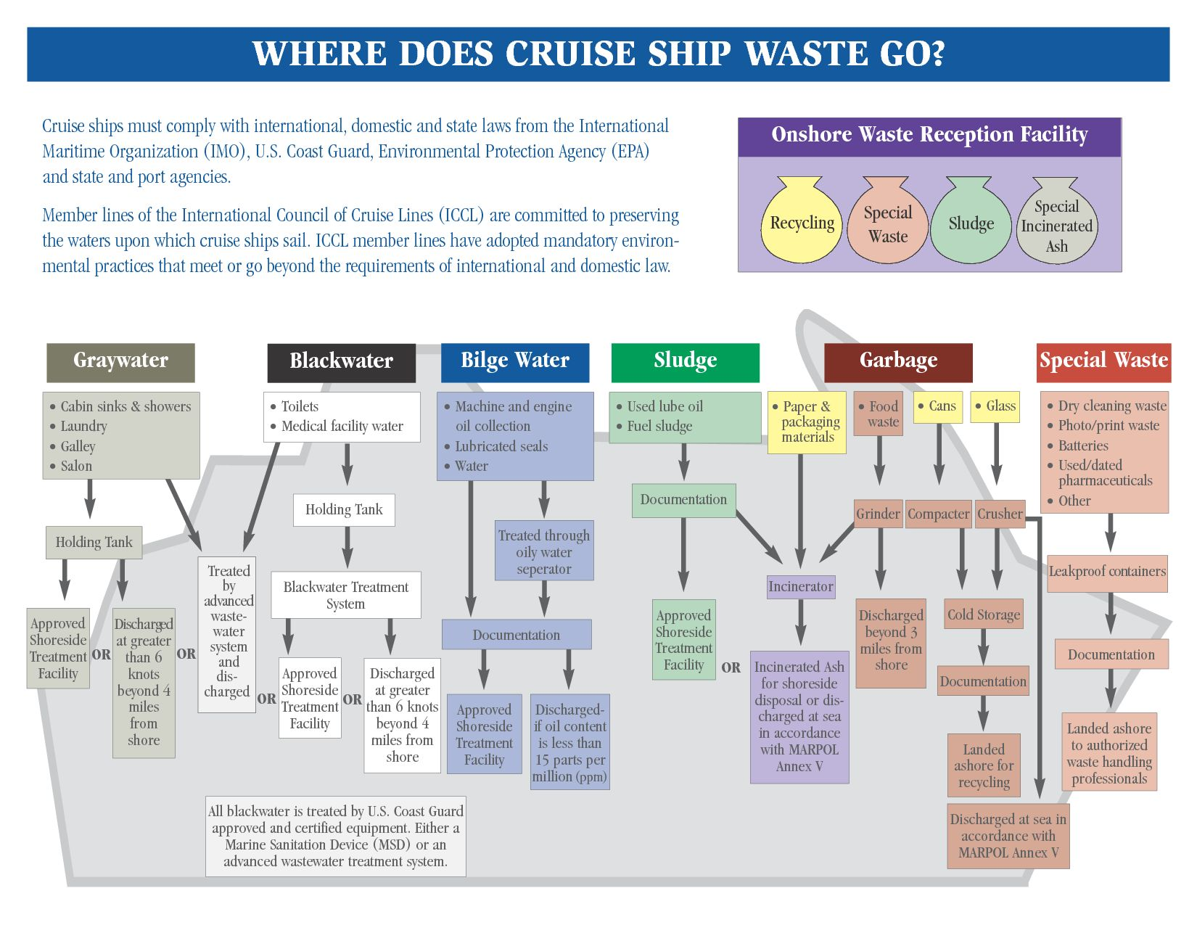

Slide 11
Waste
These wastes, if not properly treated and disposed of, can be a significant source of pathogens, nutrients, and toxic substances with the potential to threaten human health and damage aquatic life.

Slide 13
Environmental Impact

Slide 14
Damage to reefs
How are coral reefs damaged?
Harvested for construction
Ship Anchors
Blast Fishing & Cyanide Fishing

Slide 15
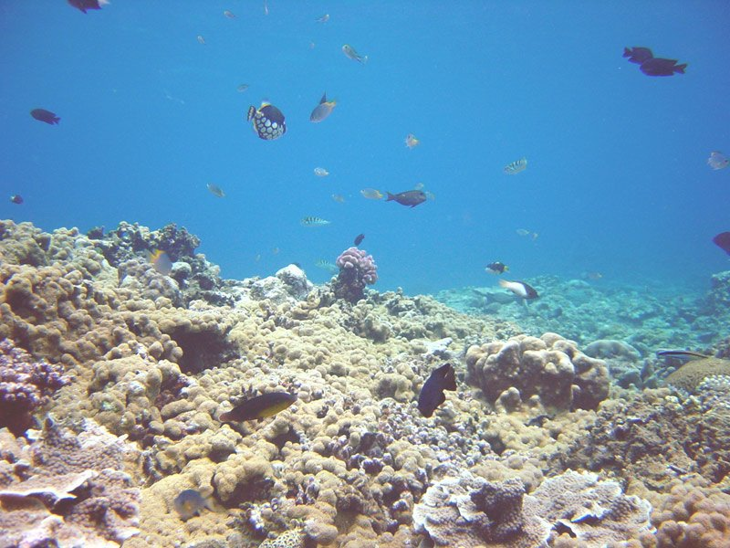
There are over 109 countries with coral reef.
Every year at least 90 of them experience significant damage due to cruise ship anchors and local harvesting
Damage to Reefs

Slide 16
Damage to Reefs
An anchor drop for just one day can destroy as much as 3100 square meters of coral reef
What we need is to maintain comfort and profit while decreasing harm to coral reef using Dynamic Positioning systems on cruise ships

Slide 17
Damage to reefs
Royal Caribbean destroyed around 35 million cubic feet of coral and 2 miles of mangrove to build a mega ships port for in Jamaica

Slide 18


Dynamic Positioning
A new alternative for anchors. It uses the ships propellers and thrusters to keep the ship from drifting the systems takes away wind and waters surge into account to keep the ship in a specific location computer programs tells each thruster how much power is required to maintain its position.

Slide 19
Dynamic Positioning
Dynamic positioning allows ships to dock without help from tugboat
Allow ships to remain in areas with water to deep for anchors
Dynamic positioning will only be useful if all cruise ships use it and education is increased.

Slide 20
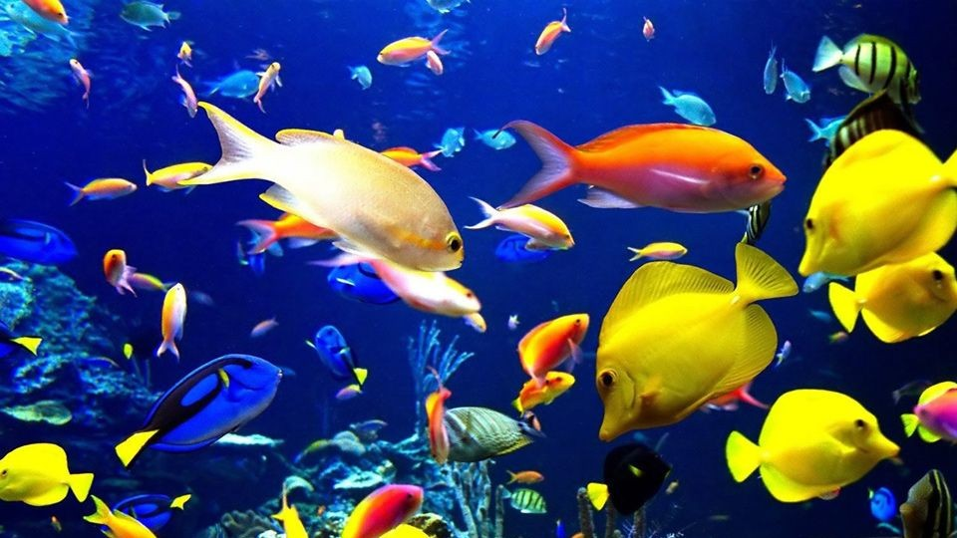
Damage to Sea Life

Slide 21
Marine Life
The noise produced by ships can travel long distances, and marine species who may rely on sound for their orientation, communication, and feeding can be harmed by this sound pollution.

Slide 22
Wildlife Collisions
Marine mammals, such as whales and manatees, risk being struck by ships, causing injury and death.
For example, if a ship is traveling at a speed of only 15 knots, there is a 79% chance of a collision being lethal to a whale.

Slide 23
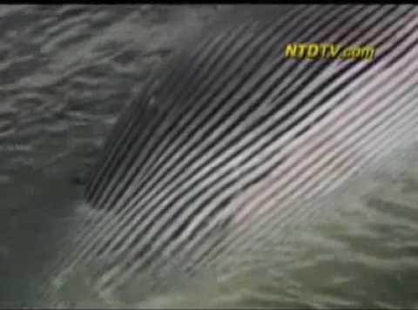

Slide 24
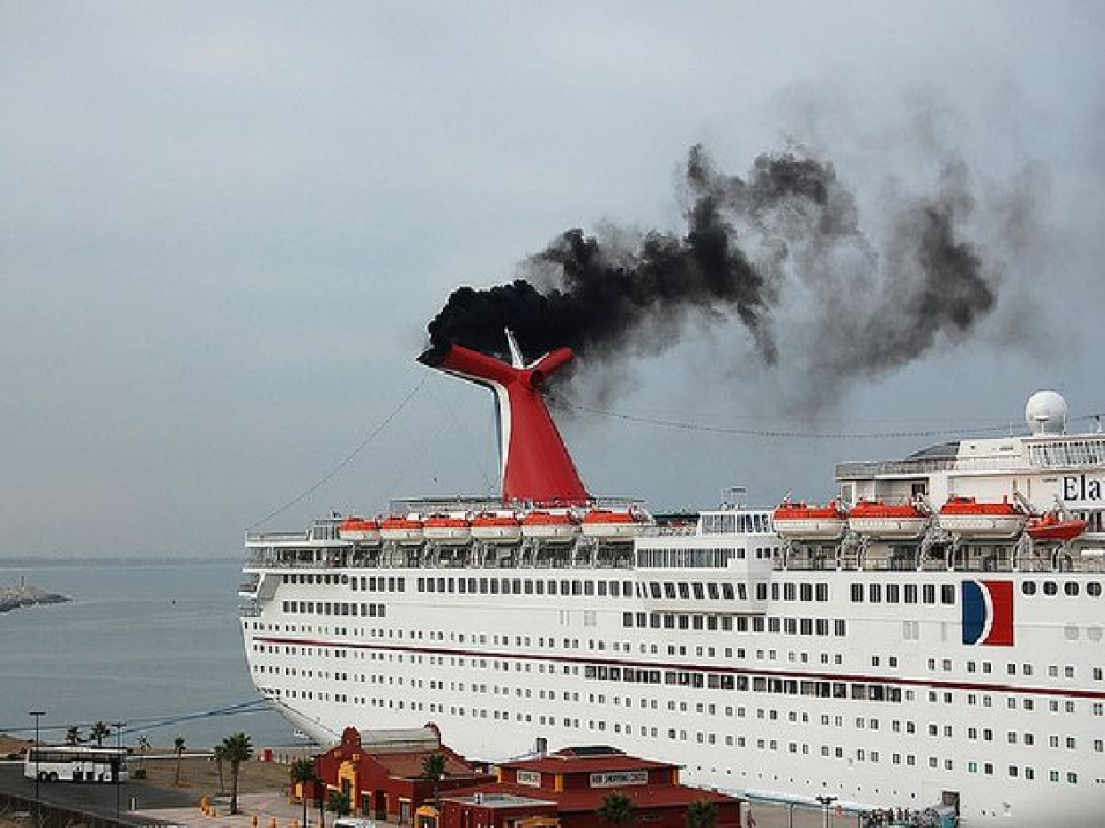
Air Pollution

Slide 25
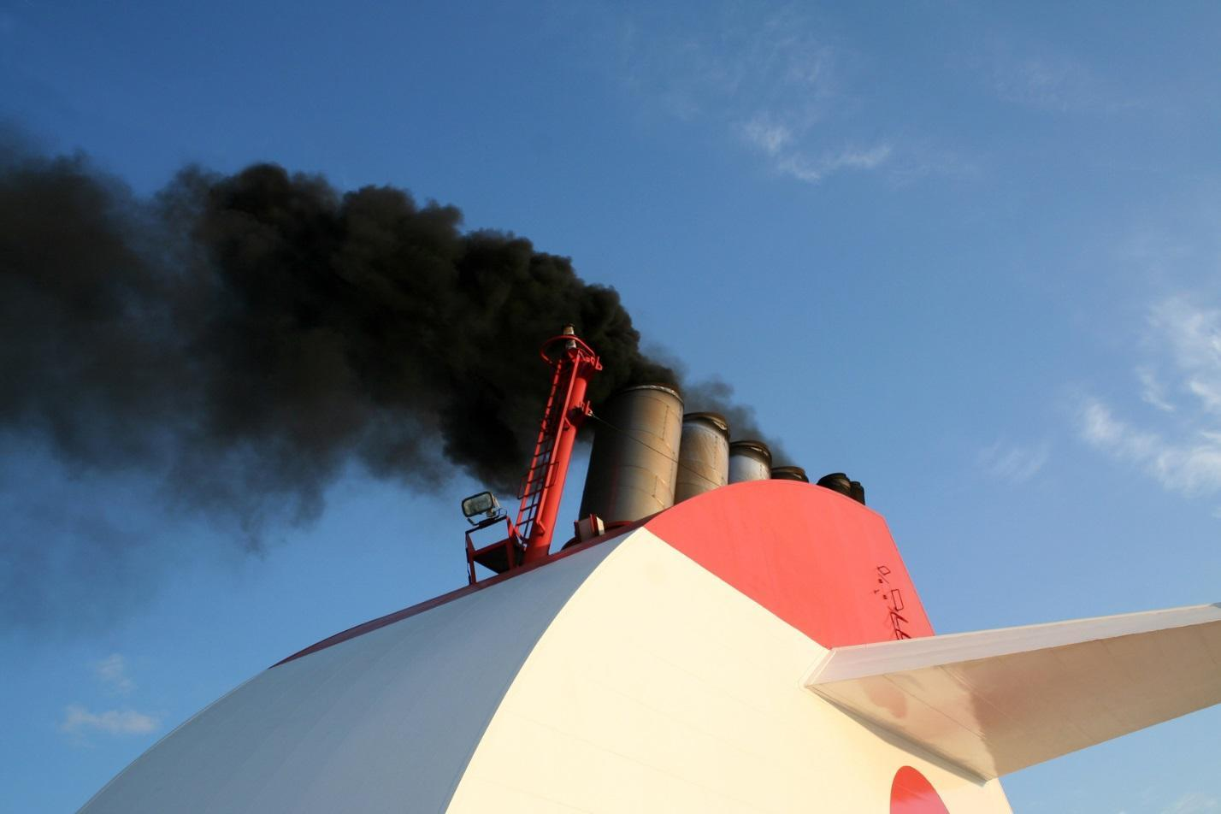
Can cause acid rain

Slide 26
Social Issues

Slide 27
Shipboard Employment
CONTRACTS
3 & 6 Months or 1 Year Renewal
Mutually Agreed
Cyclical Nature of the Cruise Line Operator

Slide 28
Hours & Work Conditions
Weekly Hours 77
No Days Off
10 Continuous Months
2 Months Vacations No Health Insurance

Slide 29
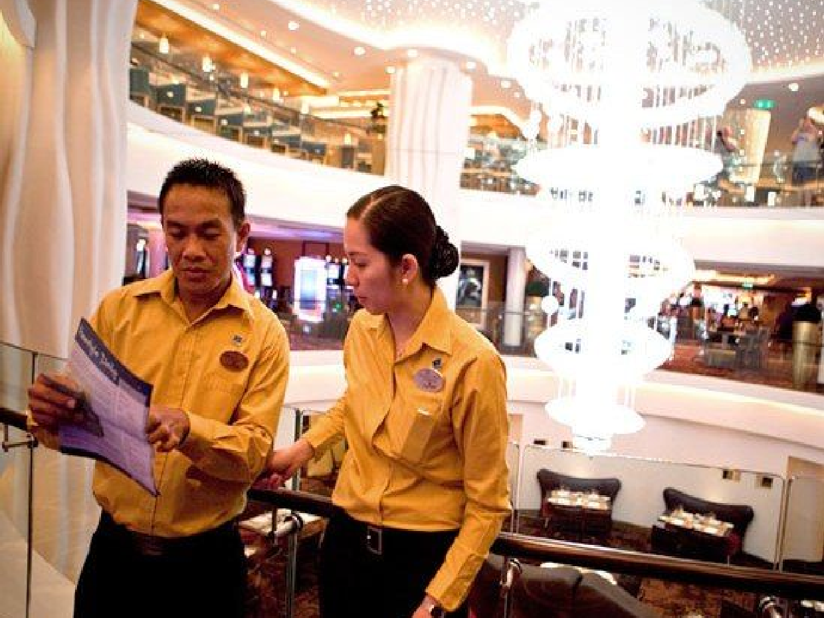
Compensation
SERVICE
EMPLOYEES
NO PAID
VACATION
NO PENSION

Slide 30
Salary
Direct salary is considered low for North America standards
Restaurant Staff have considerable earnings from potential pax tips

Slide 31
Crew Members Expenses
Crew members do not have any expenses onboard. Examples Food, Accommodation & Transportation
This makes a cruise ship career financially attractive enough to compensate for lack of employment benefits.

Slide 32
Compensation
Non Service & Management Crew
Paid Vacation Medical Retirement Options
Company’s Insurance Plan

Slide 33
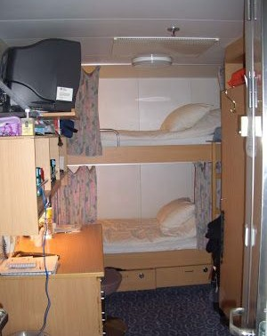
Living Arrangements
2 crew members
1 cabin
1 shower
1 commode 1 desk with tv
Senior Officers single cabin

Slide 34
Living Arrangements
There is a set of facilities for the crew separate from that of pax
Including such as mess rooms, bars, recreations rooms, prayer rooms/mosques & fitness center.
Larger Ships even having a crew deck with a swimming pool and hot tub.

Slide 35
Hiring
Hotel staff are hired from under industrialized countries in Asia, Eastern Europe, the Caribbean, and Central America.
While several cruise lines are headquartered in the United Stated, the ships are registered in countries such as Bahamas, Panama, and Liberia a practice known as “flags of convenience” to take advantage of less stringent labor regulations.

Slide 36

Foreign Flags
Taxes is another issue they do not pay taxes in the US because they use foreign flags

Slide 37
Ports of Call
There are 2,000 ports around the world and only 30 of them are in the United States
The ports have to provide services and built structures to have them at the cost of the local population

Slide 38
Sustainable Practices
What some cruise lines are doing

Slide 39
A HULL new way of doing things
Recycling programs
Energy saving lightbulbs
Energy saving appliances
Window tinting
Propulsion and hull design to save energy
Paint and coatings that are environmentally safe
Maintain standards of public health
Environmental management systems
Paper reduction

Slide 40
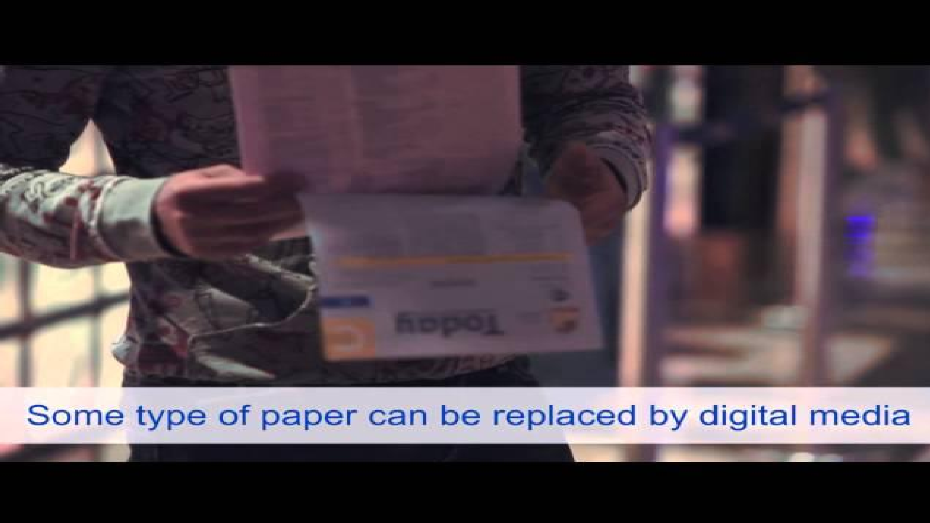

Slide 41


Slide 42
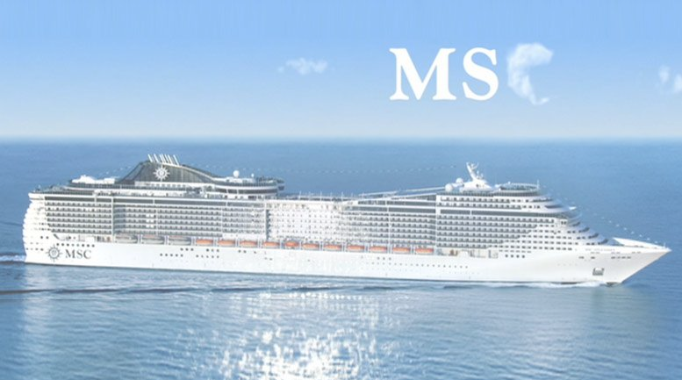
Waste Management
Separate Waste Collection
Pulping
Compaction
Griding
Hazardous Waste

Slide 43
Royal Caribbean
Environmental management at sea called saving the waves
Dynamic Positioning on two of its vessels Oasis of the Sea & Allure of the Sea

Slide 44
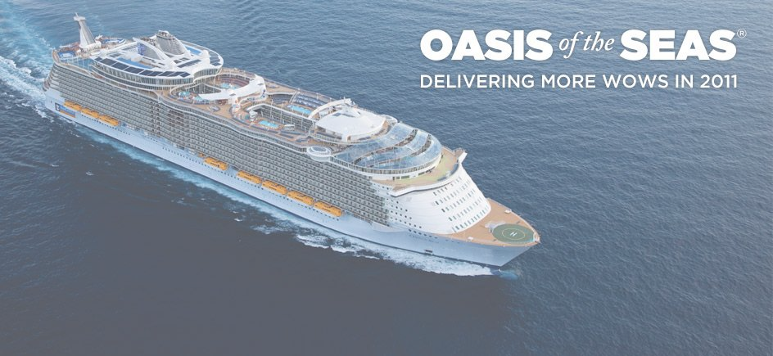
Oasis of the Seas (5,400 passengers) liquefied natural gas fueled engines come equipped with pollution scrubbers that completely eliminate all Sulfur emissions, cut Nitrogen Oxide emissions by 80 % and CO2 by more than 20%
Processes its own waste on board, reusing the wastewater and zero dumping into the ocean.
First cruise ship to have a large tropical park filled with thousands of plants and natural features.

Slide 45
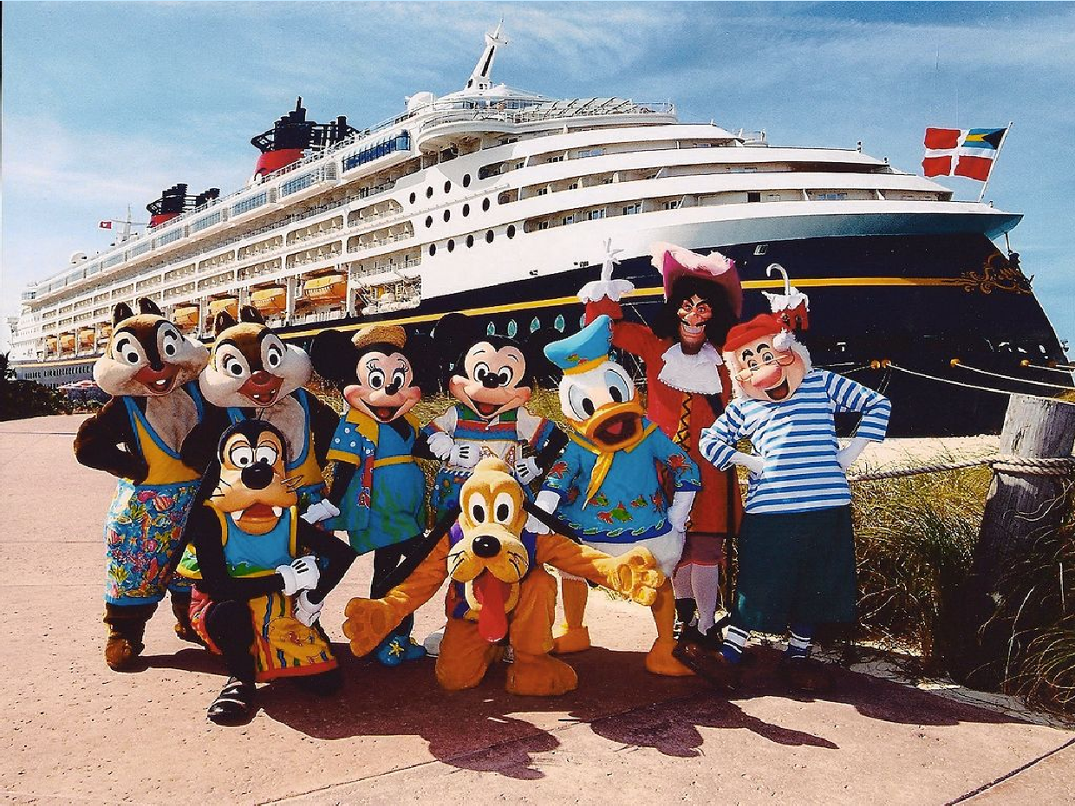
Disney Cruise Lines

Slide 46
Disney Cruise Lines
Disney Cruise Lines processed thousands recyclables each week aluminium, glass, plastic cardboard and paper bundled.
All of their recyclables are separated and made ready for unloading in the ships garbage room they sort everything in separate bins

Slide 47
Disney Cruise Lines
1st cruise line to apply a new kind of coating to the hull of the ship which works to save energy this coating is completely non toxic it cuts down the resistance in the water and helps the ship glide through the seas since we don't have to push the engines as hard to get from place to place we can use fewer engines that helps us save energy.

Slide 48

Disney Cruise Lines
Used cooking oil from the galley is collected in special containers each week when the ship arrives to the island the oil is taken to the backstage area and mixed then used as fuel for small vehicles on the island

Slide 49
Disney Cruise Lines
They also have an environmental officer onboard
Evaporators used to make fresh water from the ocean
Water condensation is collected from the air conditioners on board and then used to clean the decks on the ships

Slide 50
Carnival Cruise Lines
The New Economy

Slide 51

Carnival Cruise Lines
Has switched to eco-friendly detergents for its linens and dry cleaning
Has developed a new, energy-efficient and non polluting engine for its newer ships.

Slide 52
Carnival Cruise Lines
Carbon Emission
Reduction of the rate of carbon emission is actually related to the actual quantity of fuel that gets consumed and the rate in which we consume fuels.
Has an economic impact as well as an environment impact.

Slide 53
Carnival Cruise Lines
“The way we reduced our fuel consumption is by making our ships more efficient. 60% of the fuel consumption goes into the movement of the ship through the water thats where the energy goes if you do it slower you can save fuel and therefore save money.”

Slide 54
Carnival Cruise Lines
The second largest load is air conditioning not running air conditioning systems when they are not actually required.

Slide 55
Carnival Cruise Lines
There are a very wide range of technology that are being employed on a ship if we can make those more efficient that we are able to reduce our energy foot prints and thereby reduce our carbon emission foot prints.

Slide 56
Carnival Cruise Lines
Exhaust gas cleaning technology that we are applying on our ships uses a proprietary technology to remove the oxide of sulfur that come from combustion of fuels that have sulfur in its it’s a win for the environment and a win for the company because we have the more cost effective solutions

Slide 57
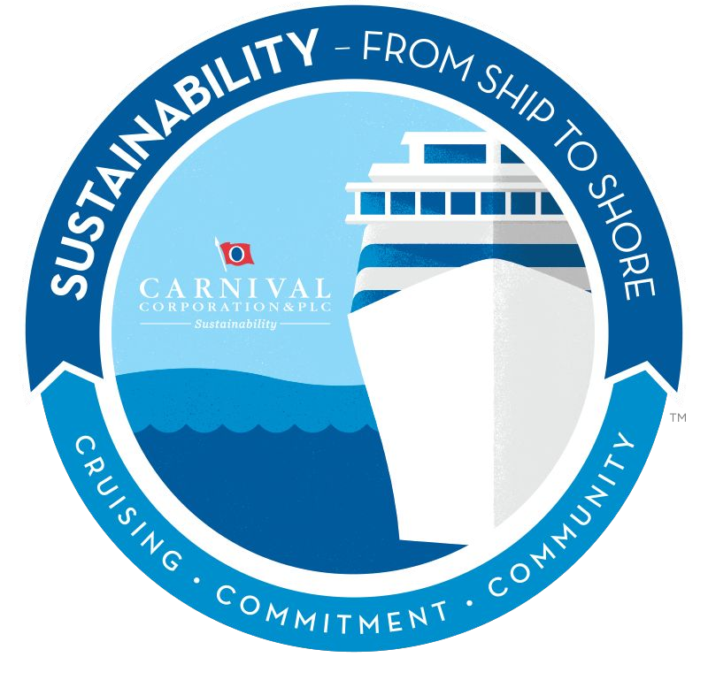
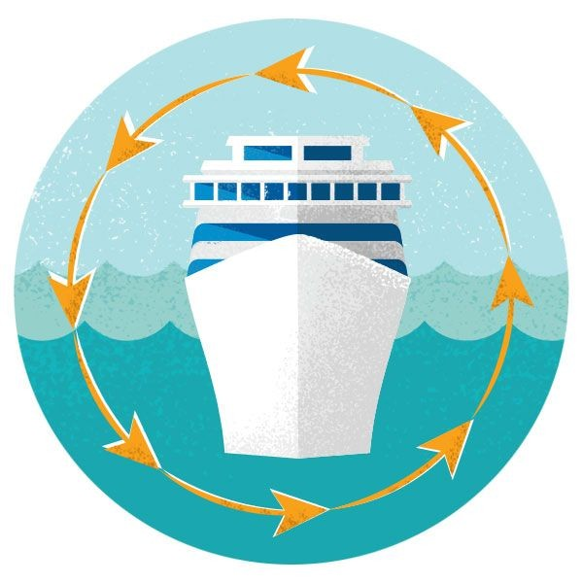
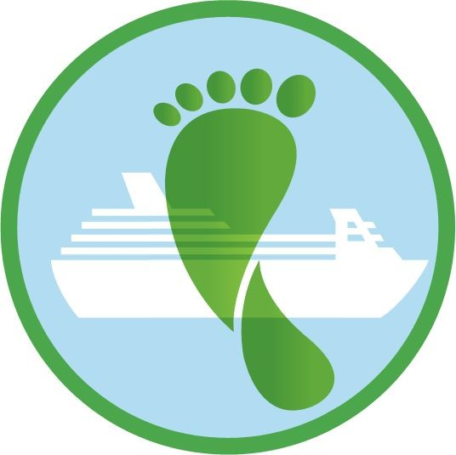
Carnival Sustainability Reports
HESSS Policy
Climate Change & Air Emissions
Technology Alternatives
Exhaust Gas Cleaning System

Slide 58
HESSS Policy
Carnival Corporation’s commitments to:
Protecting the health, safety and security of our passengers, guests, employees and all others working on behalf of the Company, thereby promoting an organization that always strives to be free of injuries, illness and loss.
Protecting the environment, including the marine environment in which our vessels sail and the communities in which we operate, and always striving to prevent adverse environmental consequences and use resources efficiently and sustainably.
Complying with or exceeding all legal and statutory requirements related to health, environment, safety, security and sustainability throughout our business activities.
Assigning health, environment, safety, security and sustainability matters the same priority as other critical business matters

Slide 59

Climate Change & Air Emissions
The worldwide demand for energy is considered one of the main factors responsible for climate change, and its use of energy sources affects global output of greenhouse gases (GHG) and other air emissions.
It is expected that the world’s energy demand will increase by as much as 36 percent between 2011 and 2030.
GHGs greatly affect the temperature of the earth and lead to climate change, while other air emissions pose a threat to human, animal, and environmental health.
Major contributors: carbon dioxide (CO2), methane (CH4), nitrous oxide (N2O) and chlorofluorocarbons (CFC)
In the cruise industry, fuel is the primary source of energy consumed for ship propulsion and generation of on-board hotel power.

Slide 60
Cold Ironing/Plug-In
The process of providing shoreside electrical power to a ship tied up at port while its main and auxiliary engines are turned off.
By connecting to the Port’s electrical grid, the air emissions are managed and regulated under the emission control requirements at the power plant supplying it.
Only five ports worldwide are currently doing this and three ports with shore power projects under construction.

Slide 61
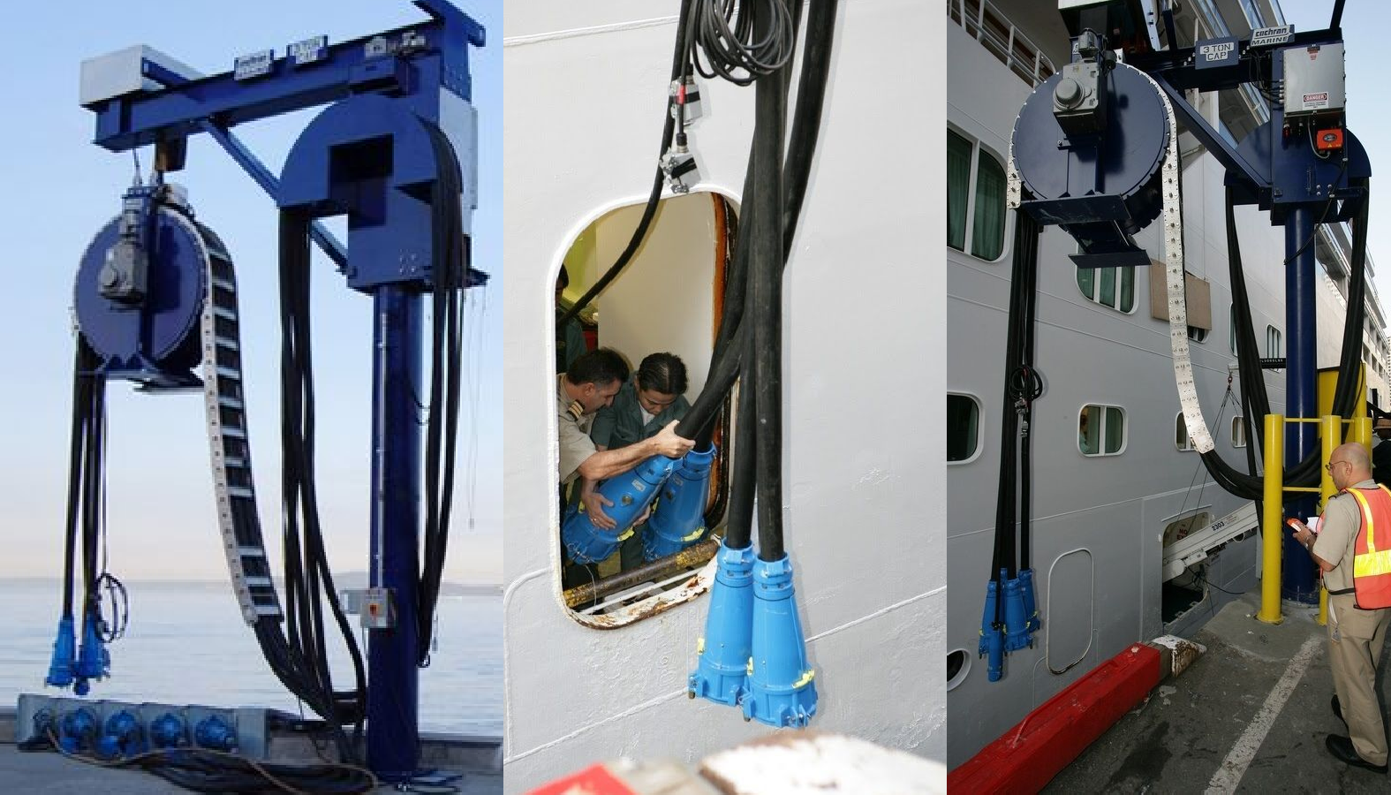

Slide 62
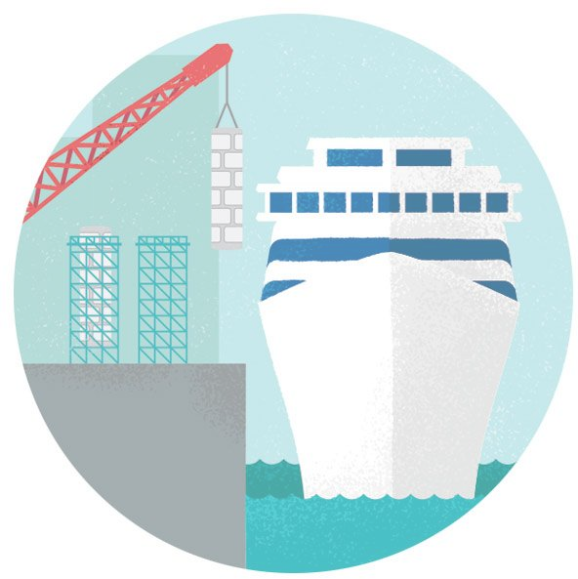
Exhaust gas cleaning system
Carnival is investing $400 million to design, build and install ECO-EGC™ systems on their ships.
Following successful initial trials, they announced plans to increase installations to 70 vessels.

Slide 63
ECO Exhaust Gas Cleaning Technology
(ECO-EGC™)
Combined established technologies used in shore-based applications, (ie: power plants, factories and vehicles), to clean the exhaust from engines burning high-sulfur fuel.
System has the ability to remove major pollutants from exhaust gases at any operating condition (whether at sea, during maneuvering and in port.)
Incorporates a two-pronged system –
  1:uses filters to reduce particulates from the ship’s engine emissions,
  2:uses seawater to remove sulfur compounds from the exhaust gases.

Slide 64
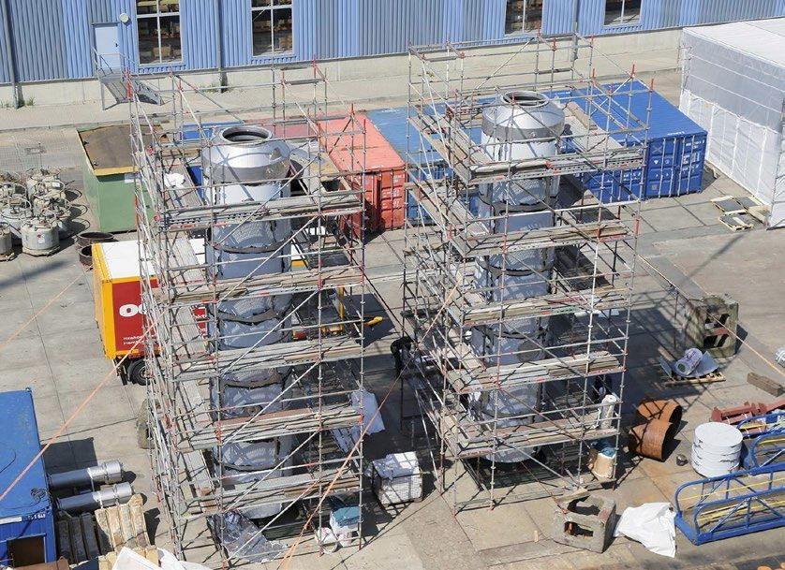
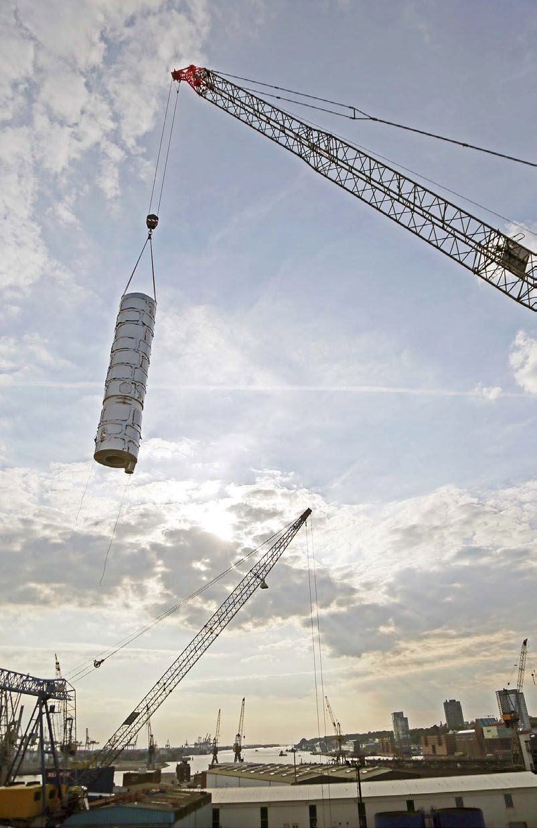
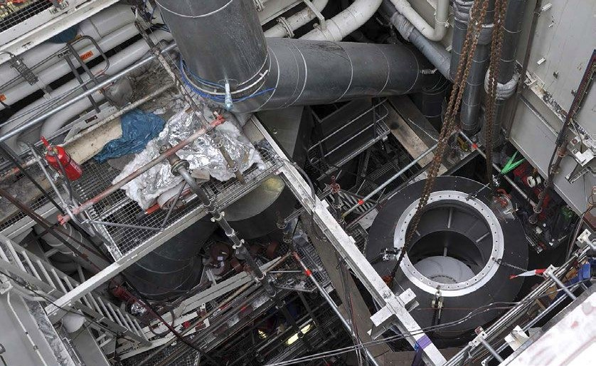

Slide 65
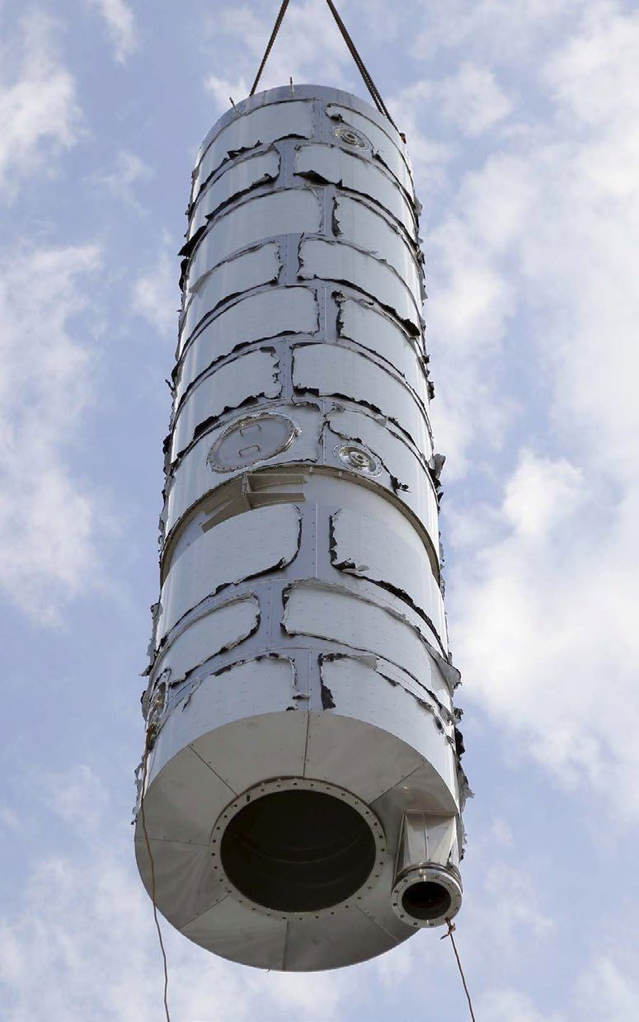
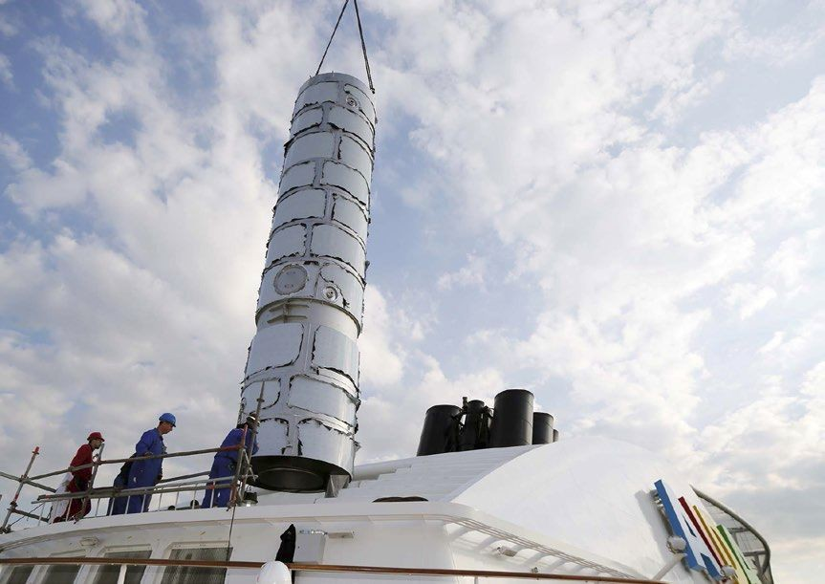
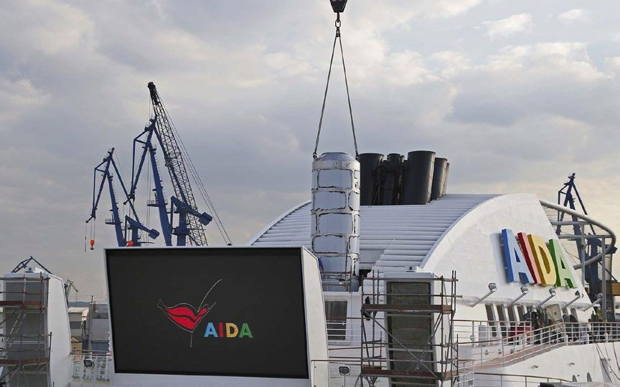

Slide 66
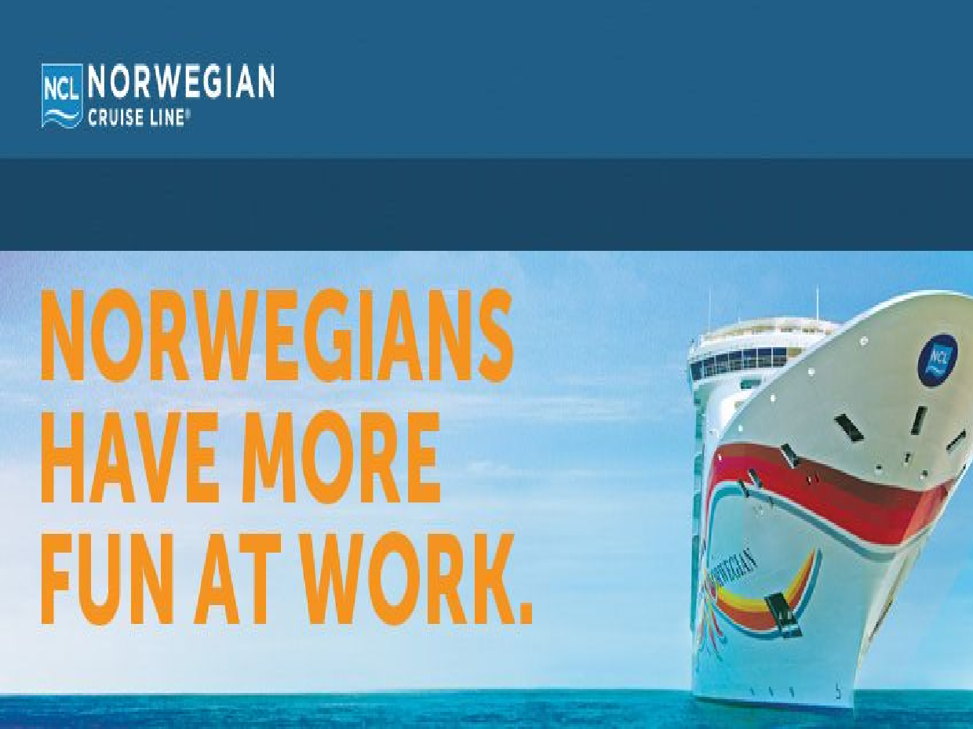
Norwegian Cruise line
Recycles thousands of gallons of used cooking grease by donating it to organic farmers in Hawaii and Miami.
Have a new way to process their solid waste on shore.

Slide 67
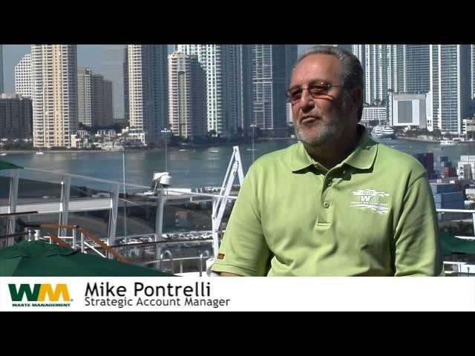

Slide 68
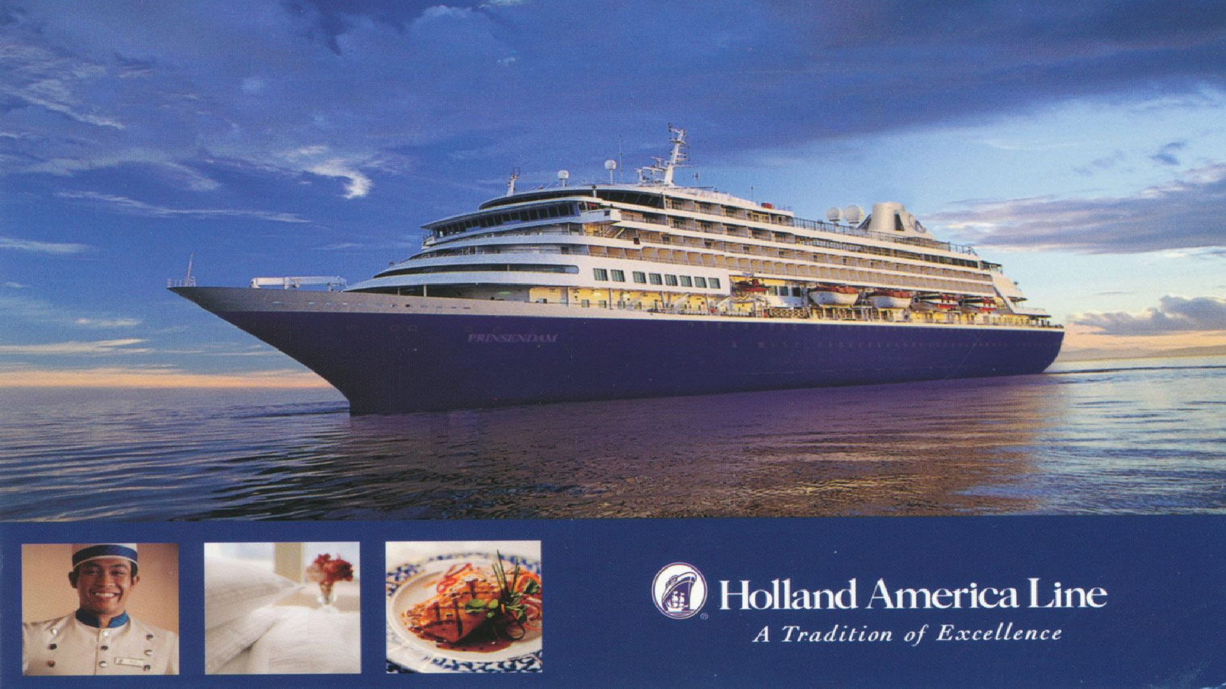
Has reduced air pollution by modifying engines so that they can be plugged into onshore hydroelectric power while at the port.
Has installed low-flow toilets and showerheads in staterooms and switched to soy-based inks for all printed materials on board.
Donates unneeded furniture, linens, travel-sized toiletries, and other items, to charities around the world.

Slide 69
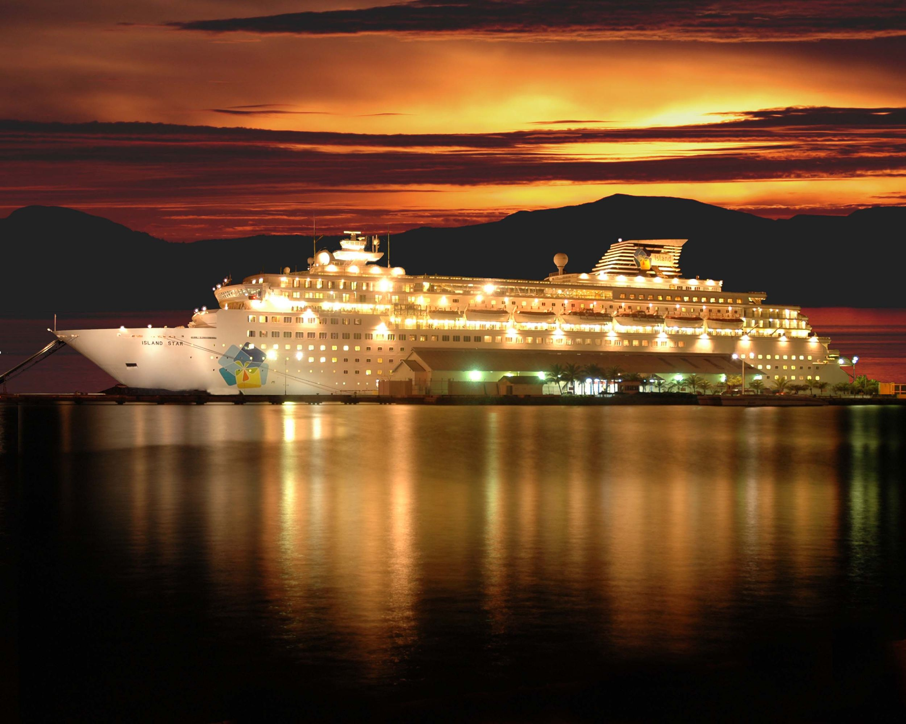
Smaller Cruise Lines
Lindblad Expeditions and Adventuresmith Explorations, are offsetting their carbon footprint by purchasing seafood from environmentally friendly sources, and adopting new sustainable technologies suitable for smaller vessels.
Norway’s Hurtigruten cruise line has a cooperative agreement with National Geographic’s Center for Sustainable Destinations to protect the destinations along its routes.

Slide 70
A new wave in sustainability
“Over the past five years, the major cruise lines have spent an average of $2 million dollars per ship to upgrade vessels with better systems for dealing with waste management and emissions. And while the industry has grown 7.6% annually over the last decade, cruise ships have cut waste almost in half, which is an amazing figure.”
Jennifer Buonatony, Green Living Magazine

Slide 71
Bibliography
Works Cited
Attamante, T. (2012, November 27). Eco sustainability: Coral Reef & Cruise Ships. Retrieved February 10, 2015, from You tube : www.youtube.com
Diseny Cruise Lines: Behind the Waves. (2013, April 10). Retrieved March 3, 2015, from You Tube: https://www.youtube. com/watch?v=YfNIYWeg4Ik
Eco sustainability: Coral Reef and Cruise Ships . (n.d.).
MSC Cruise Official . (2013, January 16). Retrieved March 1, 2015, from You Tube : https://www.youtube.com/watch? v=ijfOeiKKRE8
The New Economy . (2014, August 27). Retrieved February 22, 2015, from You Tube : https://www.youtube.com/watch? v=U7ui2xkCE7E

